Slide 1
TUMORS of blood vessels
Tumors of blood vessels and lymphatics include:
- common and benign tumors→ hemangioma
- borderline (locally aggressive but metastasize infrequently)→ kaposi sarcoma
- rare, highly malignant→ angiosarcoma
Benign tumors usually contain vascular channels lined by normal-appearing endothelial cells.
Malignant tumors are more cellular, show cytologic atypia, are proliferative, and usually do not form well-organized vessels

Slide 2
Hemangiomas
are very common tumors composed of blood-filled vessels.
Most common in infancy and childhood
most are present from birth and initially increase in size, but many eventually regress spontaneously.
Most common in the head and neck
can arise internally (1/3 → liver)
Malignant transformation is rare

Slide 3
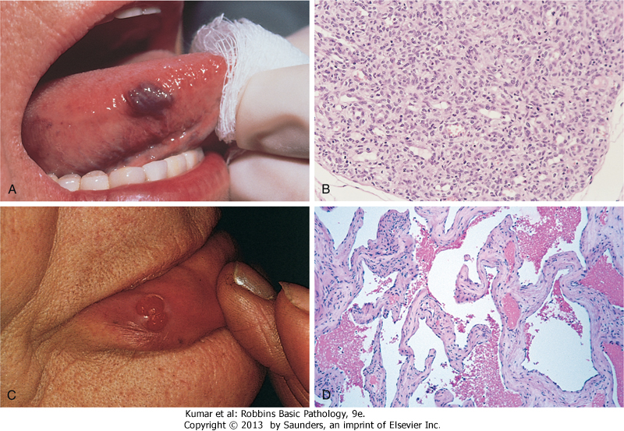
Hemangioma

Slide 4
histologic and clinical variants:
1- Capillary hemangiomas : most common type; occur in the skin, subcutaneous tissues, and mucous membranes of the oral cavities and lips
2- Juvenile hemangiomas (so-called strawberry hemangiomas) of the newborn skin
3- Pyogenic granulomas are rapidly growing red pedunculated lesions on the skin, gingival, or oral mucosa (¼→history of trauma)
4- Cavernous hemangiomas : composed of large, dilated vascular channels; frequently involve deep structures, and do not spontaneously regress

Slide 5
Intermediate-Grade (Borderline) Tumors
Kaposi Sarcoma (KS)
a vascular neoplasm caused by a herpesvirus (KSHV= human herpesvirus-8 = HHV-8).
most common in patients with AIDS
its presence is used as a criterion for the diagnosis of AIDS.
multiple red-purple skin plaques or nodules, usually on the distal lower extremities; progressively increase in size and number and spread proximally

Slide 6
pathogenesis
KS is the most common HIV-related malignancy
AIDS-associated KS often involves lymph nodes and disseminates widely to viscera early in its course.
transmitted both through sexual contact and by poorly understood nonsexual routes (oral secretions and cutaneous exposures.
KSHV and altered T cell immunity probably are required for KS development
KSHV-encoded proteins disrupt normal cellular proliferation controls (a viral homologue of cyclin D) and prevent apoptosis by inhibiting p53.

Slide 7
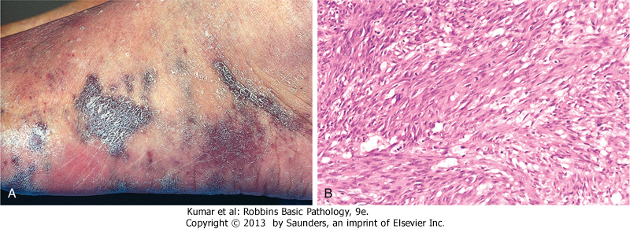
A, Characteristic coalescent cutaneous red-purple macules and plaques.
B, Histologic view of the nodular stage, demonstrating sheets of plump, proliferating spindle cells and slitlike vascular spaces

Slide 8
Malignant Tumors
Angiosarcomas :
malignant endothelial neoplasms
Older adults are more commonly affected.
There is no gender bias
lesions can occur at any site, but most often involve the skin, soft tissue, breast, and liver.
Pathogenesis= carcinogens
A latent period of years between exposure and subsequent tumor development is typical.

Slide 9
Risk factors of angiosarcomas
Chemical carcinogens→ liver angiosarcoma
Irradiation
Lymphedema→ ipsilateral upper extremity several years after radical mastectomy (i.e., with lymph node resection) for breast cancer
long-term (years) indwelling foreign bodies (e.g., catheters).

Slide 10
CARDIAC TUMORS
Metastatic Neoplasms :
the most common malignancy of the heart
occur in 5% of patients dying of cancer.
certain tumors have a higher predilection for cardiac metastases. In descending order these are:
lung cancer→ most common primary
lymphoma
breast cancer
Leukemia
Melanoma
hepatocellular carcinoma
colon cancer.

Slide 11
Primary cardiac tumors
uncommon
most are benign (80% to 90% of all primary heart tumors).
The five most common in descending order of frequency: Myxoma; Fibromas; Lipomas; papillary fibroelastomas; rhabdomyomas.
Angiosarcomas constitute the most common primary malignant tumor of the heart.

Slide 12
Myxoma
the most common primary tumors of the adult heart
90% → atrium (left atrium >80%)
pedunculated lesion arises from the atrial wall with a gelatinous appearance
The cells are embedded in an abundant acid mucopolysaccharide ground substance
Rhabdomyoma
the most frequent primary tumors of the heart in infants and children
often regress spontaneously for unknown reasons
Morphology: characteristic large cells containing numerous glycogen vacuoles separated by strands of cytoplasm running from the plasma membrane to the centrally located nucleus, so-called spider cells

Slide 13
Clinical Features and significance
1- valvular "ball-valve" obstruction
2- Embolization
3- constitutional signs and symptoms (fever and malaise)→ attributable to tumor elaboration of the cytokine interleukin-6, a major mediator of the acute-phase response.
Diagnosis: Echocardiography
Treatment: surgical resection is almost uniformly curative in benign tumors.

