Slide 1
Where should you palpate the pulse of
different arteries in the lower limb?

Slide 2
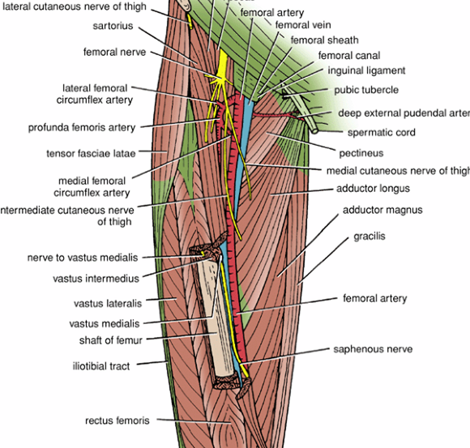
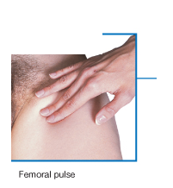
The femoral artery
In the femoral triangle, its pulse is easily felt just inferior to the inguinal ligament midway between the pubic symphysis and the anterior superior iliac spine.

Slide 3
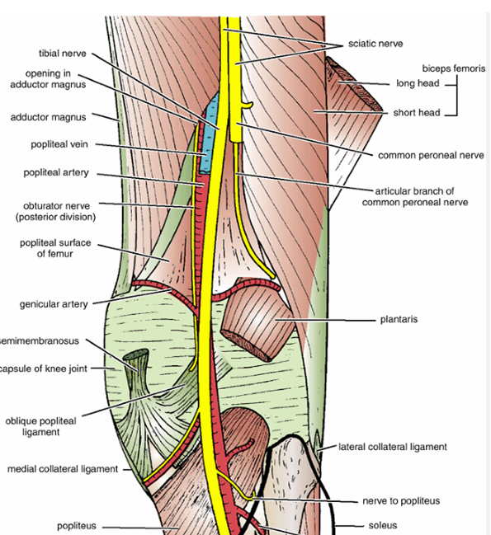
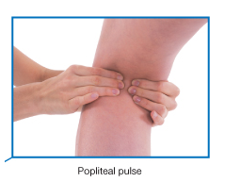
The popliteal artery
The popliteal artery pulse is difficult to find, but usually can be detected on deep palpation just medial to the midline of the popliteal fossa.

Slide 4
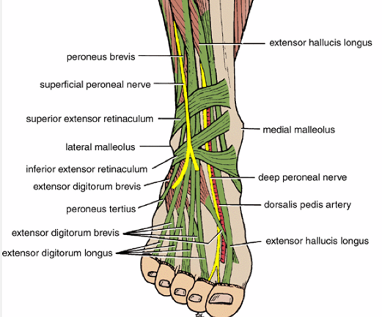
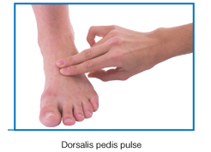
The dorsalis pedis artery
Passes onto the dorsal aspect of the foot and anteriorly over the tarsal bones where it lies between and is parallel to the tendon of extensor hallucis longus and the tendon of extensor digitorum longus to the second toe.
The artery may be absent in around 15% of people

Slide 5
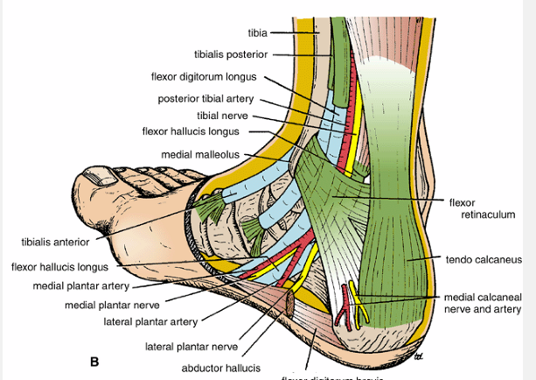
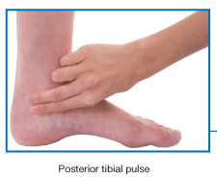
The posterior tibial artery
Is palpable just posteroinferior to the medial malleolus between the heel and medial malleolus.

Slide 6
Nerve injuries
of
lower limbs

Slide 7
Femoral Nerve Injury
The femoral nerve can be injured in:
Stab or gunshot wounds
a complete damage of the nerve is rare.
Clinical manifestations:
If The nerve is completely injured
Motor: The quadriceps femoris muscle is paralyzed, and the knee cannot be extended.
Sensory: Skin sensation is lost over
1-The anterior and medial sides of the thigh,
2-Over the medial side of the lower part of the leg
3- The medial border of the foot as far as the ball of the big toe; this area is normally supplied by the saphenous nerve

Slide 8
Sciatic Nerve Injury
The nerve is sometimes injured by:
1- penetrating wounds
2-fractures of the pelvis
3-dislocations of the hip joint. (posterior)
4-badly placed intramuscular injections in the gluteal region. (common).
The following clinical features are present:
Motor: 1-The hamstring muscles are paralyzed, but weak flexion of the knee is possible because of the action of the sartorius (femoral nerve) and gracilis (obturator nerve)
2-All the muscles below the knee are paralyzed,
the foot assume the plantar-flexed position, or Foot drop
Sensory: Sensation is lost below the knee,
except for a narrow area down the medial side
of the lower part of the leg and along the medial
border of the foot as far as the ball of the big toewhich is supplied by the saphenous nerve (femoral nerve).

Slide 9
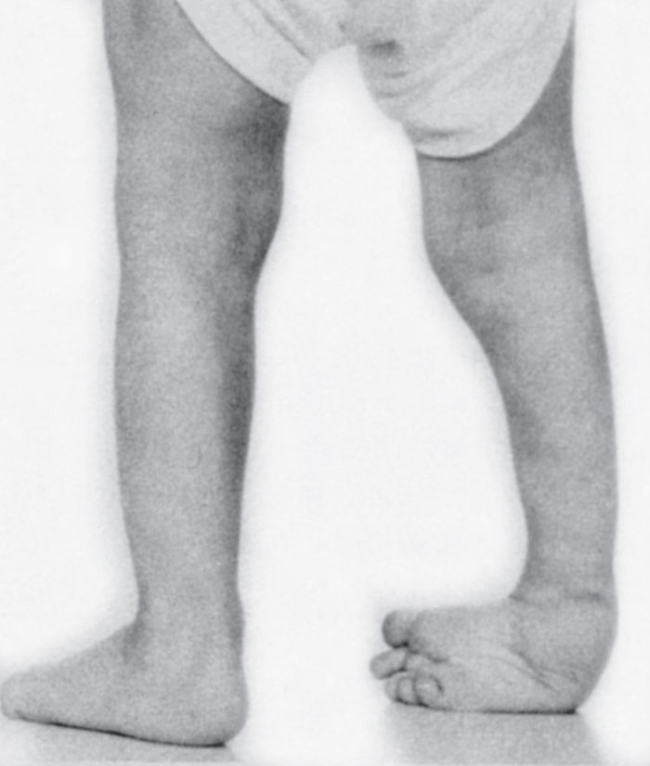
common peroneal nerve is in an exposed position as it leaves the popliteal fossa and winds around the neck of the fibula to enter the peroneus longus muscle
Injury to common peroneal nerve
Paralysis of extensor muscles (supplied by deep peroneal nerve) this means loss of dorsiflexion of the foot
Paralysis of peronei muscles (supplied by the superficial peroneal nerve) this means
loss of Eversion of the foot
The antagonistic muscles (planter flexors and invertors) will take over
this leads to
Foot drop and inversion
Equino varus

Slide 10
Tibial Nerve Injury
Because of its deep and protected position, it is rarely injured.
Complete damage results in the following clinical features:
Motor: All the muscles in the back of the leg and the sole of the foot are paralyzed. The opposing muscles dorsiflex the foot at the ankle joint and evert the foot at the subtalar and transverse tarsal joints, an attitude referred to as Calcaneovalgus
Sensory: Sensation is lost on the sole of the foot; later, trophic ulcers develop.
Read only

Slide 11
Obturator Nerve Injury
It is rarely injured in :
penetrating wounds,
in anterior dislocations of the hip joint,
or in abdominal herniae through the obturator foramen.
It may be pressed on by the fetal head during
parturition.
The following clinical features occur:
Motor: All the adductor muscles are paralyzed except the hamstring part of the adductor magnus, which is supplied by the sciatic nerve.
Read only
Sensory: The cutaneous sensory loss is minimal on the medial aspect of the thigh.
important

Slide 12
Veins of the Lower Limb
The veins of the lower limb can be divided into three groups:
1-superficial, 2- deep , 3-perforating.
The superficial veins consist of the great and small saphenous veins, which are situated beneath the skin in the superficial fascia.
The deep veins are the venae comitantes to the anterior and posterior tibial arteries, the popliteal vein, and the femoral veins and their tributaries.
The perforating veins are communicating vessels that run between the superficial and deep veins. Many of these veins are found particularly in the region of the ankle and the medial side of the lower part of the leg. They possess valves that are arranged to prevent the flow of blood from the deep to the superficial veins.

Slide 13
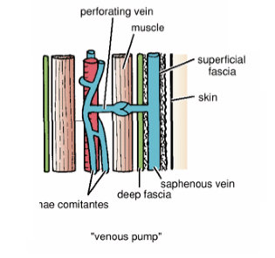
The valves in the perforating veins prevent the high-pressure venous blood from being forced outward into the low-pressure superficial veins.
Low pressure
High pressure
The superficial saphenous veins
lie within the superficial fascia and are not subject to compression forces
venae comitantes
are subjected to intermittent pressure at rest and during exercise

Slide 14
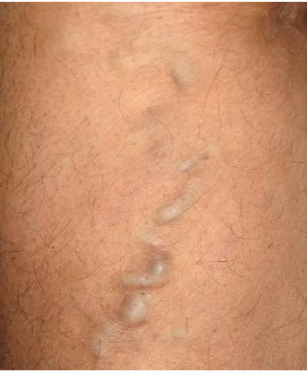
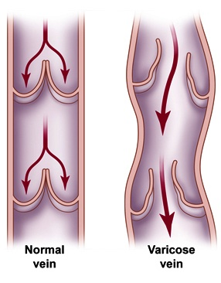
Varicose Veins
A varicosed vein is one that has a larger diameter than normal and is elongated and tortuous.
This condition commonly occurs in the superficial veins of the lower limb
CAUSES
hereditary weakness of the vein walls and incompetent valves;
elevated intra-abdominal pressure as a result of multiple pregnancies or abdominal tumors;
incompetence of a valve in a perforating vein.`

Slide 15
Dermatomes in the lower limb
Regions that can be tested for sensation and are reasonably autonomous (have minimal overlap) are:
over
1-The inguinal ligament-L1
2-Lateral side of the thigh-L2;
3-Lower medial side of the thigh-L3
4-Meidal side of the great toe (digit 1)-L4
5-Meidal side of digit 2-L5
6-Little toe (digit 5)-S1
7-Back of the thigh-S2
8-Skin over the gluteal fold-S3

Slide 17
In an unconscious patient, both somatic sensory and somatic motor functions of spinal cord levels can be tested using tendon reflexes:
1- a 'tap' on the patellar ligament at the knee tests Patellar tendon reflex (knee jerk) L3, and 4 (extension of the knee joint on tapping the patellar tendon)
2-Achilles tendon reflex (ankle jerk) S1 and S2 (plantar flexion of the ankle joint on tapping the Achilles tendon)

Slide 18
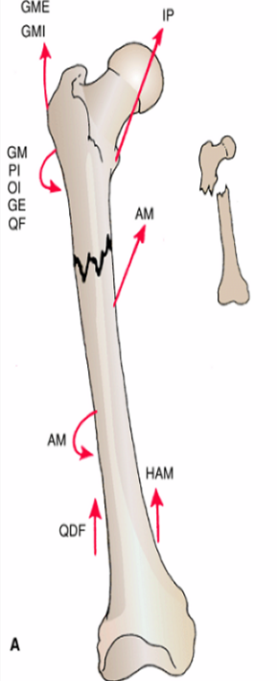
In fractures of the upper third of the shaft of the femur
The proximal fragment is
flexed by the iliopsoas
abducted by the gluteus medius and minimus
laterally rotated by the gluteus maximus, the piriformis, the obturator internus, the gemelli, and the quadratus femoris
The lower fragment is adducted by the adductor muscles,
pulled upward by the hamstrings and quadriceps, and laterally rotated by the adductors and the weight of the foot

Slide 19
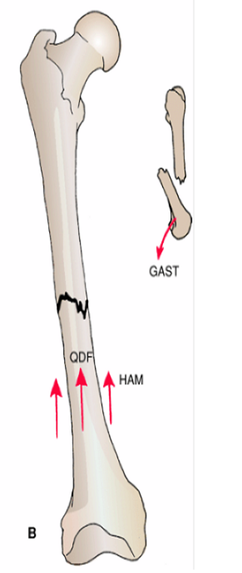
In fractures of the middle third of the shaft of the femurgastrocnemius
The distal fragment is pulled upward by the hamstrings and the quadriceps resulting in considerable shortening.
The distal fragment is also rotated backward
by the pull of the two heads of the
GASTROCNEMIUS

Slide 20
In fractures of the distal third of the shaft of the femur, the same displacement of the distal fragment occurs as seen in fractures of the middle third of the shaft..
However, the distal fragment is smaller and is rotated backward by the gastrocnemius muscle to a greater degree and may exert pressure on the popliteal artery
and interfere with the blood flow through the leg and foot

