Slide 1
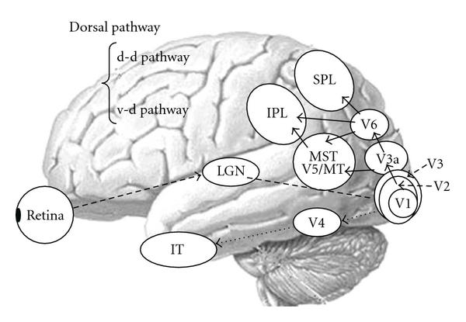

Slide 2
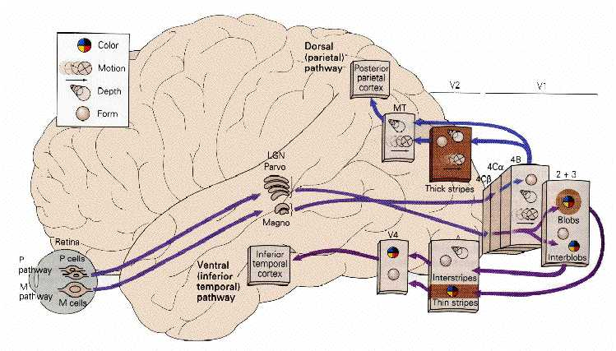
Damage to “where” pathway
Abnormal motion processing & Visuspatial neglect

Slide 3
Akinetopsia
Clinical features
Can’t see moving objects (as if under strobe lights); can see still objects
People appear suddenly
Neuropathology
BL lesion to area MT (V5; T-O-P junction)
UL lesions cause subtle defects

Slide 4
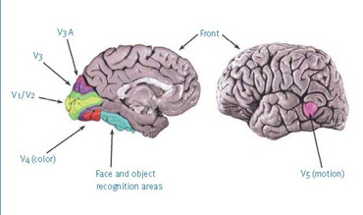
Akinetopsia
Clinical features
Can’t see moving objects (as if under strobe lights); can see still objects
People appear suddenly
Neuropathology
BL lesion to area MT (V5; T-O-P junction)
UL lesions cause subtle defects

Slide 5
Topographagnosia
Inability to navigate routes using familiar landmarks - deficit in familiar scene perception
right ventral temporo-occipital lesions like Right lingual gyrus
VS
right parietotemporal lesions

Slide 6
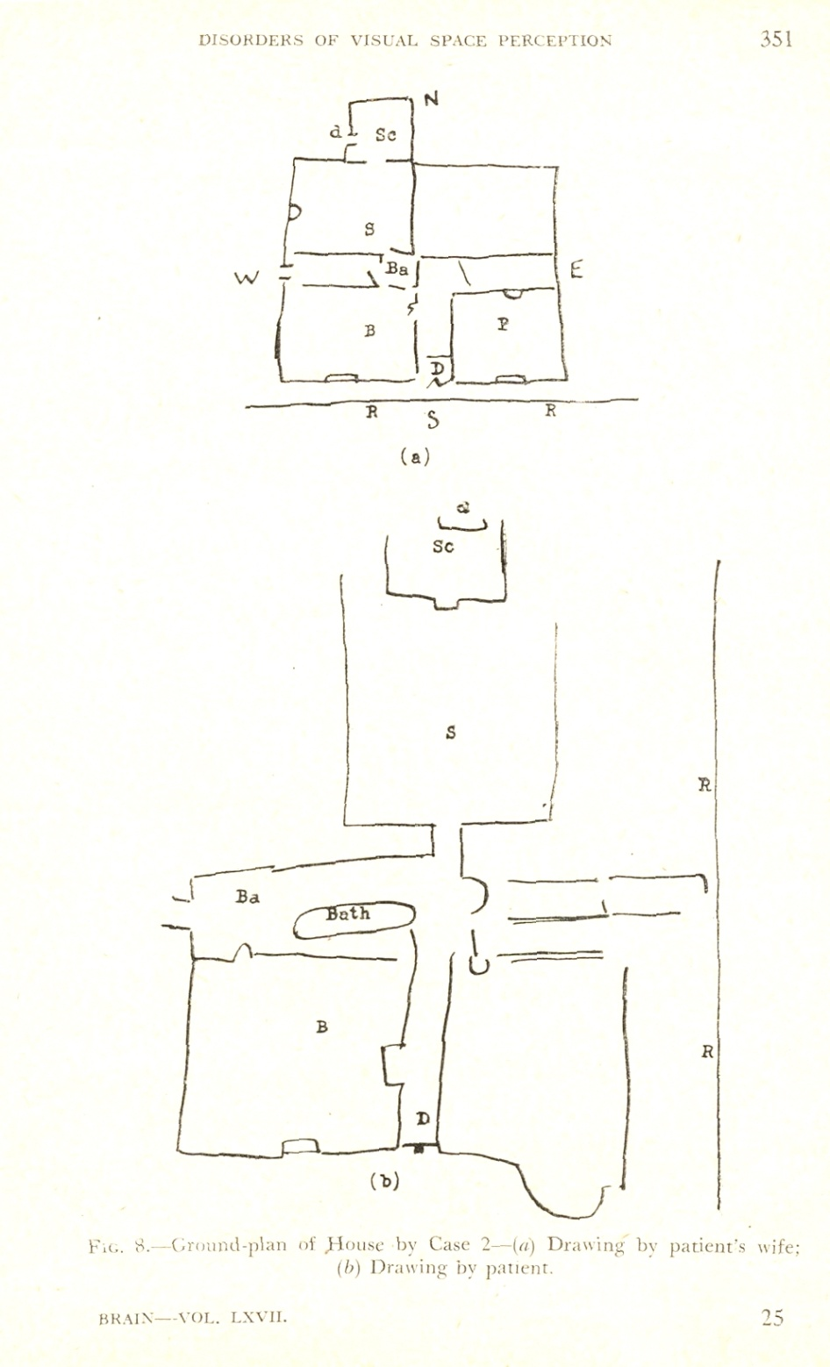
Spatial
relationships
distorted

Slide 7
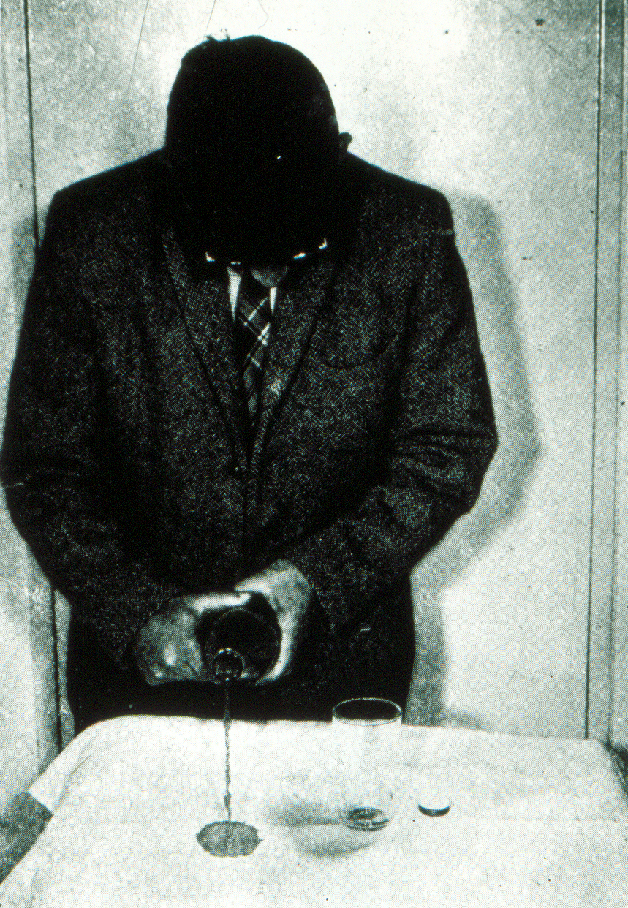
Spatial
relationships
distorted

Slide 8
Time, sequence, attention and space

Slide 9
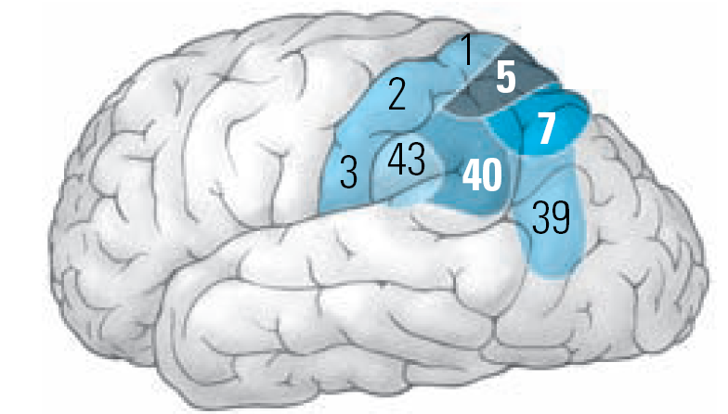
Parietal lobe

Slide 10
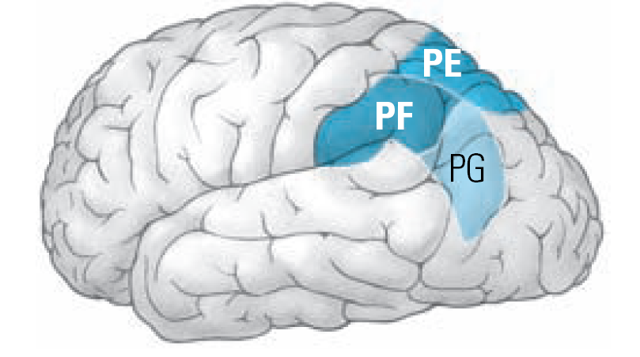
Parietal lobe

Slide 11
Spatial Information

Slide 12
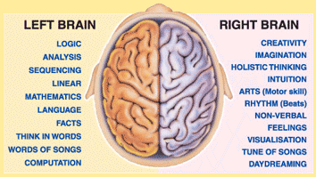
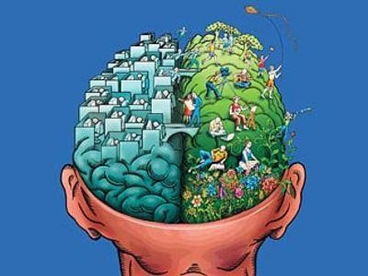

Slide 14
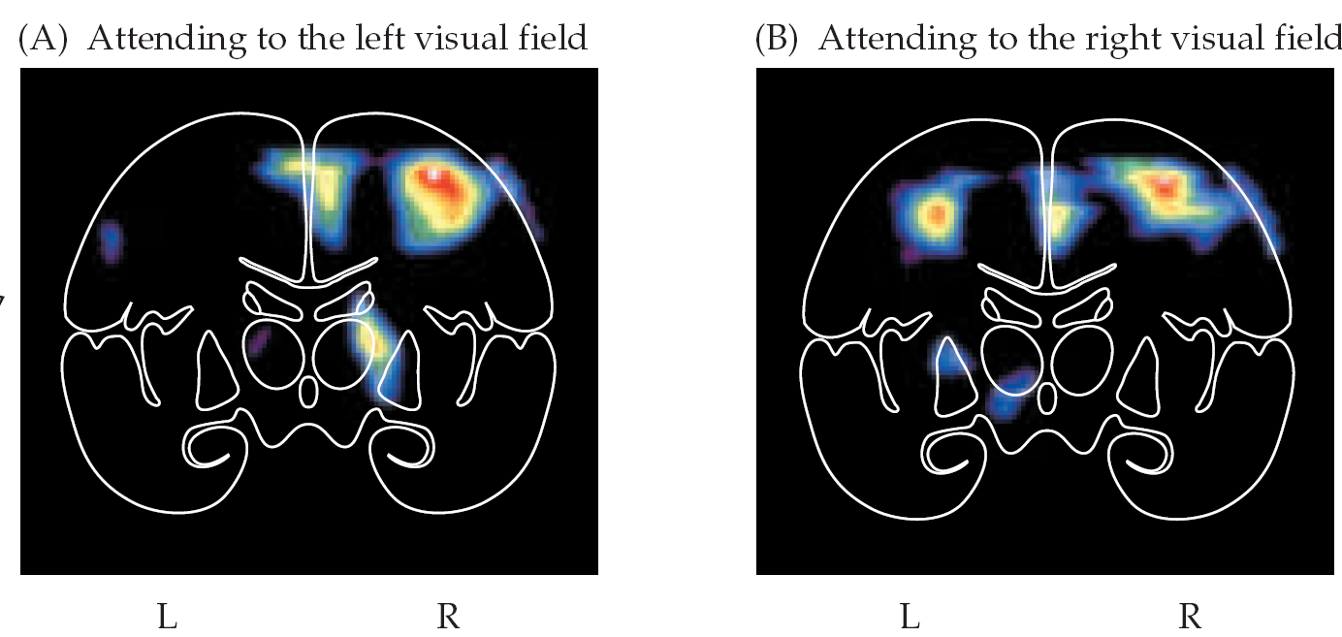

Slide 15
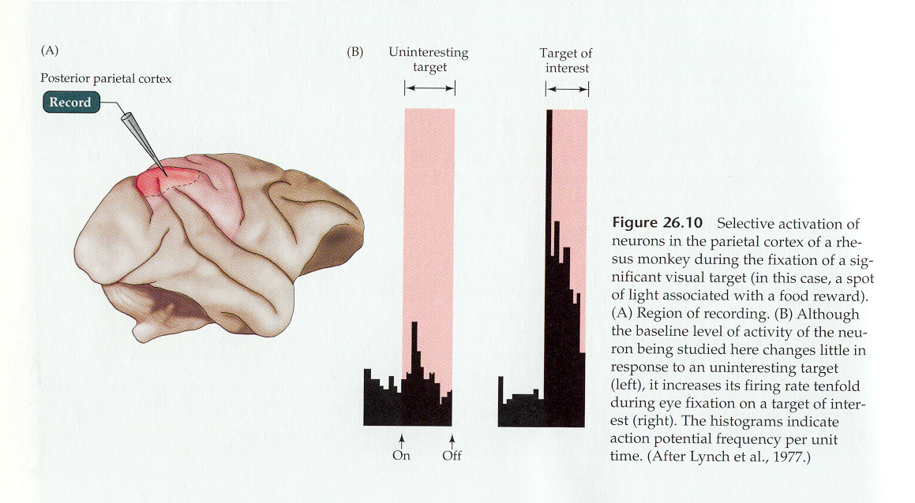
(from Lynch, Mountcastle, Talbot, and Yin, Journal of Physiology, 1977)

Slide 16
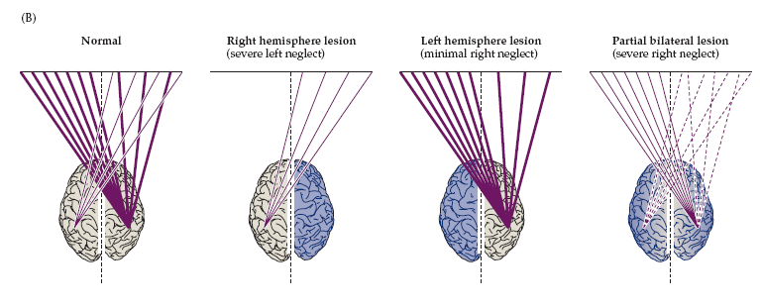

Slide 17
Neglect syndrome
(right parietal association cortex)

Slide 18
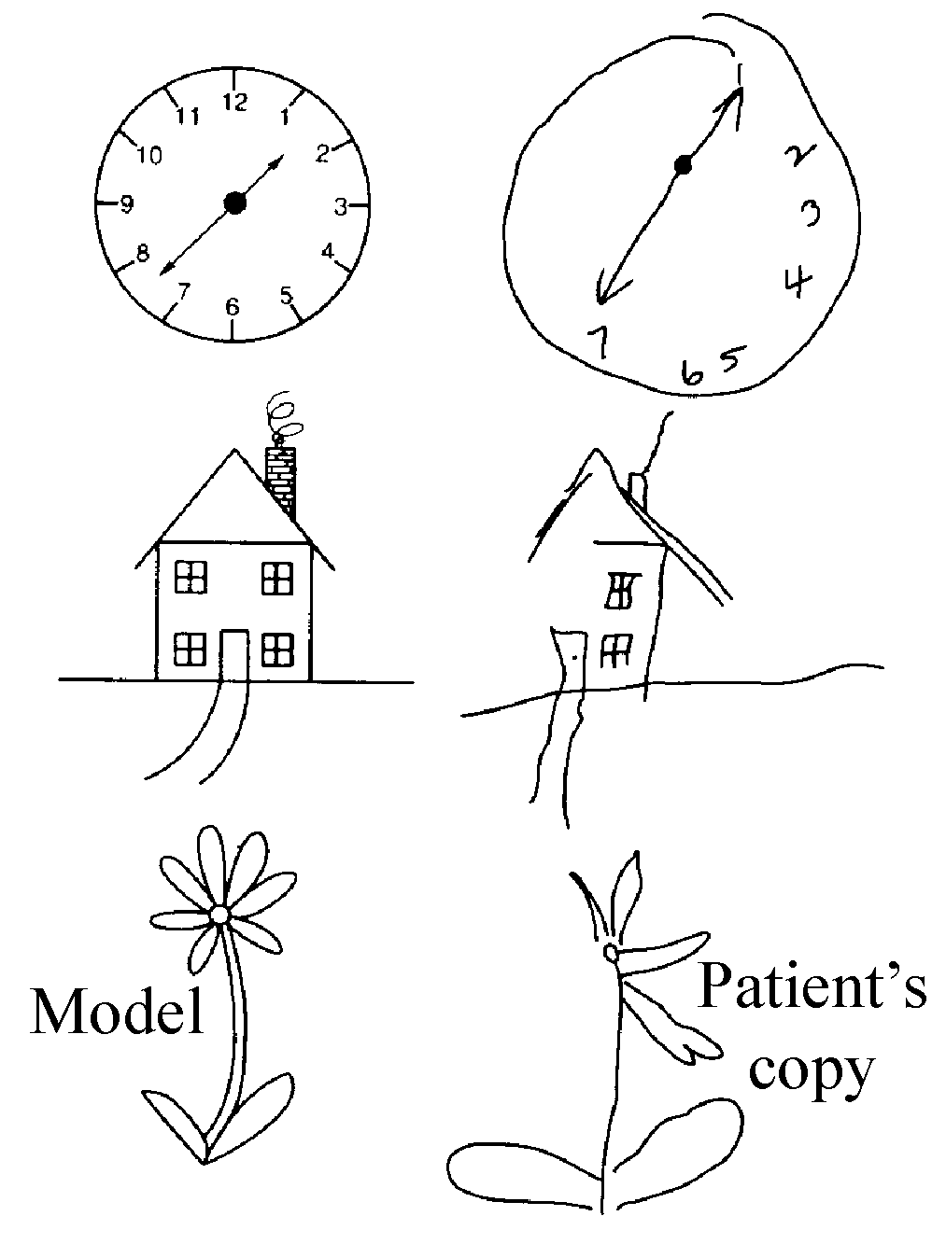
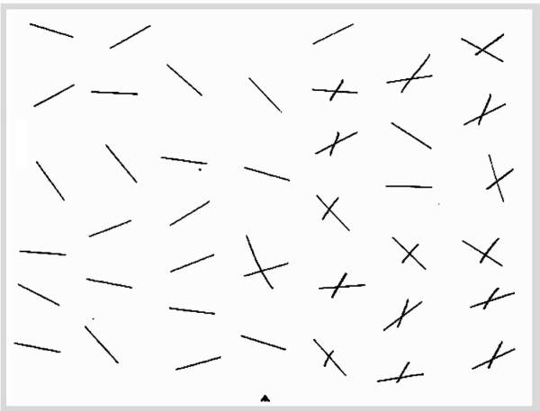

Slide 19
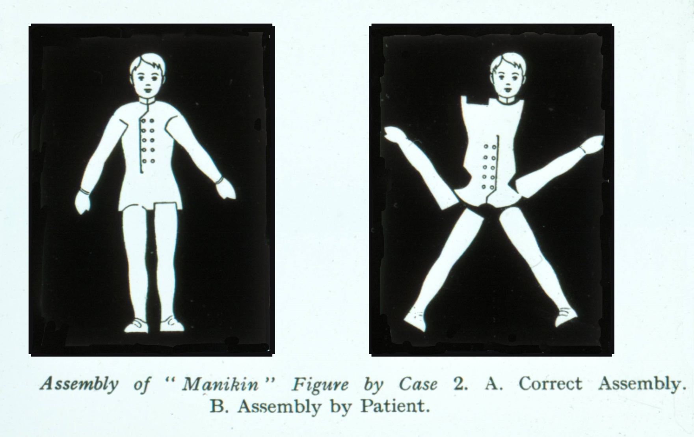

Slide 20
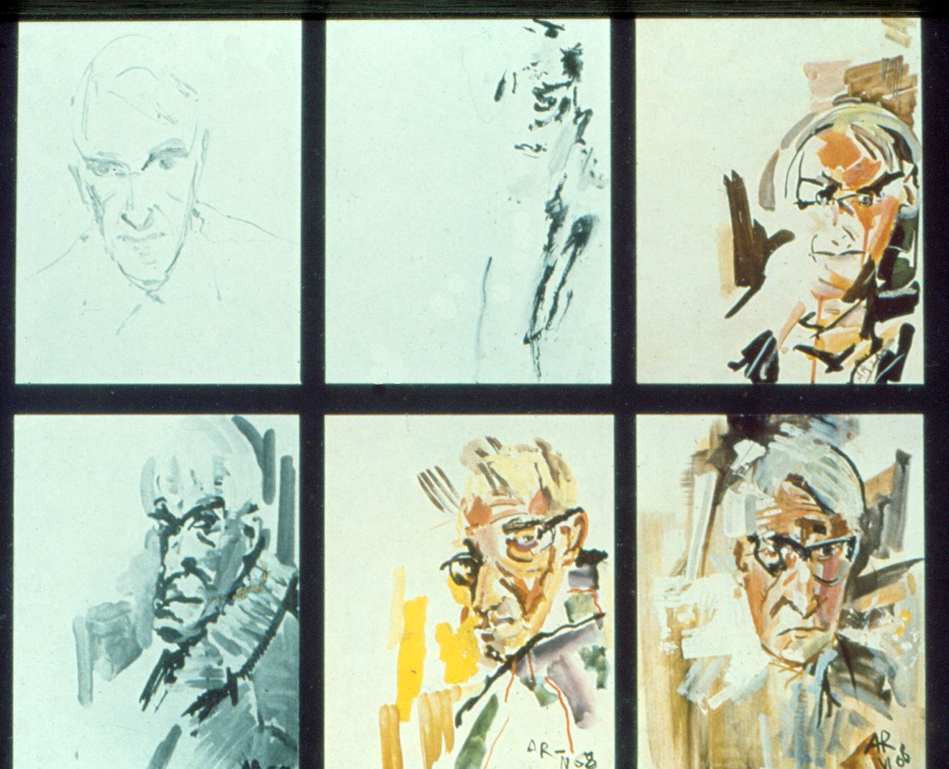

Slide 21
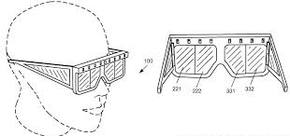

Slide 23
Left parietal

Slide 24
Parietal lobe

Slide 25
Acalculia
Language
Agraphia
Apraxia

Slide 26
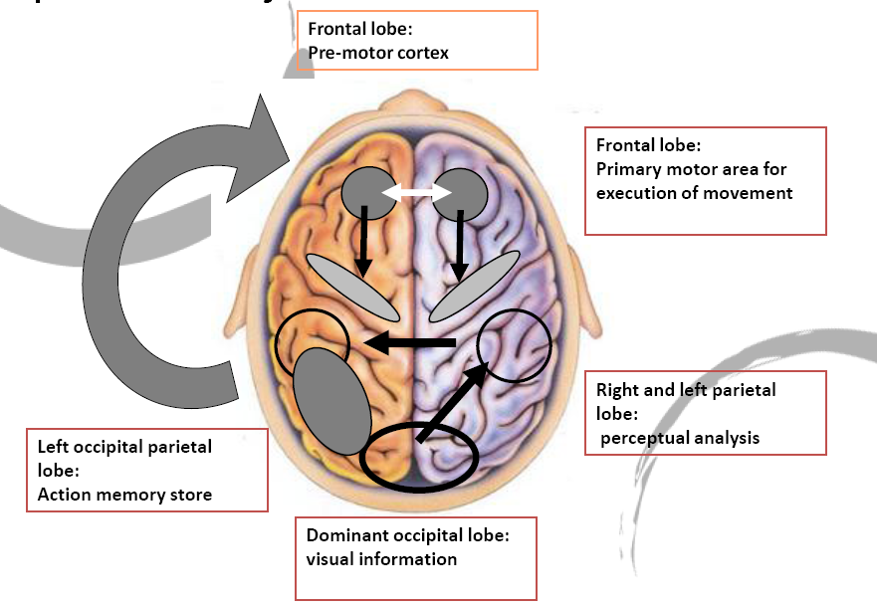

Slide 27
Bilateral Parietal Damage (Balint's Syndrome)
Impaired control over the focus of visual attention due to inattentional amnesia
Complex defects in perception of visual object structure, motion and depth.
Neglect (hemifield)

Slide 28
Bilateral Parietal Damage (Balint's Syndrome)
SIMULTANAGNOSIA : Inability to interpret the totality of a picture scene (can identify individual portions of the whole picture)

Slide 29
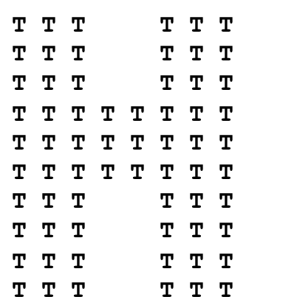
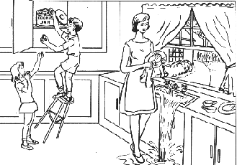

Slide 30
Bilateral Parietal Damage (Balint's Syndrome)
Simultanagnosia: Inability to interpret the totality of a picture scene (can identify individual portions of the whole picture)
Optic ataxia: Defects of visually guided hand movement

Slide 31
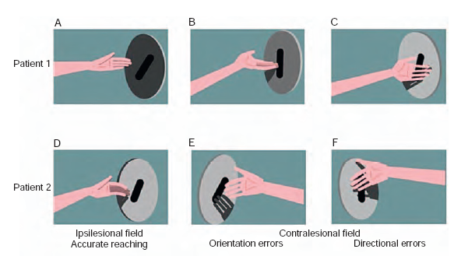

Slide 34
Bilateral Parietal Damage (Balint's Syndrome)
Simultanagnosia: Inability to interpret the totality of a picture scene (can identify individual portions of the whole picture)
Optic ataxia: Defects of visually guided hand movement
Ocular apraxia: Inability to voluntarily move eyes to objects of interest (difficulty volitionally redirecting gaze

Slide 35
language

Slide 36
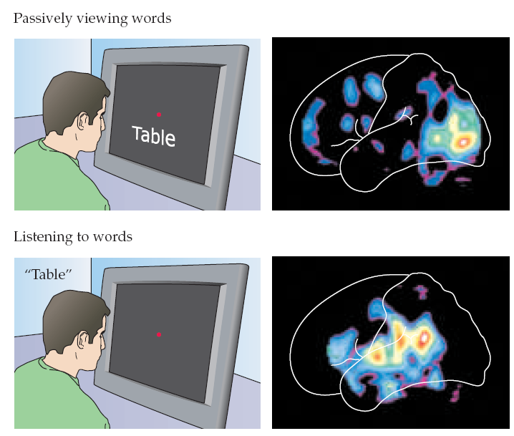
language

Slide 37
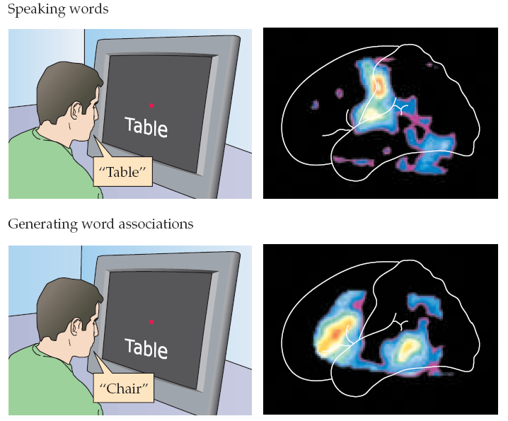

Slide 38
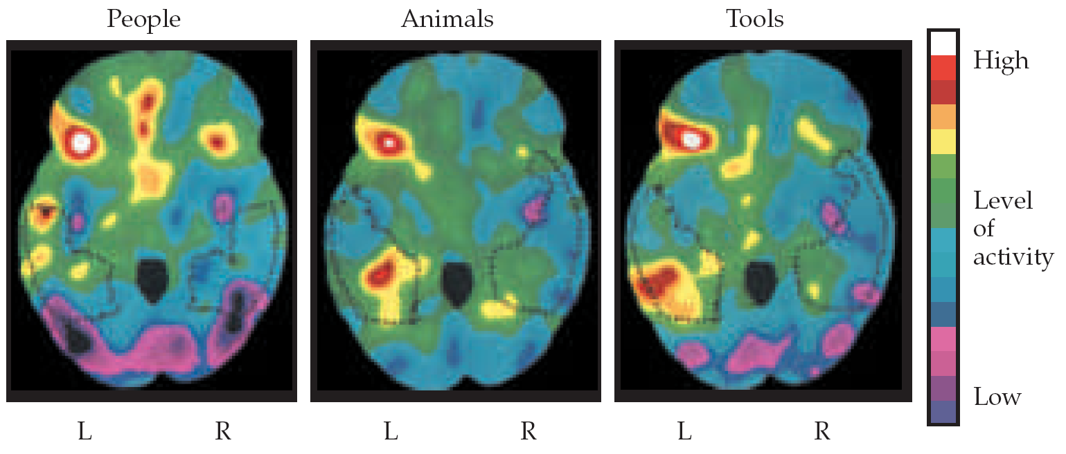

Slide 39
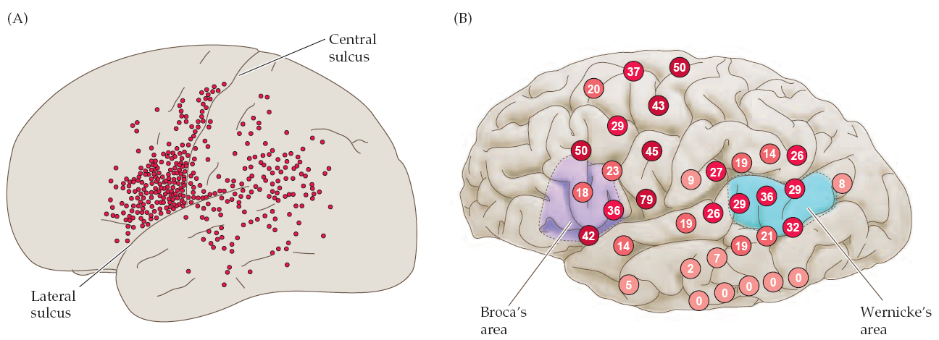
language
117

Slide 40
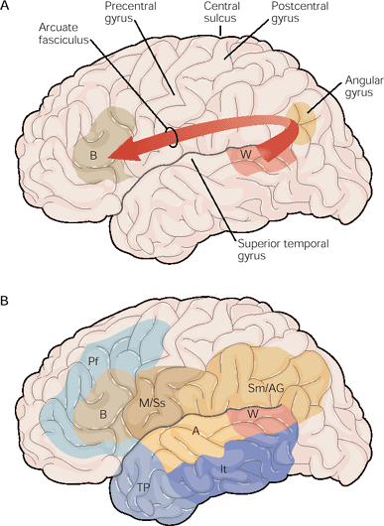
the implementation system
the mediation system
the conceptual system

Slide 41
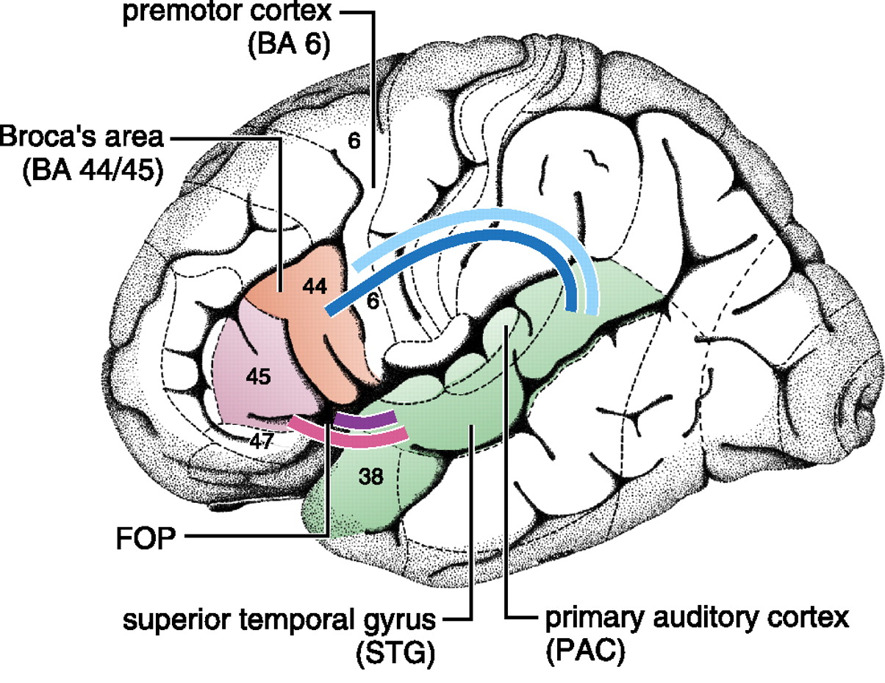

Slide 42
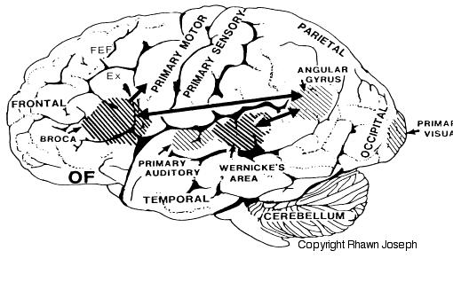

Slide 43
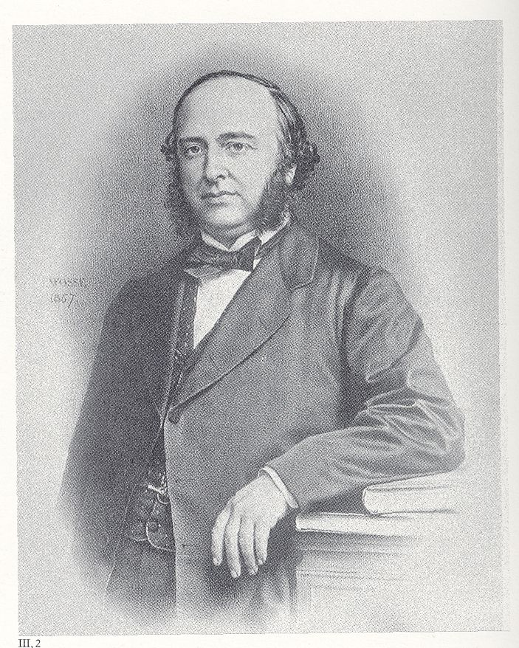
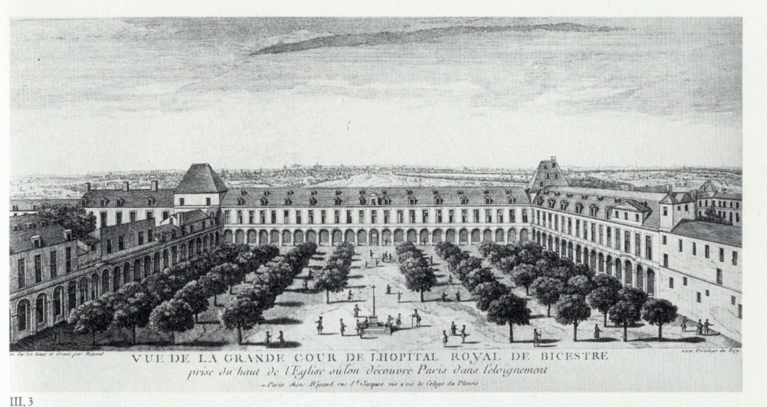
L’Hopital Royal de Bicestre
Paris
about 1750
Paul Broca
physician, anatomist, anthropologist
1824-1880

Slide 44
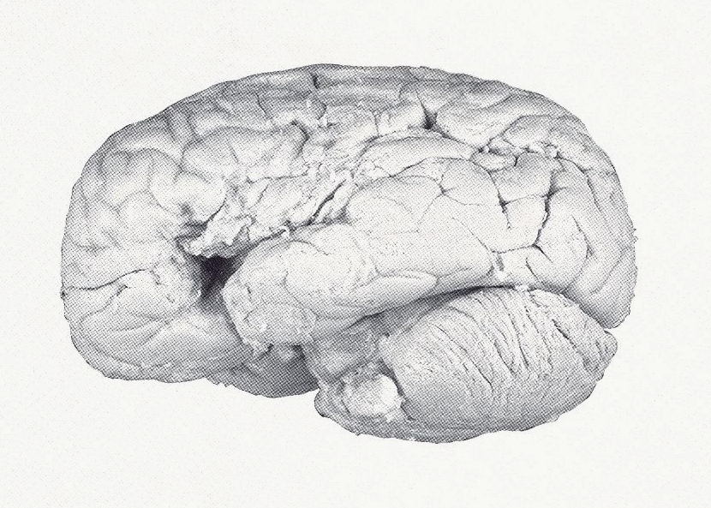
Brain of “Tan” Leborgne
(for the last 20 years of his life,
the only word M. Leborgne could say was “tan”)

Slide 45
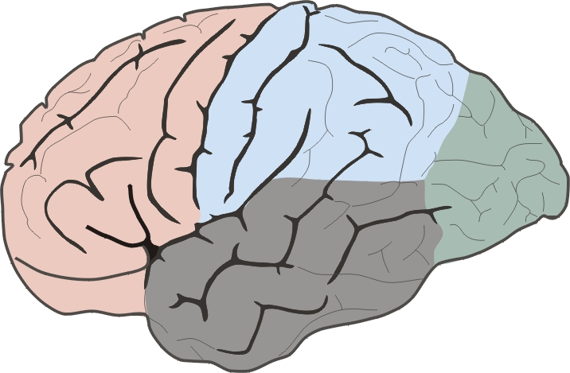
Broca Aphasia (Expressive aphasia)
Left hemisphere
Broca's aphasia - Sarah Scott - teenage stroke
http://www.youtube.com/watch?v=1aplTvEQ6ew

Slide 46
Wernicke Aphasia (Receptive aphasia)
Left hemisphere
Wernicke's Aphasia Interview with Amelia Carter
http://www.youtube.com/watch?v=UtadyCc_ybo

Slide 47
(right hemisphere)

Slide 48
Prosody of speech
(right hemisphere)

Slide 49
Broca Aphasia (Expressive aphasia)
Left hemisphere
Broca's aphasia - Sarah Scott - teenage stroke
http://www.youtube.com/watch?v=1aplTvEQ6ew

Slide 50
Wernicke Aphasia (Receptive aphasia)
Left hemisphere
Wernicke's Aphasia Interview with Amelia Carter
http://www.youtube.com/watch?v=UtadyCc_ybo

Slide 51
Pay attention to
Drugs
Transient problems (CO )
Chronic problems (alcohol )
MS
Degeneration (Alzheimer )

