Slide 1
Carditis
Dr. Fares

Slide 2
Carditis: inflammation of the heart
Pericarditis: inflammation of the pericardium
Myocarditis: inflammation of the myocardium
Endocarditis: inflammation of the endocardium

Slide 3
Causes of pericarditis
Acute, nonspecific (idiopathic)
Infective: a) bacterial, b) viral, c) other infections
Immunologic: a) Rheumatic fever, b) other
Traumatic: a) uremic, b) myxedema, c)neoplastic
Neoplastic
Myocardial infarction
Connective tissue disorder

Slide 4
Infectious Pericarditis
Acute , chronic
Etiology:
Most common viruses: enteroviruses
Most common bacteria: staphylococcus, strep, and Neisseria

Slide 5
Pathogenesis
Micro organisms reach the pericardium by:
Blood
Direct extension from lung (pneumococci)
Direct inoculation during surgery or trauma

Slide 6
Pathology
Acute serous or serofibrous pericarditis (usually viral) mild inflammatory reaction associated with focal damage to the adjacent myocardium
The response varies: small amount of serous fluid with mononuclear cells and fibrinogen to large neutrophil rich, bloody effusions
Mild fibrosis and adhesion between visceral and parietal surfaces
Constrictive pericarditis (rare)
Usually self limiting and rarely fatal
Acute purulent pericarditis (usually bacterial)
The purulent material contains large number of neutrophil in a large volume of effusion
Healing is associated with extensive fibrosis that may progress to chronic constrictive pericarditis
The mortality rate is 50%

Slide 7
Pathology
M. tuberculosis
5% of cases with pulmonary TB will have pericardial involvement
Early granulomatous stage: large pericardial effusions (>300ml), serosanguinous, mononuclear cells
As the disease evolves the inflammatory process become chronic– fusion of parietal and visceral pericardium– consecutive pericarditis and circulatory failure

Slide 8
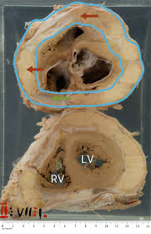
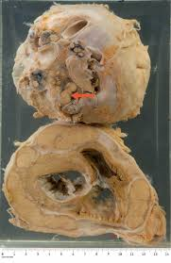

Slide 9
??
Acute serofibrous pericarditis
Chest pain
Rapid in onset, persistent : hours to days
Worse during inspiration and recumbency but improves with leaning forward
In the upper abdomen over the stomach and maybe sharp, dull constriction and/or crushing making clinical differentiation from mi difficult
Fever not prominent
Malaise
…
Acute purulent pericarditis
-little , chest pain
-Fever/chills from underlying infection
-cardiac tamponade:
1. dyspnea
2. agitation
3.orthopnea
4.cough
Pericardial friction rub- less than 50% of patients
Pericardial friction rub triphasic sound that resembles scratches or…

Slide 10
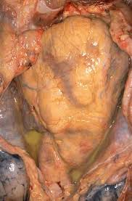
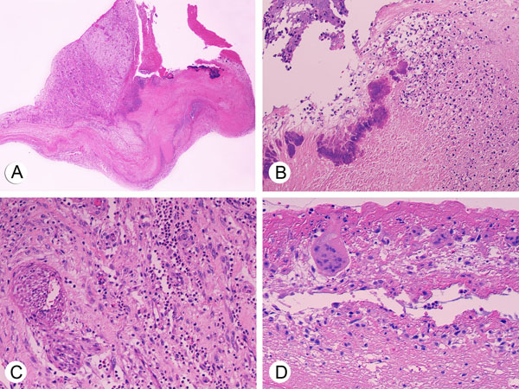

Slide 11
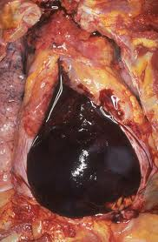

Slide 12
?

Slide 13
Treatment
Bed rest
Pain control with NSAIDs
Abx based on the infecting agent and its sensitivity pattern
+/- surgery

Slide 14
?

