Slide 1
Diseases of cervix

Slide 2
I. Inflammations

Slide 3
1.Acute and Chronic Cervicitis
- At the onset of menarche, the production of estrogens by the ovary stimulates maturation of the cervical and vaginal squamous mucosa and formation of intracellular glycogen vacuoles in the squamous cells.

Slide 4
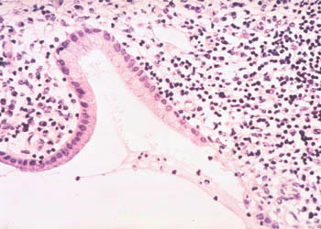
Chronic cervivitis

Slide 5
- As these cells are shed, the glycogen provides a substrate for various endogenous vaginal, particularly lactobacilli, which are the dominant microbial species in the normal vagina.
- Lactobacilli produce lactic acid, which maintains the vaginal pH below 4.5,and this leads to

Slide 6
Suppression of growth of other organisms. Because at low pH, lactobacilli produce bacteriotoxic hydrogen peroxide (H₂O₂).
If the pH becomes alkaline due to
a. bleeding,, , H₂O₂ production by lactobacilli decreases.
b. Antibiotic therapy that suppress lactobacilli can also cause the pH to rise.

Slide 7
- In each of these settings the altered vaginal environment promotes the overgrowth of other microorganisms, which may result in cervicitis

Slide 8
II. Endocervical polyps
Are common benign exophytic growths
Their main significance is that they may be the source of irregular vaginal or bleeding that arouses suspicion of some more ominous lesion.
Surgical excision is curative.
Endocervical polyp composed of a dense fibrous stroma covered with endocervical columnar epithelium.

Slide 9
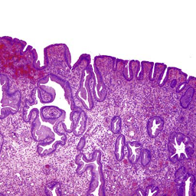
Endocervical polyp

Slide 10
III. Premalignant and Malignant Neoplasms of the Cervix
Worldwide, cervical carcinoma is the third most common cancer in women,
Fifty years ago, carcinoma of the cervix was the leading cause of cancer deaths in women in the United States, but the death rate has declined by two thirds to its present rank as the thirteenth cause of cancer mortality.

Slide 11
A. Cervical Intraepithelial Neoplasia (Squamous Intraepithelial Lesions)
Terminology:Previously
Cervical intraepithelial neoplasia (CIN) classification
i. Mild dysplasia termed CIN I,
ii. Moderate dysplasia CIN II,
iii. Severe dysplasia termed CIN III.

Slide 12
Recently
The three-tier classification system has been simplified to a two-tiered system, with
CIN I And II renamed low-grade squamous intraepithelial lesion (LSIL)
and CIN III combined into one category referred to as high-grade squamous intraepithelial lesion (HSIL) .

Slide 13
I. LSIL
a. LSILs are ten times more common than HSILs
b. LSIL does not progress directly to invasive carcinoma
And in fact most cases regress spontaneously;and only a small percentage progress to HSIL.
LSIL is not treated like a premalignant lesion.

Slide 14
II. HSIL
1. There is a progressive deregulation of the cell cycle by HPV, which results in Increased cellular proliferation,
2. Derangement of the cell cycle in HSIL may become irreversible and lead to a fully transformed malignant phenotype,
3. Therfore all HSILS are considered to be at high risk for progression to carcinoma.

Slide 15
Morphology
More than 80% of LSILs and 100% of HSILs are associated with high-risk HPVs, with HPV-16 being the most common
The diagnosis of SIL is based on identification of nuclear atypia characterized by nuclear enlargement, hyperchromasia coarse chromatin s, and variation in nuclear size and shape

Slide 16
Associated with koilocytic atypia.
At an ultrastructural level, these “halos” consist of HPV-encoded protein called E5 that localizes to the membranes of the endoplasmic reticulum.
It is important to grade SIL histologically into LSIL and HSIL

Slide 17
- Progression to invasive carcinoma, when it occurs, takes place over a period of a few years to more than a decade

Slide 18
IV.Cervical Carcinoma
The average age of patients with invasive cervical carcinoma is 45 years.
Types
80% are squamous cell carcinomas
15 % are Adenocarcinomas
5% are adenosquamous and neuroendocrine carcinomas
Note: All of the these types are caused by high-risk HPVs

Slide 19
NOTE
The progression time from in situ to invasive adenosquamous is shorter than in squamous cell carcinoma,
and patients with this type of tumors often present with advanced disease and have a less favorable prognosis.

Slide 20
Morphology
Squamous cell carcinoma
Is composed of nests and tongues of malignant squamous epithelium, either keratinizing or nonkeratinizing,
2.Adenocarcinoma
Is characterized by proliferation of malignant endocervical cells with large, hyperchromatic nuclei and relatively mucin-depleted

Slide 21
3. Adenosquamous carcinoma
Is composed of intermixed malignant glandular and squamous epithelium.
Note:
Advanced cervical carcinoma spreads by direct extension to contiguous tissues, including urinary bladder, ureters rectum, and vagina.
Lymphvascular invasion results in local and distant lymph nodes metastases

Slide 22
- Distant metastases may also be found in the liver, lungs, bone marrow, and other organs.
Cervical cancer is staged as follows:
Stage 0—Carcinoma in situ (CIN III, HSIL)
Stage I—Carcinoma confined to the cervix
Stage II—Carcinoma extends beyond the cervix but not to the pelvic wall or carcinoma that involves the vagina but not the lower third

Slide 23
Stage III:Carcinoma has extended to the pelvic wall.and the tumor involves the lower third of the vagina
Stage IV:
Carcinoma has extended beyond the true pelvis
or has involved the mucosa of the bladder or rectum.
Cancers with metastatic dissemination.

Slide 24
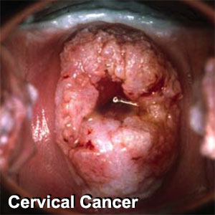

Slide 25
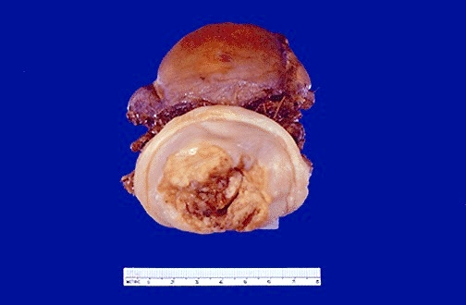
Cervical cancer stage 1

Slide 26
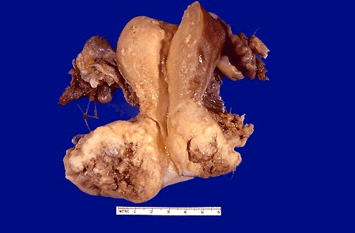
Cervical cancer extending to vagina

Slide 27
Clinically
- More than half of invasive cervical cancers are detected in women who did not participate in regular screening.(cervical smear)
- Early invasive cancers of the cervix (microinvasive carcinomas) may be treated by cervical cone excision alone,

Slide 28
- With current treatments the 5-year survival rate is 100% for microinvasive carcinomas and less than 50% for tumors extending beyond pelvis.
- Most patients with advanced cervical cancer die of the consequences of local tumor invasion (e.g., ureteral obstruction, pyelonephritis, and uremia) rather than distant metastases.

Slide 29
Cervical Cancer Screening and Prevention
Cytologic cancer screening has significantly reduced mortality from cervical cancer..
The reason that cytologic screening is so effective in preventing cervical cancer is that most cancers arise from precursor lesions over the course of years.

Slide 30
1. Cervical smear
- SIL shed abnormal cells that can be detected on cytologic examination.
- Called cervical smear and atained with Papanicolaou stain so it is known as pap smear

Slide 31
2. Testing for the presence of HPV DNA in the cervical scrape is a molecular method of cervical cancer screening.
HPV testing has a higher sensitivity but lower specificity, as compared to Pap test.

Slide 32
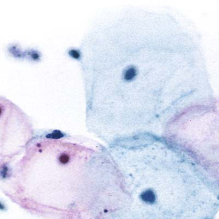
Normal cervical smear

Slide 33
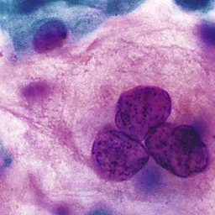
Cervical smear- LSIL

Slide 34
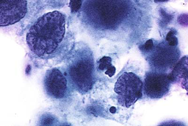
Cervical smear-HSIL

Slide 35
NOTE:
- HPV DNA testing may be added to cervical cytology for screening in women aged 30 years or older.
- HPV testing of women younger than 30 is not recommended because of the high incidence of infection, and thus the particularly low specificity of HPV test results in this age group.

Slide 36
- After age 30, women who have had normal cytology results and are negative for HPV may be screened every 5 years.
- Women with a normal cytology result, but test positive for high-risk HPV DNA, should have cervical cytology repeated every 6 to 12 months.

Slide 37
- When the result of a Pap test is abnormal, a colposcopic examination of the cervix and vagina is performed to identify the lesion.
The mucosa is examined with a magnifying glass following application of acetic acid, which highlights abnormal epithelium as white spots (aceto-white areas).
Abnormal appearing areas are biopsied.

Slide 38
Women with biopsy confirmed LSIL
a. can be followed in a conservative fashion. Or
b. Some gynecologists will perform local ablation (e.g., cryotherapy) of LSIL,
2. . HSILs are treated with cervical conization (superficial excision).

Slide 39
HPV vaccine
A new aspect of cervical cancer prevention is vaccination against high-risk oncogenic HPVs, which is now recommended for
all girls and boys by age 11 to to 12 years,
as well as young men and women up to age 26 years

Slide 40
Two HPV vaccines are now FDA-licensed
a.. Both provide nearly complete protection against high-risk oncogenic HPV types 16 and 18 (together accounting for approximately 70% of cervical cancers),
b. and one also provides protection against HPV types 6 and 11, which are responsible for genital warts.

Slide 41
Note:
Vaccination is now recommended for boys as well as girls due to
the role of that males play in the spread of HPV to women
and the toll that HPV-related anal and oropharyngeal cancers take in men.
The vaccines offer protection for up to 10 years;

