Slide 1
PRIMARY DISEASES OF MYELIN

Slide 2
Acquired forms
Characterized by preferential damage to previously normal myelin with relative preservation of axons and include:
1. Immune-mediated injury, such as multiple sclerosis (MS)
2. Progressive multifocal leukoencephalopathy

Slide 3
3. And injury caused by drugs (chemotherapy)
4. Central pontine myelinolysis

Slide 4
The natural history of demyelinating diseases is determined, by
The limited capacity of the CNS to regenerate normal myelin
and by the degree of secondary damage to axons that occurs as the disease runs its course.

Slide 5
1.Multiple sclerosis

Slide 6
- Multiple sclerosis (MS) is an autoimmune demyelinating disorder characterized by distinct episodes of neurologic deficits, separated in time, caused by white matter lesions(plaques) that are separated in space.

Slide 7
- Multiple sclerosis is the most common of the demyelinating disorders,
The disease may become clinically apparent at any age
Although onset in childhood or after age 50 years is relatively rare.
Women are affected twice as often as are men.

Slide 8
- In most individuals with MS, the clinical course takes the form of relapsing and remitting episodes of variable duration (weeks to months marked by neurologic deficits, followed by gradual, partial recovery of neurologic function.

Slide 9
- The frequency of relapses tends to decrease during the course of time, but there is a steady neurologic deterioration in most affected individuals.due to accumulated damage to axons

Slide 10
Pathogenesis.
- The lesions of MS are caused by an auto­immune response directed against components of the myelin sheath.
The pathogenesis involves both genetic and environmental factors

Slide 11
The incidence of MS is 15-fold higher when the disease is present in a first-degree relative
Genetic factors
1. There is a strong effect from the DR2 extended haplotype of the major histocompatibility complex;

Slide 12
2. There is association with IL-2 and IL-7 receptor genes
3. and subsequently with a number of genes encoding proteins involved in immune response, including cytokines and their receptors and cytoplasmic signaling proteins

Slide 13
Mechanism of demyelination
- The available evidence indicates that the disease is initiated by T_{H}1 and T_{H}17 T -cells that react against myelin antigens and secrete cytokines.

Slide 14
Immune mechanisms involved in destruction of myelin
T_{H}1 cells secrete IFN-γ, which activates macrophages,
and T_{H}17 cells promote the recruitment of leukocytes

Slide 15
The demyelination is caused by these activated leukocytes and their injurious products.
The infiltrate in plaques and surrounding regions of the brain consists of T cells (mainly CD4+, some CD8+) and macrophages.

Slide 16
How the autoimmune reaction is initiated is not understood;

Slide 17
It is postulated that in MS patients the myelin specific T cells escape central tolerance, and have been characterized as low avidity T cells that do not engage their antigen during maturation with sufficient strength to induce deletion.

Slide 18
These autoreactive T-cells might be activated by environmental factors such as EBV infection and cause their activation.

Slide 19
Morphology
GROSS:
1. Is a white matter disease that is best appreciated in sections of the brain and spinal cord.
2. In the fresh state, the lesions are firmer (sclerosis) than the surrounding white matter
.

Slide 20
MS plaques

Slide 21
Multiple sclerosis; Plaques by H&E and Luxol fast blue

Slide 24
3. Lesions appear well circumscribed, somewhat depressed, gray-tan, irregularly shaped plaques

Slide 25
3. The area of demyelination often has sharply defined borders
4. The size of lesions varies considerably, from small lesions to confluent plaques that involve large portions of the deep white matter.

Slide 26
Plaques commonly occur
a. adjacent to the lateral ventricles, and are also frequent in the
b. optic nerves and chiasm,

Slide 27
b. Brainstem,
c. Ascending and descending fiber tracts,
d. cerebellum, and spinal cord.
Note: Plaques can also extend into gray matter,

Slide 28
Microscopically
- Active plaque
There is relative preservation of axons and depletion of oligodendrocytes.
associated with abundant macrophages containing lipid-rich, PAS-positive debris.

Slide 29
c. Lymphocytes and monocytes are also present, mostly as perivascular cuffs, especially at the outer edge of the lesion
d. In time, astrocytes undergo reactive changes.

Slide 30
Active MS plaque

Slide 31
Quiescent: inactive plaques,
The inflammatory cells slowly disappear
Little to no myelin is found,
There is a reduction in the number of oligodendrocyte nuclei;

Slide 32
4. Astrocytic proliferation and gliosis are prominent.
5..Axons show severe demyelination and are also greatly diminished in number.

Slide 33
Quiescent plaque

Slide 34
Quiescent plaque- Luxol fast blue stain

Slide 36
Abnormally myelinated fibers have also been observed at the edges of typical plaques.
Although these histologic findings suggest a limited potential for remyelination in the CNS, the remaining axons within most MS plaques remain unmyelinated;

Slide 37
Mechanism of Remyelination
Remyelination Of demyelinated axons is necessary for restoring their function
But It is incomplete

Slide 38
It occurs due to migration of oligodendrocyte precursor cells to the lesions;
Therefore can proliferate and differentiate
but are usually unable to completely remyelinate remaining axons

Slide 39
Failure of remyelination
Possible mechanisms
Reexpression on demyelinated axon surface in MS plaques of neural cell adhesion molecule (NCAM), a negative signal for myelination

Slide 40
2. Astrocytes may form dense glial scar within the plaque and at its edge, so may prevent migration of oligodendocyte precursor cells to the lesions

Slide 41
Clinical Features.
Although MS lesions can occur anywhere in the CNS and consequently may induce a wide range of clinical manifestations, certain patterns of neurologic symptoms and signs are more common.

Slide 42
1. Unilateral visual impairment due to involvement of the optic nerve (optic neuritis,) a frequent initial manifestation of MS.

Slide 43
- However, about (10% to 50%, depending on the population studied) with an episode of optic neuritis go on to develop MS (which requires multiple episodes to support the diagnosis).

Slide 44
b. Involvement of the brainstem produces cranial nerve signs, ataxia, nystagmus, and internuclear ophthalmoplegia from interruption of the fibers of the medial longitudinal fasciculus.

Slide 45
c. Spinal cord lesions give rise to motor and sensory impairment of trunk and limbs, spasticity, and difficulties with the voluntary control of bladder function.

Slide 46
Examination of the CSF in individuals with MS shows
a mildly elevated protein level and in one third of cases a moderate pleocytosis.(increase in WBCs)

Slide 47
IgG levels in the CSF are increased
and oligoclonal IgG bands are usually observed on immunoelectrophoresis; these are indicative of the presence of a small number of activated B cell clones, postulated to be self-reactive, in the CNS

Slide 49
Chronic multiple sclerosis patterns
1.Relapsing remitting pattern
Most common pattern
Usually symptoms have acute or subacute onset, with symptoms increasing over days to weeks to months followed by a period of a period of recovery over 1-2 months Remission)

Slide 50
- Remission of symptoms occurs due to redistribution of sodium channels throughout the axolemma of demylinated segment.
But overtime, over time there is usually a gradual, often stepwise, accumulation of neurologic deficits
Due to accumulated damage to axons

Slide 51
Mechanism of damage to axons
While MS is characterized by the presence of de-myelination out of proportion to axonal loss, some injury to axons does occur because
a. chronic and recurrent inflammation release cytotoxic enzymes , matrix metalloproteases and NO from infiltrating lymphocytes cause damage to axons

Slide 52
- Changes in cognitive function can be present, but are often much milder than the other deficits
- In any individual patient, it is hard to predict when the next relapse will occur;

Slide 53
2. Neuromyelitis Optica
- Neuromyelitis optica (NMO) is a syndrome characterized by
Synchronous bilateral optic neuritis
and spinal cord demyelination.

Slide 54
Note
Once considered a variant of MS, it is now clear that it has distinct epidemiology and pathophysiology
Is more commonly associated with poor recovery from the first attack

Slide 55
Pathogenesis
- Caused by the by the presence of antibodies against aquaporin-4. channels
This protein is the major water channel of astrocytes,
and areas of demyelination in NMO show loss of aquaporin-4. channels

Slide 56
These antibodies injure astrocytes through complement-dependent mechanisms

Slide 57
Morphology
Within the damaged white matter, there is
Necrosis,
an inflammatory infiltrate including neutrophils,
Vascular deposition of immunoglobulin and complement.

Slide 58
CSF
- White cells are common often neutrophils

Slide 59
- Therapies include approaches to reduce the antibody burden, either through plasmapheresis or depletion of B cells with anti-CD20 antibody.
.

Slide 60
3. Central pontine myelinolysis :
Is a nonimmune process
Is an acute process
- Characterized by loss of myelin involving the
center of the basis pontis and portions of pontine tegmentum in a symmetric pattern

Slide 61
It most commonly arises 2 to 6 days after rapid correction of hyponatremia
The rapid increases in osmolality damage the oligodendrocytes

Slide 62
Mechanism
- A fall in serum sodium (in the absence of a compensatory rise in other osmoles) will cause entry of water into brain cells and consequent brain swelling
To protect cells from swelling, protective mechanisms will prevent it and include

Slide 63
1. Over the next few hours potassium is lost, and this is maximal after 24 hours.

Slide 64
2.Oorganic osmoles (such as myoinisotol, taurine, and glutamate) will be lost from brain cells over day to a very few days, rendering the cell isotonic to the extracellular fluid and maintaining cell volume.

Slide 65
Rapid correction of hyponatremia will cause fast rise in the tonicity of extracellular fluid
And this will be faster than the rate at which organic osmoles can be synthesized and/or transported into the cell, therefore ,the cell will shrink especially the oligodendrocytws.

Slide 66
Morphology
Loss of myelin
No inflammation
Neurons and axons are preserved
Because of the synchronus onset of the damage, all lesions are of same stage of myelin loss and reaction

Slide 67
Central pontine myelinolysis

Slide 68
. Progressive multifocal leukoencephalopathy (PML
:Is a demyelinating disease that occurs after reactivation of JC virus in immunosuppressed patients.

Slide 69
PML- inclusions inoligodendrocytes

Slide 70
Subarachnoid Hemorrhage
Causes:
A. Saccular (berry) aneurysm
- Is the most frequent cause of clinically significant subarachnoid hemorrhage is rupture of a saccular (berry) aneurysm.
B. Vascular malformation

Slide 71
C. Trauma
Rupture of an intra-cerebral hemorrhage into the ventricular system,

Slide 72
A. Saccular (Berry ) aneurysm:
- Rupture of saccular aneurysm can occur at any time
- In about one-third of cases it is associated with acute increases in intracranial pressure, such as with straining at stool or sexual orgasm.

Slide 73
The main symptom is sudden, excruciating headache (classically described as "the worst headache I've ever had") and rapidly lose consciousness.
- Between 25% and 50% of individuals die with the first rupture, although those who survive typically

Slide 74
improve and recover consciousness in minutes
Recurring bleeding is common in survivors
about 90% of saccular aneurysms occur in the anterior circulation
- Multiple aneurysms exist in 20% to 30% of cases.

Slide 75
Although they are referred to as congenital, they are not present at birth but develop over time because of underlying defects in the vessel media
-

Slide 76
It might be associated with:
a. Disorders of extracellular matrix proteins,
b. There is an increased risk of aneurysms in individuals with autosomal dominant polycystic kidney disease
- Overall, aneurysms have a roughly 1.3% per year rate of bleeding.

Slide 77
Complications of subarachnoid hemorrhage
1- In the early period there is a risk of additional ischemic injury from vasospasm involving other vessels.
2- In the healing phase , meningeal fibrosis occurss sometimes leading to obstruction of CSF flow and interruption of pathways of CSF resorption.

Slide 78
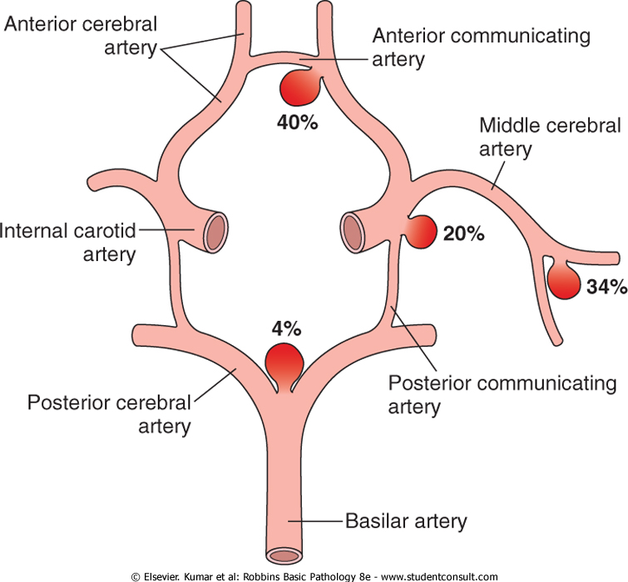

Slide 79
A. Atherosclerotic (fusiform) mostly of the basilar artery),
- other types of aneurysms present with cerebral infarction from vascular occlusion and include
B. Mycotic, traumatic, and dissecting aneurysms.
, are most often found in the anterior circulation.

Slide 80
B. Vascular Malformations
Arteriovenous malformations (AVM)
Is the most common type and the most dangerous
- Affect males twice as frequently as females;
The lesion is most often recognized clinically between the ages of 10 and 30 years

Slide 81
- The lesions presenting as :
a. A seizure disorder
b. An intra-cerebral hemorrhage
c. A subarachnoid hemorrhage

Slide 82
Large AVMs occurring in the newborn period can lead to high-output congestive heart failure because of blood shunting directly from arteries to veins.

Slide 83
.
2. Cavernous hemangiomas
- Consist of distended, loosely organized vascular channels with thin collagenized walls.
- They are devoid of intervening nervous tissue
-

Slide 84
- They occur most often in the cerebellum, pons, and subcortical regions,
- Have a low flow without arterio-venous shunting.
- Foci of old hemorrhage, infarction, and calcification frequently surround the abnormal vessels

Slide 85
3. Capillary telangiectasias
- Are microscopic foci of dilated, thin-walled vascular channels separated by relatively normal brain parenchyma
- Occurring most frequently in the pons.

Slide 86
4. Venous angiomas (varices)
- Consist of aggregates of ectatic venous channels.
Note:
- The latter two types are unlikely to bleed and are most commonly discovered as incidental lesions.

