Slide 1
Diseases of Nervous System
Fatima Obeidat, MD
Pathologist/Neuropathologist
The University of Jordan
Lecture 2

Slide 2
2. Hydrocephalus
Means accumulation of excessive CSF within the ventricular system as a result of disturbance in its secretion, circulation or absorption

Slide 3
Hydrocephalus

Slide 4
Brain damage can occur as a result of the fluid buildup.
This can lead to impaired developmental, physical, and intellectual functions.
It requires treatment to prevent serious complications.

Slide 5
Sunset eyes in hydrocephalus

Slide 6
Causes
a. Most commonly due to impaired flow or impaired resorption of CSF
b. Overproduction of CSF, seen in choroid plexus tumors such as choroid plexus papilloma or carcinoma rarely causes hydrocephalus.

Slide 7
Types of hydrocephalus
I. Non-communicating hydrocephalus (obstructive):
- It occurs when a lesion impedes the free passage of the CSF from the ventricles to the subarachnoid space, causing dilatation of the portion of the CSF pathway that lies proximal to the obstructions;

Slide 8
Causes
Obstructive hydrocephalus affecting the lateral ventricles only may be caused by:
- Colloid cyst of the third ventricle
Or intraventricular hemorrhage or
suprasellar tumors invaginating the anterior part of the third ventricle

Slide 9
b. Obstruction of the posterior end of the third ventricle and aqueduct may be due to aqueductal stenosis or tumors of the pineal region
c. Lesions obstructing the fourth ventricle such as ependymoma
d. Lesions of the cerebellum such as medulloblastioma may produce sufficient distorsion of the the fourth ventricle

Slide 10
II. Communicating hydrocephalus, :
- Refers to the abnormality in which there is free passage of CSF from within the ventricular system into the subarachnoid space
-Causes
a. Defects in the subarachnoid space such as fibrosis in leptomeningitis and hemorrhage from saccular aneurysms

Slide 11
B. Defects in absorption of CSF at the arachnoid granulations such as
1. congenital deficiency of arachnoids' granulation
2. Increased cerebral venous pressure
C. Overproduction of CSF by choroid plexus papilloma
D. Idiopathic

Slide 12
C.Hydrocephalus ex vacuo
- Refers to dilation of the ventricular system with a compensatory increase in CSF volume secondary to a loss of brain parenchyma, as may occur after infarcts or with a degenerative disease.

Slide 13
Hydrocephalus Ex vacue

Slide 14
. Interstitial Edema:
- It occurs in Patients with acute obstructive high pressure hydrocephalus
- Due to damage to the ependymal lining by stretching

Slide 15
Which leads to an increase in the water content in the periventricular white matter
- It is most pronounced around the frontal and occipital horns of the lateral ventricles

Slide 16
3. Brain herniations

Slide 17
Changes in the intracranial pressure may result from increase in the volume of brain, blood or CSF
Compensatory mechanisms maintain a normal intracranial pressure for any increase in the volume of 100-120 ml

Slide 18
When the volume increases beyond the point of compensation the ICP increases which can lead to cerebral herniation.

Slide 19
- Herniations are named by .
a. Either the part of the brain that is displaced or
b. The structure across which it moves.
- The usual consequence of such displacement is compromise of the blood supply to the "pushed" tissue, resulting in infarction.
- This often leads to another round of swelling and further herniation.

Slide 20
- Types of herniations

Slide 21
Brain herniation

Slide 22
1. Subfalcine (cingulate) herniation
Caused by expansion of a mass (hematoma or tumor) in the frontal or parietal lobe
Means displacement of the ipsilateral cingulate gyrus under the free edge of the falx
It produces selective displacement of the pericallosal arteries (branches of the anterior cerebral artery ) away from the lesion and from the midline

Slide 23
- This may compromise circulation through the pericallosal arteries ( branches of anterior cerebral artery)
- This type of herniation results in infarction of the parietal parasaggital cortex , manifesting clinically as a weakness in the contralateral leg

Slide 24
Transtentorial herniations
Uncal or uncinate gyrus herniation-
Caused by any supratentorial expanding hemispheric mass
This occurs most frequently when the mass is located in the temporal lobe

Slide 25
- Means herniation of the ipsilateral uncus (tip and medial part of parahippocampal gyrus)medially and downwards through the tentorial incisura
- Its complications include:

Slide 26
Uncal Herniation

Slide 27
A. As the uncus herniates it compresses the oculomotor nerve between the free edge of the tentorium and th posterior cerebral artery
It results in compression of the parasympathetic input to the eye resulting in pupil dilatation ipsilateral to the lesion

Slide 28
NOTE:
- Dilation of the pupil is the earliest consistent sign of uncal herniation and may occur before there is any loss of consciousness

Slide 29
B. Compression of the cerebral peduncle on the side of the mass lesion by direct pressure from the herniating brain will result in contralateral limb weakness

Slide 30
c. When the extent of herniation is large enough , the contralateral cerebral peduncle may be compressed against the free edge of the tentorium and this may lead to its infarction and this results in n hemiparesis ipsilateral to the side of the herniation

Slide 31
NOTE:
1. Because hemispheric lesions typically cause contralateral weakness, this ipsilateral hemiparesis can be a false localizing sign that
would suggest to the examiner that the patient has a lesion in the opposite, unaffected hemisphere

Slide 32
2. The side of the dilated pupil is a much more reliable sign of the side of the lesion than the side of the hemiparesis

Slide 33
The posterior cerebral artery may also be compressed,
- This results in ischemic injury to the territory supplied by that vessel, including the primary visual cortex

Slide 34
E. Duret hemorrhages .
- Progression of uncal is often accompanied by hemorrhagic lesions in the in the tegmentum of the midbrain and the tegmental parts of the pons but NOT in the medulla
- Are linear or flame-shaped lesions

Slide 35
- The most likely mechanism of hemorrhage is stretching and tearing of the central perforating branches of the basilar artery that supply the rostral brainstem leading to infarction or hemorrhage
- The presence of Duret hemorrhages implies a grim prognosis

Slide 36
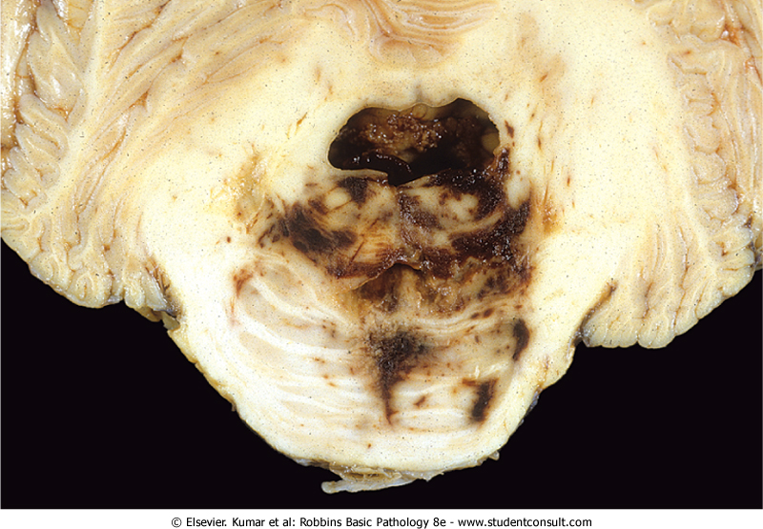
Durett hemorrhage

Slide 37
.
4.Tonsillar herniation
- Called (foramen impaction, cerebellar cone)
- Refers to displacement of the cerebellar tonsils through the foramen magnum.
- It occurs as an early complication of expanding masses in the posterior cranial fossa but may also occur with supratentorial space-occupying lesion

Slide 38
- The pathognomonic indication of this herniation is hemorrhagic necrosis at the tips of the cerebellar tonsils and a groove on the ventral surface of the medulla where it is compressed against the anterior border of foramen magnum
- This pattern of herniation is life-threatening

Slide 39
Tonsillar herniation

