Slide 1
Pharmacology of Endocrine System
Munir Gharaibeh, MD, PhD, MHPE
Faculty of Medicine, The University of Jordan
April 2014

Slide 2
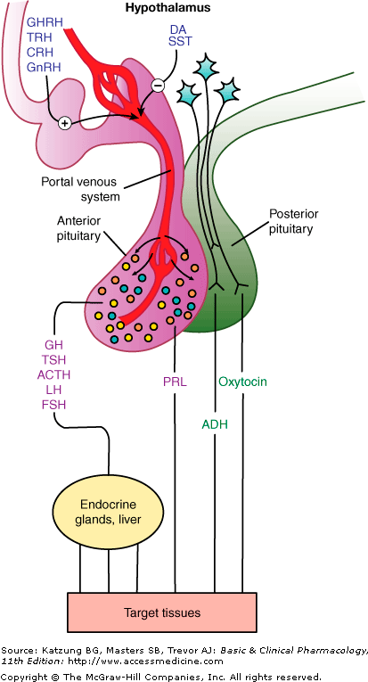

Slide 3
Hypothalamic Hormones
Hypothalamic releasing and inhibiting hormones are carried directly to the anterior pituitary gland via adenohypophyseal portal vasculature.
Specific hypothalamic hormones bind to receptors on specific anterior pituitary cells, modulating the release of the hormone they produce.
Hypothalamus
Releasing Hormones (turn ON)
Inhibiting Hormones (turn OFF)
Anterior pituitary
Systemic Target Organs

Slide 4
Hypothalamus
Dopamine GHRH TRH CRF GnRH Somatostatin
Anterior Pituitary
Growth Hormone
Prolactin
LH and FSH
TSH
ACTH

Slide 5
Hypothalamic Hormones
Dopamine: inhibit the secretion of prolactin from the anterior pituitary gland
GHRH: Growth Hormone-Releasing Hormone
Somatostatin: inhibits the secretion of growth hormone
TRH: Thyrotropin-Releasing Hormone, stimulates the release of thyroid-stimulating hormone and prolactin. (Protirelin)
CRF: Corticotropin-Releasing hormone, stimulates ACTH release
GnRH: Gonadotropin-Releasing Hormone

Slide 6
Somatostatin
Inhibits the secretion of growth hormone
Primarily a 14-amino acid peptide
Have very brief half-life in the serum
So Not Useful Clinically………..
Octreotide: An 8-amino acid analogue, so More Stable.
Notes:
A depot injection is an injection, usually subcutaneous or intramuscular, of a pharmacological agent which releases its active compound in a consistent way over a long period of time.

Slide 7
Effects of Somatostatin
Inhibition of secretion of :
Growth Hormones
Thyroid-stimulating hormones
Prolactin
ACTH
Insulin
Glucagon
Pancreatic polypeptide
Gastrin
Cholecystokinin
Secretin
Vasoactive intestinal peptide
Exocrine pancreas secretion
Inhibition of bile flow
Inhibition of mesenteric blood flow
Decreased gastrointestinal motility

Slide 8
Octreotide (Sandostatin, LAR)
Depot injection (Monthly).
Used to treat Acromegaly
Other uses:
Counteract diarrhea associated with neuroendocrine tumors such as insulinomas or carcinoid tumors.
Control severe diarrhea associated with AIDS that doesn’t respond to other treatments.
Side effects:
Gastrointestinal discomfort.
Decreased glucose tolerance.
Formation of gallstones.

Slide 9
Gonadotropin-Releasing Hormone (GnRH) or Gonadorelin
Stimulates the production of Luteinizing hormone (LH) and Follicle stimulating hormone (FSH) from anterior pituitary.
Released in bursts at regular intervals (every 2 hours).
Has very short half-life (7 minutes)
The response to GnRH ( or its analogues) depends on the concentration and mode of administration.
Pulsatile administration doesn’t have the same effect as continuous administration

Slide 10
Biological actions of GnRH Agonists and Antagonists
DRUG | DOSE and Regime | EFFECT
Agonist | Low, pulsatile | Pituitary and gonadal stimulation
Agonist | High, constant | Pituitary and gonadal stimulation followed by suppression for 2 weeks
Antagonist | Constant | Pituitary and gonadal suppression
Part of the desensitization of GnRH is caused by a decreased number of pituitary receptors.

Slide 11
Lutrepulse (agonist)
Lutrepulse, (Gonadorelin) is used to cause ovulation in women who do not have a period. (when FSH and LH are low)
Administered intravenously, in pulses, through a pump.
Used for women who are not producing enough GnRH.

Slide 12
Gonadotropin Suppression
Leuprolide
Goserelin
Stable potent derivatives of GnRH.
Long acting agents.
Suppress gonadotropin production(after initial stimulation)
Used as palliative treatment for reduction of prostate cancer growth.
Ganirelix:
Is an antagonist given by monthly injections.
Used to prevent premature ovulation in women undergoing ovarian stimulation as part of fertility treatment.

Slide 13
 | Hormone | Major target organ(s) | Major Physiologic Effects
Anterior Pituitary | Growth hormone | Liver, adipose tissue | Promotes growth (indirectly), control of protein, lipid and carbohydrate metabolism
 | Thyroid-stimulating hormone | Thyroid gland | Stimulates secretion of thyroid hormones
 | Adrenocorticotropic hormone | Adrenal gland (cortex) | Stimulates secretion of glucocorticoids
 | Prolactin | Mammary gland | Milk production
 | Luteinizing hormone | Ovary and testis | Control of reproductive function
 | Follicle-stimulating hormone | Ovary and testis | Control of reproductive function
Posterior Pituitary | Antidiuretic hormone | Kidney | Conservation of body water
 | Oxytocin | Ovary and testis | Stimulates milk ejection and uterine contractions

Slide 14
Anterior Pituitary Hormones
Anterior pituitary hormones are released in a pulsatile manner.
Secretion varies with time of day or physiological conditions such as exercise or sleep.
Understanding the rhythms that control hormone secretion leads to better uses of hormones in therapy.
Notes:
Example

Slide 15
Growth Hormone (Somatotropin)
191- amino acid peptide.
Required during childhood and adolescence for attainment of normal adult size
Has important effects throughout postnatal life on lipid and carbohydrate metabolism, and on lean body mass.
Effects are primarily mediated via insulin-like growth factor 1 (IGF-1, somatomedin C) and, to a lesser extent through insulin-like growth factor 2 (IGF-2).

Slide 16
Growth hormone deficiency (Pituitary Dwarfism)
Individuals with congenital or acquired deficiency of GH during childhood or adolescence fail to reach their predicted adult height and have disproportionately increased body fat and decreased muscle mass.
Also, these individuals have disproportionate delayed growth of skull and facial skeleton giving them a small facial appearance for their age.
Adults with GH deficiency also have disproportionately low lean body mass.

Slide 17
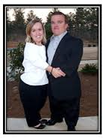
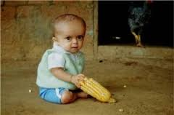

Slide 18
Dental Manifestations (Dwarfism)
The maxilla and mandible of affected patients are smaller than the normal and the face appears smaller with the permanent teeth showing a delayed pattern of eruption .
Often the shedding pattern of deciduous teeth is delayed for several years, and also the development of roots of permanent teeth appears to be delayed.
Dental professionals may be the first health care providers to see the signs and symptoms of growth disorders, and thus have the first opportunity to correctly diagnose this serious disease.

Slide 19
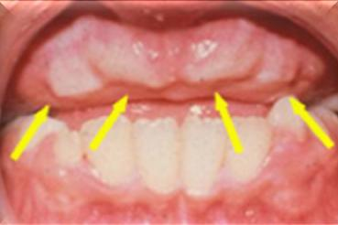
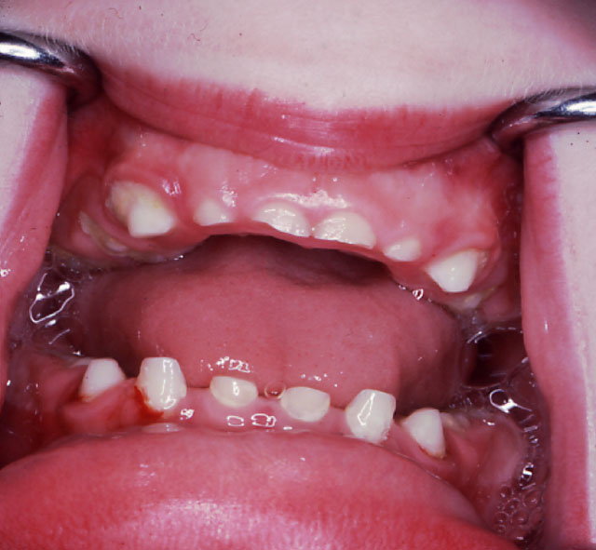
Dwarfism
Delayed eruption of teeth
Microdontia
The dental arch gets smaller than normal; it cannot accommodate all the teeth, thus irregularity of teeth develops.
The roots of the teeth are also shorter than normal in dwarfism.

Slide 20
Somatotropin (Humatrope)
A recombinant form of growth hormone (GH).
Has the same amino acid sequence.
Administration: subcutaneously (SC) in the evening.

Slide 21
Clinical Uses of Somatotropin
Mainly used in growth failure of pediatric patients.
Other effects include :
Improved metabolic state, increased lean body mass, sense of well-being in adults with GH deficiency.
Increased lean body mass, weight, and physical endurance and wasting in patients with HIV infection
Improved gastrointestinal function in short bowel syndrome in patients who are also receiving specialized nutritional support

Slide 22
Gigantism
Gigantism is the childhood version of growth hormone excess and is characterized by the general symmetrical overgrowth of all body parts

Slide 23
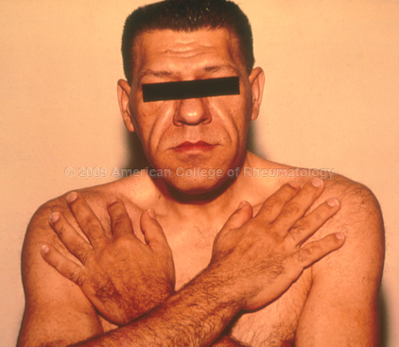
Acromegaly
A chronic metabolic disorder in which there is too much growth hormone and the body tissues gradually enlarge.
Excess secretion occurs after epiphyseal plate closure at puberty.
Usually results from pituitary tumor (adenoma).
Treatment of choice is surgical removal of the tumor
Octreotide

