Slide 1
Large intestine

Slide 2
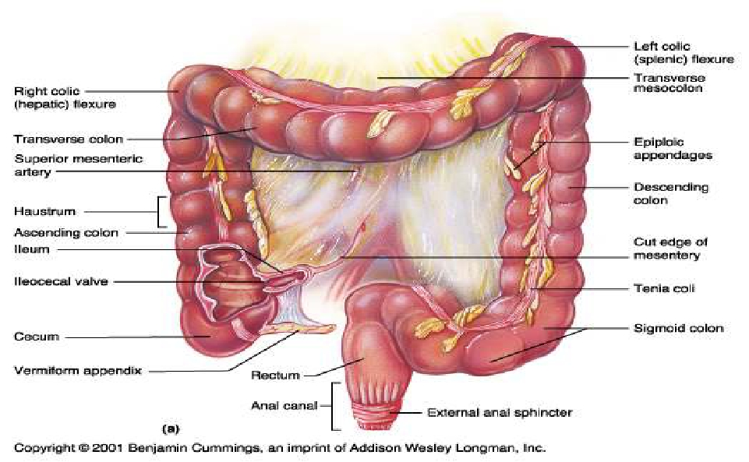
Anatomy of the Large Intestine
2

Slide 3
Large Intestine
• Extends from ileocecal valve to anus
• Length = 1.5- 2.5m = 5 feet
• Regions
– Cecum = 2.5- 3 inch
– Appendix= 3-5 inch
– Colon
•
•
•
•
Ascending= 5 inch
Transverse= 15 inch
Descending= 10 inch
Sigmoid colon = 10 – 15 inch
– Rectum= 5 inch
– Anal canal= 4 cm
3

Slide 4
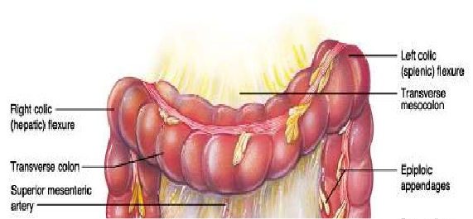
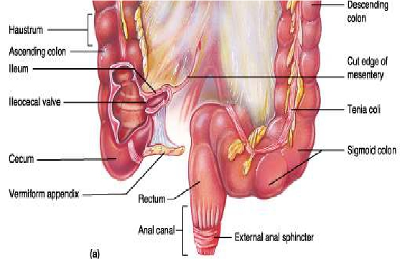
General features of large intestine
1- Sacculation= Haustra
2- Teania coli(three separate
longitudinal ribbons of smooth
muscle)
except appendex and
rectum
3- Appendices epiplolca( adipose
structures protruding from the
serosal surface of the colon )
except appendix , Cecum and
rectum

Slide 5
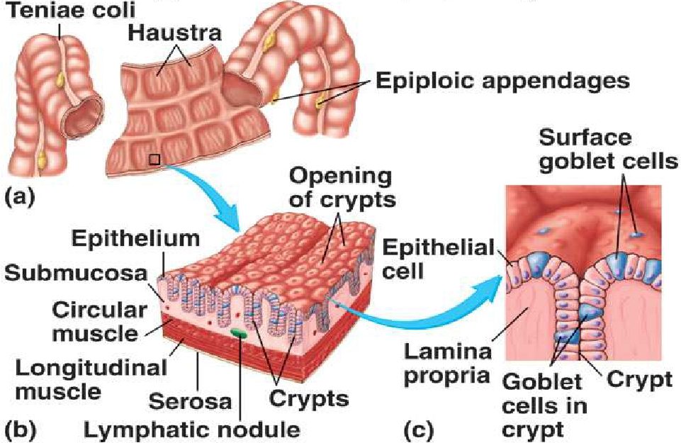
LARGE INTESTINE ANATOMY

Slide 6
Cecum
It is a blind-ended pouch
Site: situated in the right iliac fossa , above the lat ½ of inguinal ligament
Size: It is about 3 inch in diameter
Completely covered with peritoneum.
It possesses a considerable amount of mobility, although it does not have a
mesentery.
Attached to :
- Ascending colon
- posteromedially surface is the appendix , 1 inch below ileocoecal valve
•
•
•
•
•
•
- medially
Ileum
•
-
-
-
The presence of peritoneal folds in the vicinity of the cecum creates
The superior ileocecal recesses
The inferior ileocecal recesses
The retrocecal recesses .

Slide 7
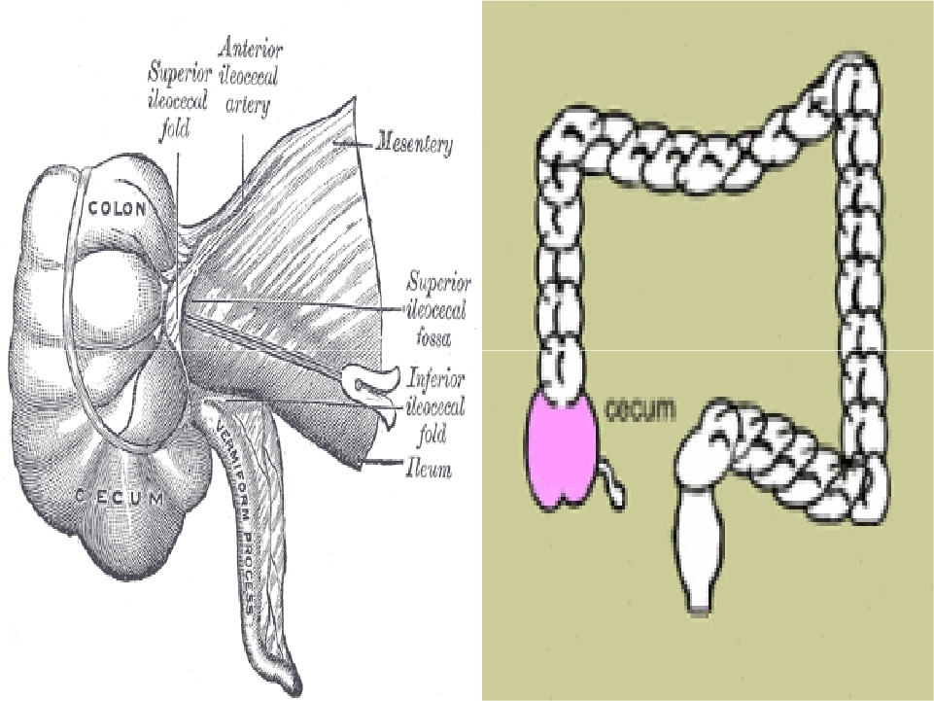

Slide 8
Cecum….cont
• The longitudinal muscle is restricted to three
flat bands, the taenia coli, which converge on
the base of the appendix and provide for it a
complete longitudinal muscle coat .

Slide 9
Relations of cecum
• Anteriorly:
- Coils of small intestine
- the greater omentum
- the anterior abdominal wall in the right iliac region
• Posteriorly:
- The psoas and the iliacus muscles
- the femoral nerve
- and the lateral cutaneous nerve of the thigh .
- Postero- medially
The appendix is commonly
retrocecal
common.
• Medially:
- Small intestine( ileum)

Slide 10
Blood Supply of cecum
Arteries
• Anterior and posterior cecal arteries
branch of Superior mesenteric artery
a
The veins correspond to the arteries and drain
into the superior mesenteric vein.

Slide 11
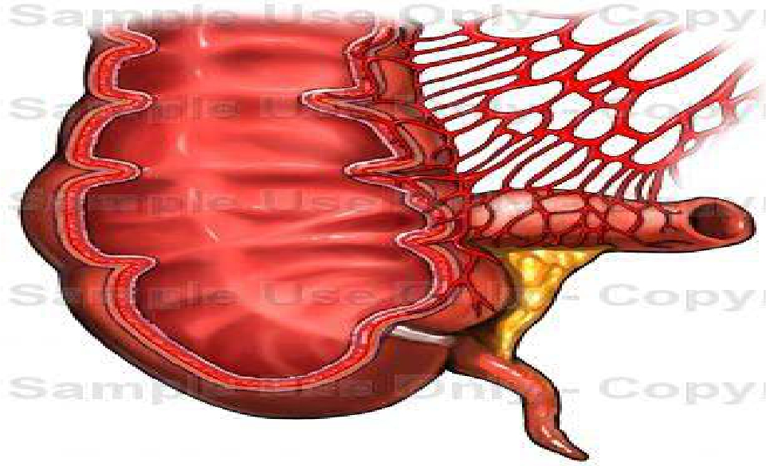
Blood supply of cecum

Slide 12
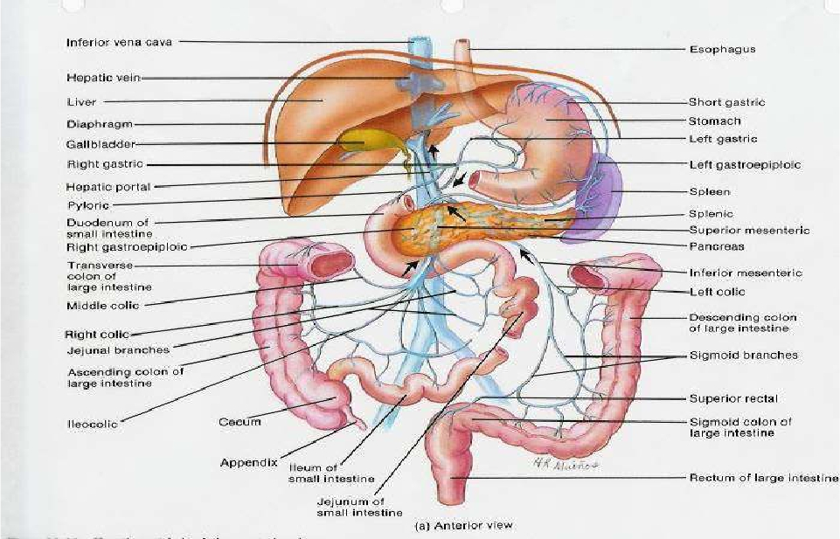
Venous drainage of cecum

Slide 13
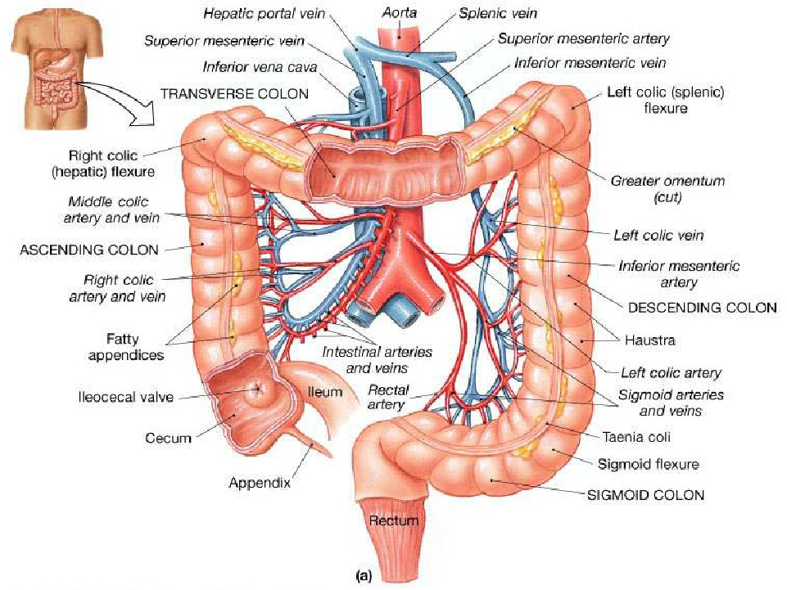

Slide 14
Lymphatic Drainage of cecum
• The lymph vessels pass through several
mesenteric nodes
mesenteric nodes.
finally reach the superior

Slide 15
Nerve Supply of cecum
• Branches from the sympathetic and
parasympathetic (vagus) nerves form the
superior mesenteric plexus.

Slide 16
Ileocecal Valve
A rudimentary structure
consists of two horizontal folds of mucous membrane
Project around the orifice of the ileum.
The valve plays little or no part in the prevention of reflux
of Cecal contents into the ileum.
•
•
•
•
• The circular muscle of the lower end of the ileum (called
the ileocecal sphincter by physiologists) serves as a
sphincter and controls the flow of contents from the ileum
into the colon.
• The smooth muscle tone is reflexly increased when the
cecum is distended; the gastrin hormone, which is
produced by the stomach, causes relaxation of the muscle
tone.

Slide 17
Appendix
Location and Description:
• It is a narrow, muscular tube
•
•
•
containing a large amount of lymphoid tissue.
It varies in length from 3 to 5 inch. (2 -22 cm).
The base is attached to the posteromedial surface of the cecum
about 1 inch. (2.5 cm) below the ileocecal junction .
• The remainder of the appendix is free.
• Peritoneum:
- It has a complete peritoneal covering, which is attached to the
mesentery of the small intestine by a short mesentery of its own,
the mesoappendix.
- The mesoappendix contains the appendicular vessels and nerves.

Slide 18
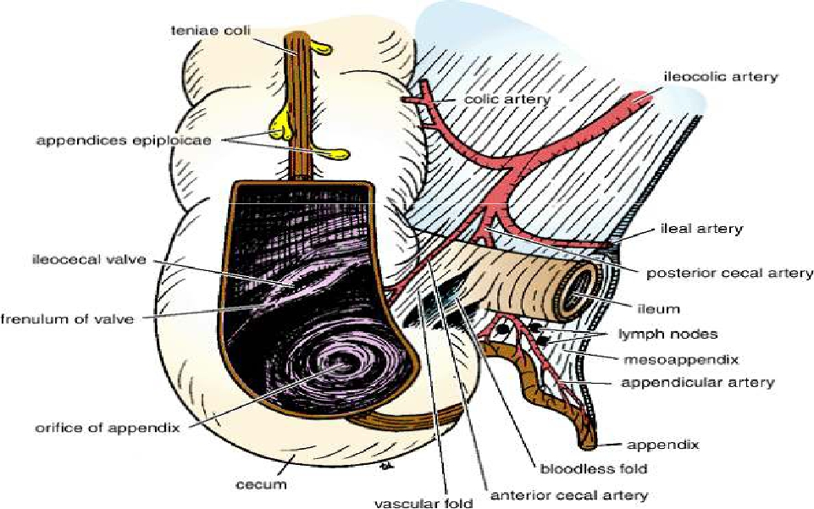
APPENIX

Slide 19
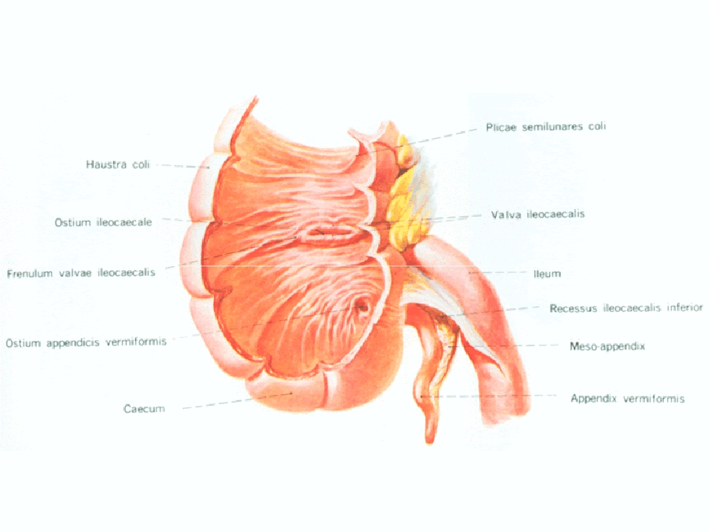

Slide 20
Appendix….cont
• Position
- The appendix lies in the right iliac fossa, and in relation to the anterior
abdominal wall
1- Retrocecal in retrocaecal recess behind cecum
in 74% of people
2- pelvic: in pelvis related to Rt. Ovary and uterine tube
in 21% of people
3- Subcaecal: below cecum
4- Preileal: infront of ileum
in 3.5%
1%
5- Postileal: behind the ileum 0.5%
• Surface anatomy of appendix= McBurney's point
- Its base is situated one third of the way up the line joining the right
anterior superior iliac spine to the umbilicus
- To reach the appendix during operation follow the taenia coli which
converge toward the appendix

Slide 21
Blood Supply of appendix
Arteries
• The appendicular artery is a branch of the
posterior cecal artery(ilio-cecal.a)which
descends behind the ileum.
Veins
• The appendicular vein drains into the
posterior cecal vein.

Slide 22
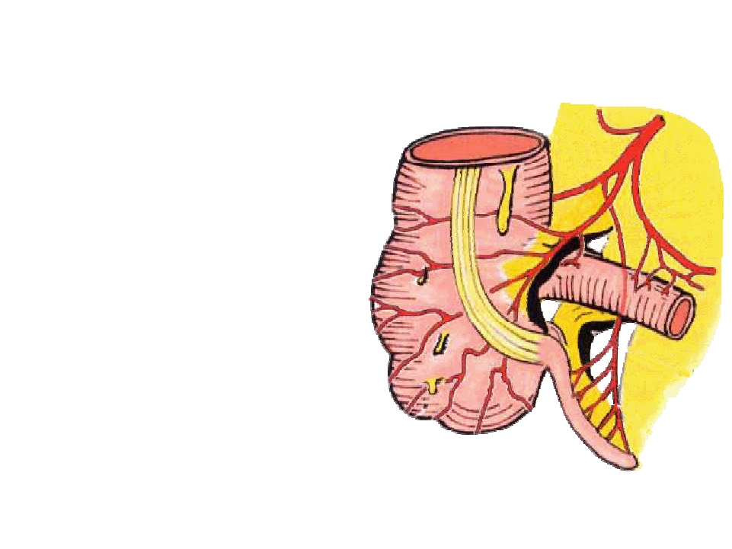
• Appendicular artery runs in
free margin of the
mesoappendix

Slide 23
Lymphatic Drainage of appendix
• The lymph vessels drain into one or two nodes
lying in the mesoappendix
eventually into
the superior mesenteric nodes.

Slide 24
Nerve Supply of appendix
• The appendix is supplied by the sympathetic and
parasympathetic (vagus) nerves from the
superior mesenteric plexus.
• Afferent nerve fibers concerned with the
conduction of visceral pain from the appendix
accompany the sympathetic nerves and enter the
spinal cord at the level of the 10th thoracic
segment.
• The peritoneum over the appendix is innervated
by the 10th intercostal nerve= skin of umbilicus

Slide 25
Clinical notes
• Acute appendetitis
uncommon in the two
extremes of life
• Thrombosis of appendicular .a
gangrene(just one artery for appendix)
perforation
Lt.paracolic gutter while in
Acute cholecystitis
no gangrene( more than
one artery supply the gallbladder)
• Appendiectomy

Slide 26
Ascending Colon
Location and Description:
• The ascending colon is about 5 inch. (13 cm) long
• lies in the right lower quadrant.
• It extends upward from the cecum to the inferior surface
of the right lobe of the liver, where it turns to the left,
forming the right colic flexure
• Then becomes continuous with the transverse colon.
• Taenia coli, sacculation & appendeces epiplolca are present
The peritoneum
- Covers the front and the sides of the ascending colon
- Binding it to the posterior abdominal wall.

Slide 27
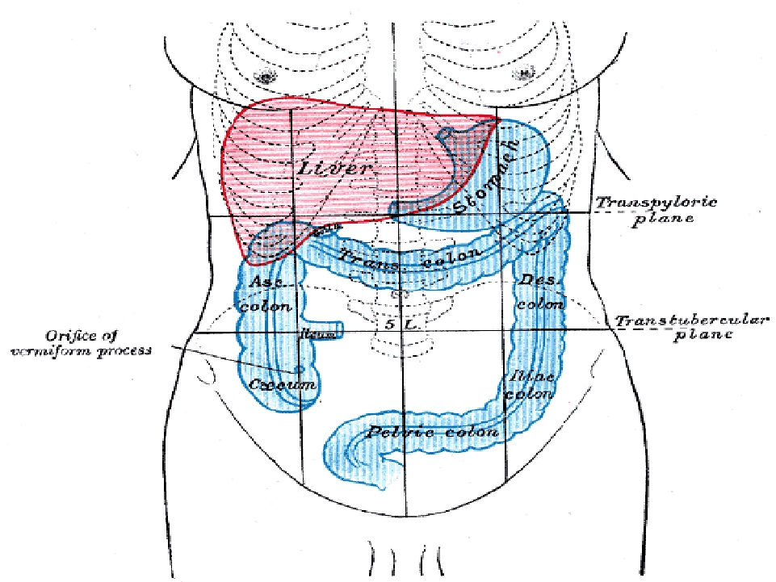

Slide 28
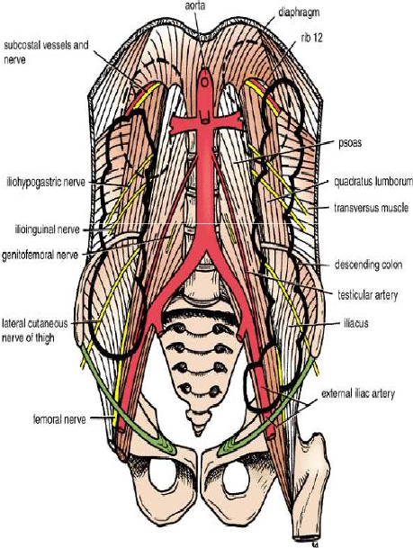
Relations of ascending colon
Anteriorly:
Coils of small intestine
The greater omentum
The anterior abdominal wall
Posteriorly:
The iliacus
The iliac crest
The quadratus lumborum
The origin of the transversus
•
-
-
-
•
-
-
-
-
abdominis muscle,
- The lower pole of the right
kidney.
- The iliohypogastric .n
- The ilioinguinal nerves cross
behind it .

Slide 29
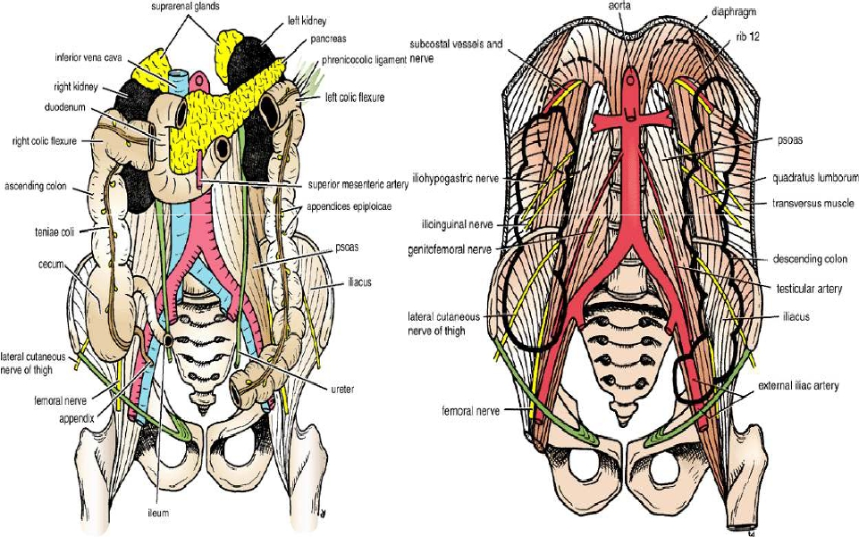
Relations of ascending colon

Slide 30
Blood Supply of Ascending colon
Arteries
• The ileocolic & right colic branches of the
superior mesenteric artery supply this area.
Veins
• The veins correspond to the arteries and drain
into the superior mesenteric vein.

Slide 31
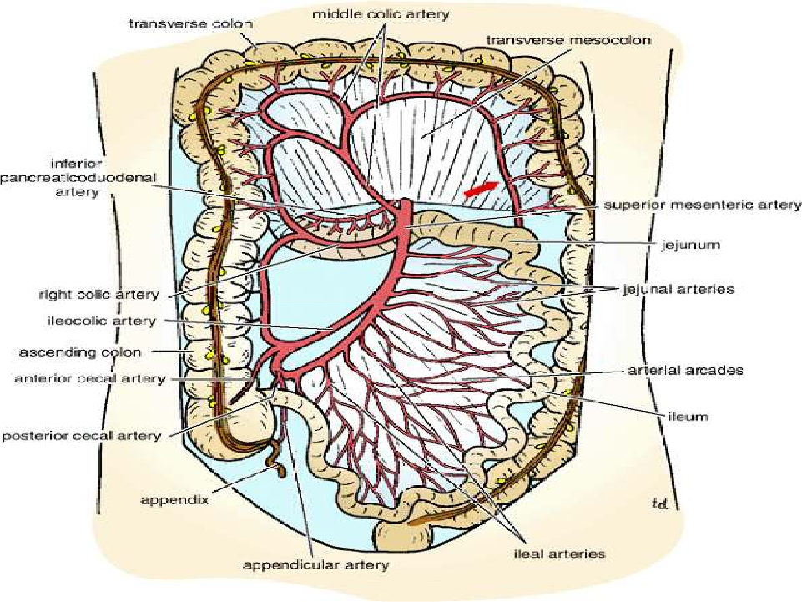

Slide 32
Lymphatic drainage of Ascending colon
• The lymphatic vessels
lymph nodes lying
along the course of the colic blood vessels
the superior mesenteric nodes.

Slide 33
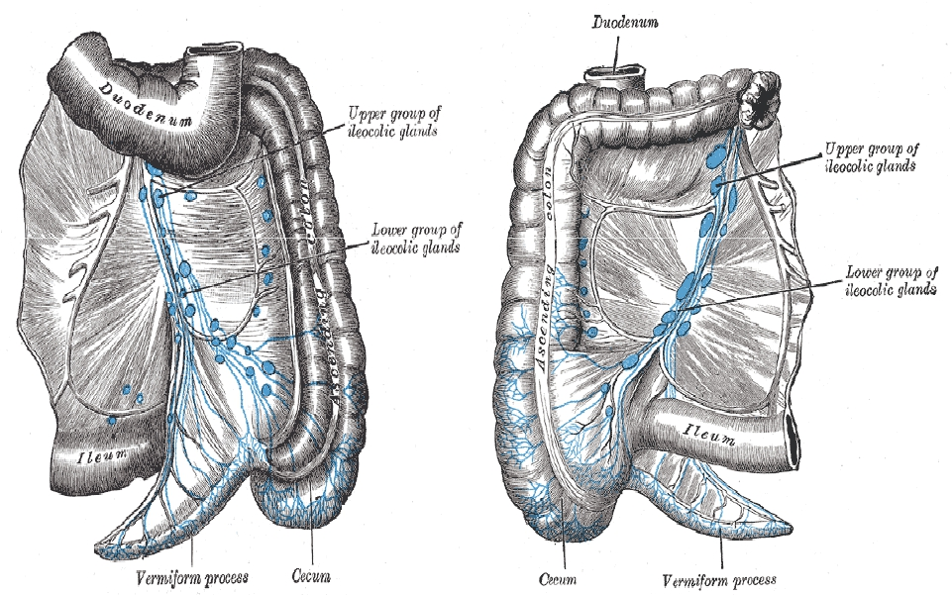
Lymphatic drainage

Slide 34
Nerve Supply of ascending colon
• Sympathetic and parasympathetic (vagus)
nerves from the superior mesenteric plexus .

Slide 35
Transverse colon

Slide 36
Transverse Colon
Location and Description
• The transverse colon is about 15 in. (38 cm) long
• extends across the abdomen
• occupying the umbilical region.
• It begins at the right colic flexure below the right lobe of
the liver
• Hangs downward
• Suspended by the transverse mesocolon from the pancreas
• It then ascends to the left colic flexure below the spleen.
• The left colic flexure is higher than the right colic flexure
and is suspended from the diaphragm by the phrenicocolic
ligament .
• Taenia coli, sacculation & appendeces epiplolca are present

Slide 37
The transverse mesocolon= mesentery of the
transverse colon
• suspends the transverse colon from the
anterior border of the pancreas .
• The mesentery is attached to the superior
border of the transverse colon
• The posterior layers of the greater omentum
are attached to the inferior border .
• The position of the transverse colon is
extremely variable and may sometimes reach
down as far as the pelvis.

Slide 38
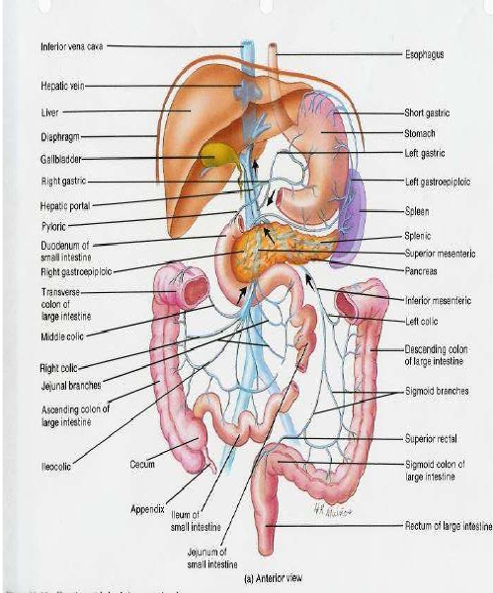
Relations of Transverse colon
• Anteriorly:
- The greater omentum
- The anterior abdominal
wall (umbilical and
hypogastric regions)
• Posteriorly:
- The second part of the
duodenum
- The head of the
pancreas
- The coils of the
jejunum and ileum

Slide 39
Blood Supply of transverse colon
• Arteries:
- The proximal two thirds are supplied by the middle colic
artery
a branch of the superior mesenteric artery.
- The distal third is supplied by the left colic artery
a
branch of the inferior mesenteric artery .
Veins
- The veins correspond to the arteries and drain into the
superior & inferior mesenteric veins.

Slide 41
Lymphatic Drainage of transverse
colon
• The proximal two thirds drain
the colic
nodes and then into the superior mesenteric
nodes
• The distal third drains
the colic nodes
the inferior mesenteric nodes.

Slide 42
Nerve Supply of transverse colon
• The proximal two thirds are innervated by
sympathetic and vagal nerves through the
superior mesenteric plexus
• The distal third is innervated by sympathetic
and parasympathetic pelvic splanchnic nerves
through the inferior mesenteric plexus.

Slide 43
Descending Colon
Location and Description:
• The descending colon is about 10 in. (25 cm) long
• It extends downward from the left colic flexure, to the
pelvic brim, where it becomes continuous with the
sigmoid colon.
• Taenia coli, sacculation & appendeces epiplolca are
present
• The peritoneum
- Covers the front and the sides and binds it to the
posterior abdominal wall.

Slide 44
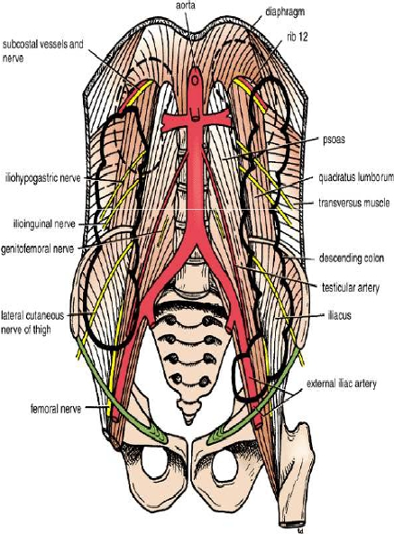
Relations of Descending colon
Anteriorly:
Coils of small intestine
the greater omentum
the anterior abdominal wall
Posteriorly:
The lateral border of the left kidney
the origin of the transversus
abdominis muscle
the quadratus lumborum
the iliac crest
the iliacus
the left psoas
The iliohypogastric and the
ilioinguinal nerves
the lateral cutaneous nerve of the
thigh
the femoral nerve
•
-
-
-
•
-
-
-
-
-
-
-
-
-

Slide 45
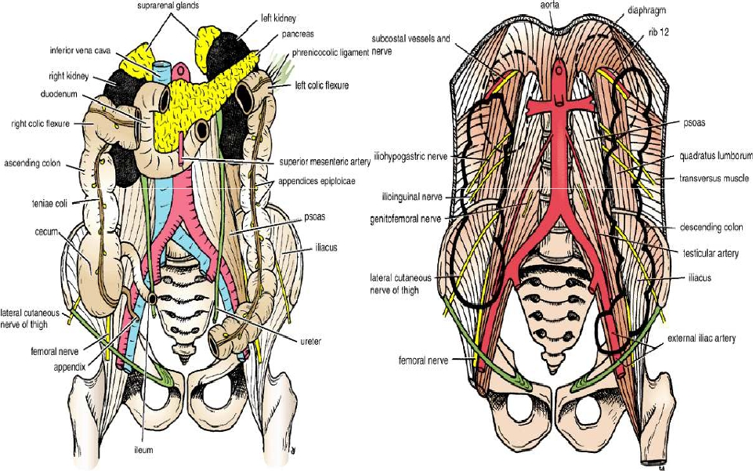
Relations of Descending colon

Slide 46
Blood Supply of Descending colon
• Arteries
- The left colic and the sigmoid branches of the
inferior mesenteric artery.
• Veins
- The veins correspond to the arteries
into the inferior mesenteric vein.
drain

Slide 47
Lymphatic Drainage of descending colon
• Lymphatic drains
the colic lymphatic nodes
& the inferior mesenteric nodes around the
origin of the inferior mesenteric artery.

Slide 48
Nerve Supply of descending colon
• The nerve supply is the sympathetic and
parasympathetic pelvic
• Splanchnic nerves through the inferior
mesenteric plexus

