Slide 1
Endocrine system Fatima Obeidat, MD

Slide 2
I. Thyroid diseases

Slide 3
I. THYROTOXICOSIS
- A hypermetabolic state caused by increase T3 and T4 and most commonly, caused by hyperfunction of the
thyroid gland ( called hyperthyroidism)
Causes of thyrotoxixosis are:
A. Associated with hyperthyroidism (Thyroid hyperfunction):
1. Primary
a. Diffuse toxic hyperplasia (Graves disease)
b. Hyperfunctioning (Toxic) multinodular goiter)
c. Hyperfunctioning (toxic ) adenoma
2. Secondary -- TSH-secreting pituitary adenoma (rare)

Slide 4
B. Not associated with hyperthyroidism
- Excessive release of pre-formed hormone due to destruction of follicles such as in thyroiditis
Clinical manifestations of thyrotoxicosis
a. Constitutional symptoms : warm flushed skin, heat intolerance and excessive sweating
- Weight loss despite increased appetite.
b. Malabsorption, and diarrhea.
c. Tachycardia and elderly patients may develop heart failure due to aggravation of pre-existing heart disease
d. Nervousness, tremor, and irritability

Slide 5
e. A wide, staring gaze and lid lag because of sympathetic overstimulation of the levator palpebrae superioris muscle
Note: True thyroid ophthalmopathy associated with proptosis is a feature seen only in Graves disease.
f. 50% develop proximal muscle weakness (thyroid myopathy).
g Thyroid storm : Designates the abrupt onset of severe hyperthyroidism, and this condition occurs most commonly in individuals with Graves disease and it is a medical emergency because significant numbers of untreated patients die of cardiac arrhythmias

Slide 6
h- Apathetic hyperthyroidism : thyrotoxicosis occurring in elderly persons, in whom the typical features of thyroid hormone excess seen in younger patients are blunted and in these patients the diagnosis is often made during - laboratory workup for unexplained weight loss or worsening cardiovascular disease.
Note:
- The measurement of serum TSH is the most useful single screening test for hyperthyroidism, because TSH levels are decreased even at the earliest stages, when the disease may still be subclinical

Slide 7
- Once the diagnosis of thyrotoxicosis has been confirmed measurement of radioactive iodine uptake by the thyroid gland often is valuable in determining the etiology
For example, such scans may show :
a. Diffusely increased (whole-gland) uptake in Graves disease,
b. Increased uptake in a solitary nodule in toxic adenoma
c. Or decreased uptake in thyroiditis.

Slide 8
II. HYPOTHYROIDISM :
Primary causes
a. - Worldwide, the most common cause of hypothyroidism is dietary deficiency of iodine.
b. In most developed countries, autoimmune diseases predominate such as Hashimoto thyroiditis
c. Genetic defects such as
1. Thyroid dysgenesis or
2. Congenital biosynthetic defect (dyshormogentic goiter).
II. Secondary causes: Pituitary or hypothalamic disorder

Slide 9
A. Cretinism :
- Refers to hypothyroidism developing in infancy or early childhood
1. Endemic cretinism: This disorder formerly was common
in areas of the world where dietary iodine deficiency is endemic, including mountainous areas ( the Himalayas )
- It is now much less frequent because of the widespread supplementation of foods with iodine
2. Sporadic cretinism. Caused by enzyme defects that interfere with thyroid hormone synthesis

Slide 10
Clinical features of cretinism include:
- Impaired development of skeletal system- short stature,
- Coarse facial features, protruding tongue, umbilical hernia.
- Central nervous system- with mental retardation
Note-
- The severity of the mental impairment seems to be , directly influenced by the timing of onset of the deficient state in utero.
- Normally, maternal hormones that are critical to fetal brain development, including T₃ and T₄, cross the placenta

Slide 11
1. Severe mental retardation if maternal thyroid deficiency is present before the development of the fetal thyroid
2. Reduction in maternal thyroid hormones later in pregnancy, after the fetal thyroid has developed
allows normal brain development.
2. Myxedema. or Gull syndrome :
Hypothyroidism in older children and adults and characterized by:
a. Patients are listless, cold intolerant, and often obese.
b. Generalized apathy and mental sluggishness that in the early stages of disease may mimic depression
c. Broadening and coarsening of facial features

Slide 12
d. Enlargement of the tongue, and deepening of the voice.
e. Bowel motility is decreased, resulting in constipation..
g. Mucopolysaccharide-rich edematous fluid accumulates in skin, subcutaneous tissue, and number of visceral sites
Laboratory evaluation :.
a - Serum TSH is the most sensitive screening test .
- The serum TSH is increased in primary hypothyroidism
b. Serum T₄ is decreased hypothyroidism of any origin.

Slide 13
III. Thyroiditis
1. Chronic Lymphocytic (Hashimoto) Thyroiditis
- Is the most common cause of hypothyroidism in areas of the world where iodine levels are sufficient.
- It is characterized by gradual thyroid failure secondary to autoimmune destruction of the thyroid gland
- It is most prevalent between the ages of 45 and 65 years and is more common in women than in men
- It can occur in children and is a major cause of non-endemic goiter in children

Slide 14
PATHOGENESIS :-
Caused by breakdown in self-tolerance to thyroid antigens
- Circulating autoantibodies against thyroid antigens are- present in the vast majority of patients
- Multiple immunologic mechanisms may contribute to thyrocyte damage ,
I. Cytokine-mediated cell death: Excessive T cell activation leads to the production of inflammatory cytokines such as IFN-γ in the thyroid with resultant recruitment and activation of macrophages and damage to follicles

Slide 15
.
2. Binding of anti-thyroid antibodies (antithyroglobulin, and antithyroid peroxidase antibodies), followed by antibody- dependent cell-mediated cytotoxicity
- A significant genetic component is supported by the
a. Concordance of disease in 40% of monozygotic twins,
b. And the presence of circulating antithyroid antibodies in 50% of asymptomatic siblings of affected patients .

Slide 16
Gross :
- Diffuse and symmetric enlargement of the thyroid but localized enlargement may be seen in some cases to raise suspicion for neoplasm
Microscopic examination reveals
1. Infiltration by small lymphocytes, plasma cells, and well-developed germinal centers
2. The thyroid follicles are atrophic
2. Some follicles are lined by epithelial cells with abundant eosinophilic, cytoplasm, termed Hürthle cells and these Hurthle cells have numerous mitochondria

Slide 17
- Less commonly, the thyroid is small due to extensive fibrosis (fibrosing variant) but unlike Reidel thyroiditis, the fibrosis does not extend beyond the capsule of the gland.
Clinically ,
Painless thyroid enlargement associated with some degree of hypothyroidism,
- In the usual clinical course, hypothyroidism develops gradually.; however, it may be preceded by transient thyrotoxicosis due to disruption of thyroid follicles ,and secondary release of thyroid hormones .

Slide 18
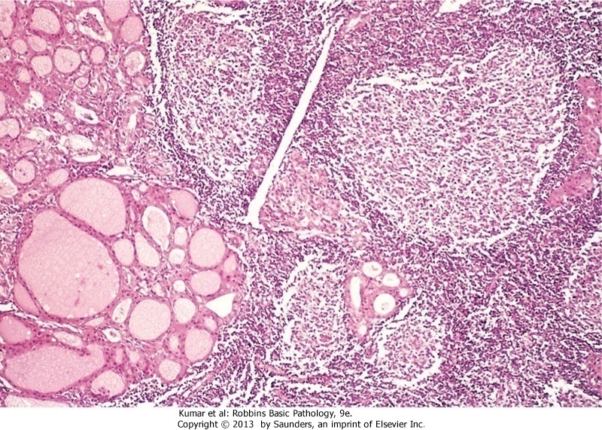
Hashimoto thyroiditis

Slide 19
- Patients with Hashimoto thyroiditis often :
1. Have other autoimmune diseases
2. .Are at increased risk for the development of B cell non-Hodgkin lymphomas within the thyroid gland.
Note:
- The relationship between Hashimoto disease and thyroid epithelial cancers remains controversial, with some morphologic and molecular studies suggesting a predisposition to papillary carcinomas

Slide 20
2. Subacute Granulomatous (de Quervain) Thyroiditis
- Is much less common than Hashimoto disease
- Is most common between the ages of 30 and 50 and,
- More frequently in women than in men.
- Is believed to be caused by a viral infection and a majority of patients have a history of an upper respiratory infection just before the onset of thyroiditis.
Gross- The gland has intact capsule, and may be unilaterally or bilaterally enlarged.
Histologic examination reveals
1. Disruption of thyroid follicles, with extravasation of colloid

Slide 21
leading to a neutrophilic infiltrate, which is replaced by lymphocytes, plasma cells, and macrophages.
2. The extravasated colloid provokes a granulomatous reaction with giant cells that contain fragments of colloid.
3. Healing occurs by resolution of inflammation and fibrosis.
Clinical Features :
-Acute onset characterized by neck pain ( with swallowing)
- Fever, malaise, and variable enlargement of the thyroid.
- Transient hyperthyroidism may occur as a result of disruption of follicles and release of excessive hormones.
- The leukocyte count is increased.

Slide 22
- With progression of disease and gland destruction, a transient hypothyroid phase may ensue.
- The condition typically is self-limited, with most patients returning to a euthyroid state within 6 to 8 weeks

Slide 23
3..Subacute Lymphocytic Thyroiditis :
- Also is known as silent or painless thyroiditis;
- And in a subset of patients the onset of disease follows pregnancy (postpartum thyroiditis).
- Most likely to be autoimmune because circulating antithyroid antibodies are found in a majority of patients
- It mostly affects middle-aged women, who present with a- painless neck mass or features of thyrotoxicosis

Slide 24
- The initial phase of thyrotoxicosis (which is likely to be secondary to thyroid tissue damage) is followed by return To euthyroid state within a few months.
- In a minority of affected persons the condition eventually progresses to hypothyroidism.
- The histologic features consist of lymphocytic infiltration

Slide 25
4/ Riedel thyroiditis,:
- A rare disorder of unknown etiology,
- Characterized by extensive fibrosis involving the thyroid and contiguous structures simulating a thyroid neoplasm
May be associated with idiopathic fibrosis in other parts of the body, such as the retroperitoneum
- The presence of circulating antithyroid antibodies in most patients suggests an autoimmune etiology

