Slide 1
Diseases of the vulva

Slide 2
1. Bartholin Cyst
Infection of the Bartholin gland produces an acute inflammation within the gland (adenitis) and may result in an abscess.
Bartholin duct cysts
Are relatively common, and result from obstruction of the duct by an inflammation
The cyst is lined by metaplastic squamous epithelium.
They produce pain and local discomfort

Slide 3
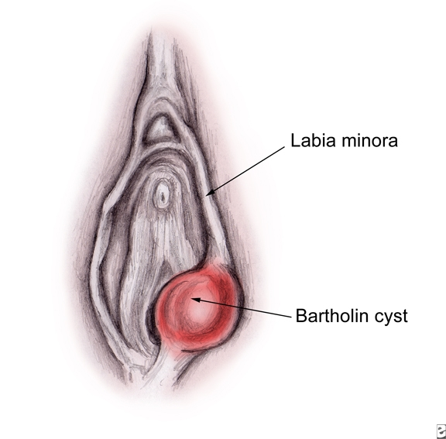
Bartholin cyst

Slide 4
2.Non-Neoplastic Epithelial Disorders
Are heterogeneous group of lesions of the vulva presents as white, mucosal thickening
May produce itching and scaling.
Are of unknown etiology are classified into two categories which may coexist and often multiple, making their clinical management particularly difficult

Slide 5
Lichen sclerosus
The lesions appear clinically as white lesions time may extend and coalesce, and when involve the entire vulva, the labia become atrophic and stiffened.
Is most common in postmenopausal women
It may also be encountered elsewhere on the skin

Slide 6
The pathogenesis is uncertainincreased frequency of autoimmune disorders in these women suggests an autoimmune reaction may be involved
Although the lesion is not pre-malignant by itself, women with symptomatic lichen sclerosus have a somewhat increased chance of developing squamous cell carcinoma in their lifetime.

Slide 7
2. Squamous Cell Hyperplasia
Is a nonspecific condition resulting from rubbing or scratching of the skin to relieve pruritus.
It is marked by
a. Epithelial thickening, with hypergranulosis
b. Significant surface hyperkeratosis
c..Leukocytic infiltration of the dermis
d. No atypia .

Slide 8
3. Condyloma acuminata
A benign exophytic lesions
Are sexually transmitted, benign lesions caused by low oncogenic risk HPVs, 6 and 11
They are more frequently multifocal
They may involve vulvar, perineal, and perianal regions , vagina and less commonly, the cervix
- Are not considered precancerous lesions

Slide 9
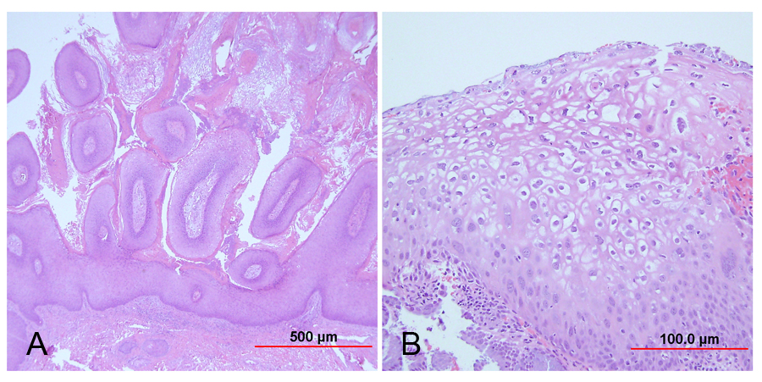
Condyloma acuminatum

Slide 10
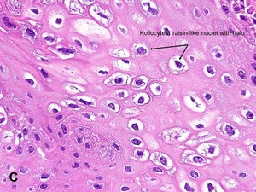
Koilocytic atypia

Slide 11
4.Vulvar Intraepithelial Neoplasia and Vulvar Carcinoma
Carcinoma of the vulva is an uncommon malignant neoplasm represents about 3% of all genital cancers in the female;
Approximately two thirds occur in women older than 60 years.
Squamous cell carcinoma Is the most common histologic type of vulvar cancer.

Slide 12
Vulvar squamous cell carcinomas are divided into two groups:
Basaloid and warty carcinomas
Acccounts for 30% of cases of vulvar carcinomas
Related to infection with high oncogenic risk HPVs
- Develop from a precancerous in situ lesion called classic vulvar intraepithelial neoplasia (classic VIN)

Slide 13
- It most commonly occurs in reproductive-age women, and the risk factors are :
a. Young age at first intercourse,
b. Multiple sexual partners
c. Male partner with multiple sexual partners

Slide 14
Vulvar intraepithelial neoplasia (VIN)
1. Frequently multicentric in the vulva, a
2.10% to 30% of patients with VIN also have vaginal or cervical HPV-related lesions
3. The majority of cases of classic VIN are positive for HPV 16, and less frequently for other high-risk HPV types, like HPV 18 or 31.

Slide 15
Note:
- Spontaneous regression of VIN lesions has been reported, usually in younger women
- The risk of progression to invasive carcinoma is higher in women older than 45 years of age or in women with immunosuppression.

Slide 16
Gross of warty carcinoma of vulva
- May be exophytic or indurated,with ulceration.
On histologic examination, are
An infiltrating tumors
Composed of nests and cords of small, tightly packed malignant squamous cells lacking maturation and may show necrosis

Slide 17
2.Non-HPV-related keratinizing squamous cell carcinomas
Account for 70% of all cases of vulvar carcinomas
Not related to HPV infection (70% of cases).
- Frequently arise in individuals with long-standing lichen sclerosus or squamous cell hyperplasia.
- The mean age of the patients is 76 years.

Slide 18
The immediate premalignant lesion is referred to as differentiated vulvar intraepithelial neoplasia (differentiated VIN) of unknown etiology
It is postulated that chronic epithelial irritation in lichen sclerosus or squamous cell hyperplasia may contribute to a gradual evolution of the malignant phenotype.

Slide 19
Gross
May develop as nodules in an inflammatory background and may be misinterpreted as dermatitis for long periods .
Micro: Keratinizing squamous cell carcinoma
Note:
- The clinical manifestations are nonspecific, including local discomfort, itching, and the superficial secondary infection, may underscore the importance of repeated examination in women with vulvar inflammatory disorders.).

Slide 20
Patients with lesions less than 2 cm in diameter have a 60% to 80% 5-year survival after treatment with vulvectomy and lymphadenectomy
- Large lesions with lymph node involvement have a 5-year survival rate of less than 10%.

Slide 21
Verrucous carcinomas of vulva
Are fungating tumors resembling condyloma acuminatum,
Not associated with papillomaviruses.
Rarely metastasize
Successfully cured by wide excision.

Slide 22
Extramammary Paget Disease
This is rare lesion of the vulva, and sometimes the perianal region and presents as a pruritic, red, sharply demarcated, area
Most commonly affects the labia majora.
Note;
- In contrast to Paget disease of the nipple, in which 100% of patients show an underlyingductal breast carcinoma, vulvar lesions are most frequently confined to the epidermis of the skin

Slide 23
Paget disease is treated with wide local exision
With high recurrence rate
Typically, Paget cells spread beyond the confines of the grossly visible lesion, and therefore are frequently present beyond the margins of surgical excision .
It may persist for many years, or decades, without invasion or metastases.
Invasion develops rarely, and in such patients the prognosis is poor

Slide 25
Diseases of Vagina

Slide 26
1.Vaginal adenosis
Is a remnant of endocervical-type epithelium that during embryonal development extends from the endocervix and covers the ectocervix and upper vagina
Adenosis, while normally present in a small percentage of adult women, has been reported in 35% to 90% of women exposed

Slide 27
to Diethysl stillbesterol DES in utero
Adenosis presents clinically as red, areas contrasting with the normal pale-pink vaginal mucosa
On microscopic examination, it is composed of columnar mucinous epithelium
Note: Rare cases of clear cell carcinoma of vaginain DES-related adenosis were recorded in teens and young women in the 1970s and 1980s, resulting in discontinuation of DES treatment

Slide 28
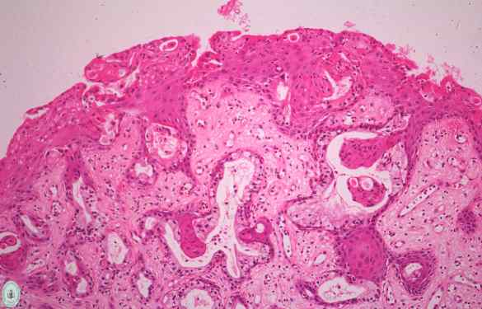
Vaginal adenosi

Slide 29
2.Gartner duct cysts of vagina
Are relatively common lesions found along the lateral walls of the vagina and derived from wolffian (mesonephric) duct rests.
3.Vaginal carcinoma
The most common malignant tumor of the vagina is carcinoma metastatic from the cervix,
Followed by a primary squamous cell carcinoma of the vagina which are uncommon accounting for

Slide 30
about 1% of malignant neoplasms in the female genital tract.
All of the tumors are squamous cell carcinomas associated with high oncogenic risk HPVs.
Note: The greatest risk factor is a previous carcinoma of the cervix or vulva and 1% to 2% of women with an invasive cervical;carcinoma eventually develop a vaginal squamous cell carc

Slide 31
.carcinoma
Primary squamous cell carcinoma of the vagina arises from a premalignant lesion, vaginal intraepithelial neoplasia (VaIN)
Most often the invasive tumor affects the upper posterior vagina.
Primary carcinomas in the lower two thirds of the vagina metastasize to the inguinal nodes, whereas upper lesions tend to involve the regional iliac nodes.

Slide 32
5.Embryonal Rhabdomyosarcoma
Called sarcoma botryoides of the vagina
This uncommon vaginal tumor is
Most frequently found in infants and in children younger than 5 years of age
This tumor tend to invade locally
It causes death by penetration into the peritoneal cavity or by obstruction of the urinary tract.

Slide 33
Conservative surgery, coupled with chemotherapy, seems to offer the best results in cases diagnosed sufficiently early
Gross appearance
1.These tumors tend to grow as polypoid, rounded, bulky masses that sometimes fill and project out of the vagina;
2. They have the appearance and consistency of grapelike clusters

Slide 34
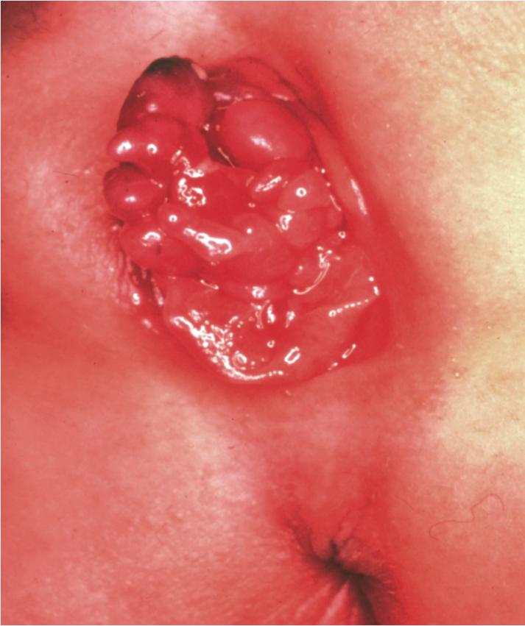
Sarcoma botryodes

Slide 35
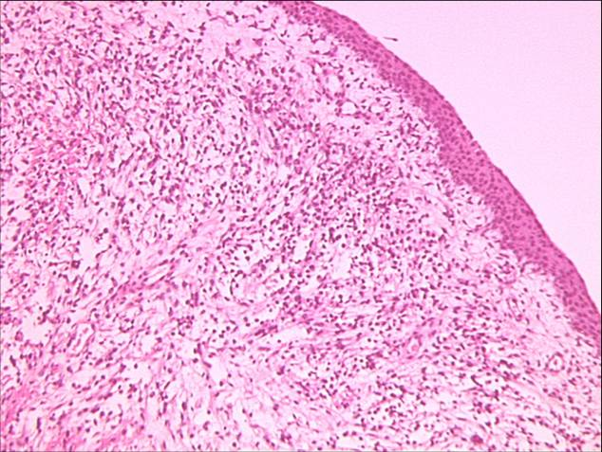
Sarcoma Botryodes

