Slide 1
Metabolism of cardiac muscle
Dr. Mamoun Ahram
Cardiovascular system, 2014
Resources:
This lecture
Mark’s Basic Medical Biochemistry, 4th ed., p. 890-891
Hand-out

Slide 2
What is heart failure?
Heart failure is “a complex clinical syndrome that can result from any structural or functional cardiac disorder that impairs the ability of the ventricle to fill with or eject blood”.
Why is this topic important?
It is currently a leading cause of death and disability across the globe.
Heart failure (HF) is associated to changes in metabolic profile.
20-30% of HF patients are diabetic indicative of a connection.
Optimization of substrate metabolism improves cardiac function.

Slide 3
Lecture outline
Metabolic profile in cardiomyocytes
Alteration in metabolic profile during ischemia and reperfusion
Therapeutic targets
Biomarkers of heart failure

Slide 4
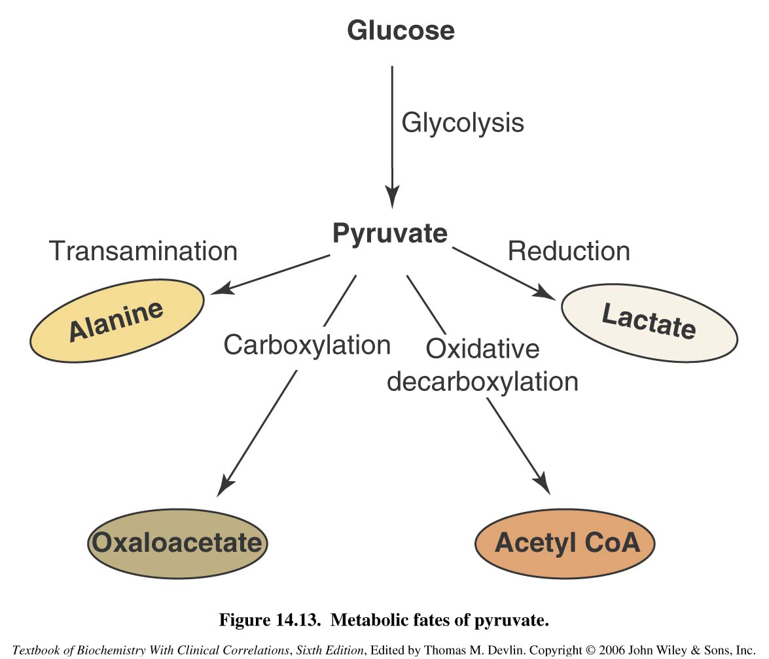
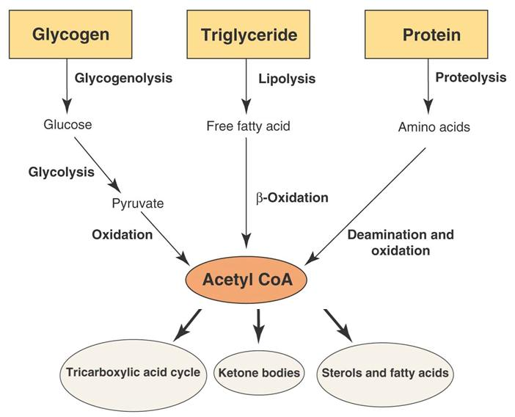
Pathways
60-90%
10-40%
>95% of ATP comes from oxidative phosphorylation
Complete ATP turnover every 10s (constant)
60–70% of ATP hydrolysis fuels contractile power., and the rest is used for maintaining ionic homeostasis.
Fatty acid oxidation requires a greater oxygen consumption per produced ATP compared to glucose oxidation.

Slide 5
Preferential substrates
Sufficient oxygen:
Fatty acids (50-70%)
Glucose (30%)
Glycolysis produces 5% of ATP.
Increased muscular activity and under ischemic conditions
Glucose and lactate
Pathological conditions and starvation:
Ketone bodies and amino acids

Slide 6
Fatty acid metabolism
Fatty acids enter the cardiomyocyte by either passive diffusion or by either FAT or FABPpm
Malonyl-CoA is formed from carboxylation of acetyl-CoA by ACC.
The activity of CPT-I is strongly inhibited by malonyl-CoA.
MCD converts malonyl-CoA back to acetyl-CoA and CO2.
The activity of ACC is inhibited by phosphorylation by AMPK.
FAs are esterified into fatty acyl-CoA by FACS
10-30%
70-90%
fatty acyl molecule is transferred into the matrix by a carnitine-dependent transport system.
ACC, acetyl-CoA carboxylase; CAT, carnitine acyltranslocase; CPT-I, carnitine palmitoyltransferase; FABPPM, plasma membrane fatty acid binding protein; FAT, fatty acid transporter;
LPL, lipoprotein lipase; MCD, malonyl-CoA decarboxylase.

Slide 7
Glucose and glycogen
Glycolytic substrate is derived from exogenous glucose and glycogen stores.

Slide 8
Glucose transporters
Tansporter | Major Sites of Expression | Characteristics
GLUT-1 | Brain, erythrocyte, endothelial cells, fetal tissues | Transports glucose and galactose, not fructose Low Km (~ 1 mM)
GLUT-2 | Liver, pancreatic beta cell, small intestine, kidney. | Transports glucose, galactose and fructose Low affinity, high capacity glucose transporter High Km (15–20 mM)
GLUT-3 | Brain, placenta and testes | Transports glucose (high affinity; and galactose, not fructose Low Km (<1 mM)
GLUT-4 | Skeletal and cardiac muscle, adipocytes | Insulin-responsive; High affinity for glucose Medium Km (2.5–5 mM)
GLUT-5 | Small intestine, sperm, brain, kidney, adipocytes and muscle | Transports fructose, but not glucose or galactose Medium Km (~ 6 mM)

Slide 9
GLUT-4 translocation
Ischemia
Work load

Slide 10
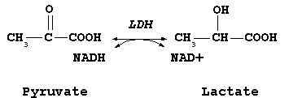
Lactate transport and metabolism
A healthy nonischemic heart is a net consumer of lactate.
It becomes a net lactate producer under accelerated glycolysis and impaired oxidation of pyruvate (as in ischemic conditions)
The all H4 isozyme
functions aerobically
Reduces lactate into pyruvate
low Km for lactate
inhibited by pyruvate

Slide 11
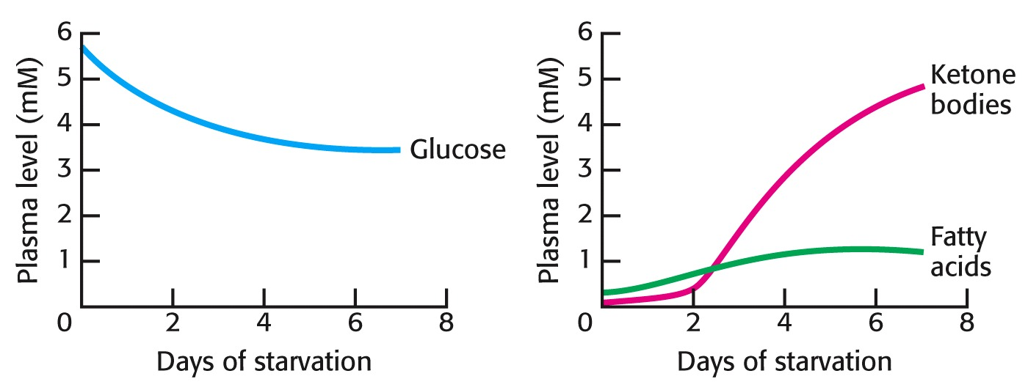
Production of ketone bodies

Slide 12
Regulation of glucose metabolism by FFA and ketone bodies
Ketone bodies metabolism increases
acetyl CoA, which activates PDK inactivating PDH
citrate, which inhibits PFK
Fatty acids metabolism increases:
LCFAs that inhibit HK
NADH/NAD+ ratio, which inhibits PDH
acetyl CoA and citrate (see above)

Slide 13
Regulation of fatty acid metabolism by glucose
Glucose oxidation produces citrate, which can be converted to malonyl-CoA by acetyl-CoA carboxylase (ACC).
Malonyl-CoA then can bind to and inhibit CPT1 blocking fatty acid oxidation.

Slide 14
The glucose-fatty acid (Randle) cycle
The Randle cycle describes the reciprocal relationship between fatty acid and glucose metabolism.
The increased generation of acetyl CoA derived from fatty acid-oxidation decreases glucose (pyruvate) oxidation.
The increased generation of acetyl CoA derived from glucose (pyruvate) oxidation inhibits fatty acid oxidation.
In the heart, inhibition of glucose utilization by fatty acids is a form of glucose intolerance that resembles, or may lead to, insulin resistance.

Slide 15
Metabolic regulation by AMPK
AMPK
Activates GLUT-4 translocation into membrane
Stimulates glycolysis by activating hexokinase and phosphofructokinase
Activates glycogenolysis
Inactivates glycogenesis

Slide 16
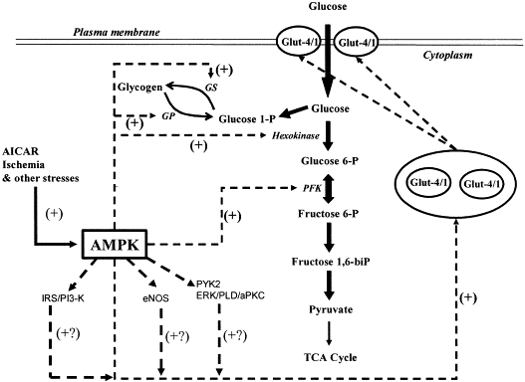
AMPK and glucose metabolism
Activation
Inhibition

Slide 17
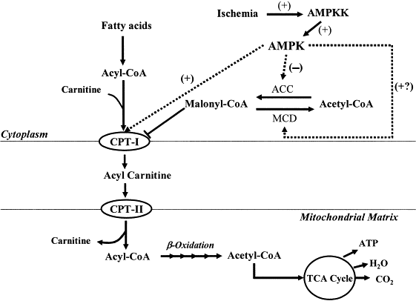
AMPK and fatty acid oxidation
AMPK activates fatty acid oxidation by inhibiting formation of malonyl CoA and activating CPT-1

Slide 18
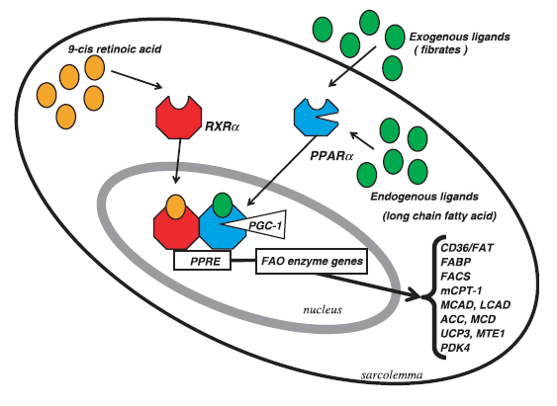
Peroxisome proliferator activated receptor (PPAR)
PPAR isoforms
PPAR-α >> PPAR-β >> PPAR-γ
Heart, skeletal muscle, and liver
adipose tissue
skeletal muscle
PPAR-α increases the expression of inducers of fatty acid oxidation (uptake, esterification, and oxidation).
PPARs can indirectly regulate fatty acid oxidation by decreasing the fatty acid concentration to which the heart is exposed.

Slide 19
How does ischemia alter metabolic profile?
Ischemia results in
A decrease of O₂ and nutrients, which inhibits oxidation of fatty acid and glucose.
An increase in AMP/ATP ratio, which activates AMPK, which activates glucose uptake and glycolysis.

Slide 20
Metabolism during reperfusion
Fatty acid oxidation resumes, glycolysis continues, but glucose oxidation is inhibited. This is called “lipotoxicity”.
Oxygen wasting
Fatty acid oxidation
Synthesis of uncouplers

Slide 21
Consequences of metabolism during reperfusion
(1) Increased glycolysis and (2) beta oxidation
(3) Activation of AMPK and (4) inhibition of glucose oxidation
Lactate and protons accumulate (acidosis)
ATP wasting results from:
(5) removal of via H+/Na+ exchanger (Na+ overload) and Na+ ions are removed by Na+/Ca++ exchanger (Ca++ overload)
(6) Increased FFA stimulated synthesis of uncouplers that dissipate the electrochemical gradient across the inner mitochondrial membrane
Production of free radicals (mitochondrial damage)
H+
All lead to loss of cardiac contractile power.
6
UCP

Slide 22
Therapeutic targets (1)
Glucose–insulin–potassium (GIK) (reduce circulating fatty acid concentrations, while maintaining circulating glucose concentration)
PPAR agonists (increase beta-oxidation in peripheral tissues)
β-adrenoceptor antagonists (reduce catecholamine-induced lipolysis)

Slide 23
Therapeutic targets (2)
The mitochondrial uptake of long chain acyl-CoAs can be reduced
Carnitine palmitoyl tranferase-I (CPTI)
Malonyl-CoA decarboxylase (MCD) inhibitors

Slide 24
Therapeutic targets (3)
Fatty acid oxidation inhibitors reduce the rates of myocardial fatty acid oxidation.

Slide 25
Therapeutic targets (4)
Glucose oxidation can be increased by compounds that
increase pyruvate dehydrogenase (PDH) complex activity
inhibit PDK

Slide 26
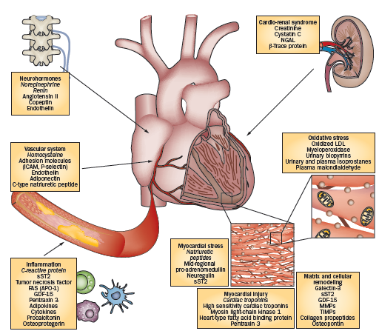
Biomarkers of HF

