Slide 1
DISEASES WITH ABNORMAL MATRIX MSK-1 for 2nd year medical students
Dr. Nisreen Abu Shahin

Slide 2
Congenital diseases with abnormal matrix

Slide 3
Osteogenesis imperfecta (OI):
also known as "brittle bone disease"
a group of genetic disorders caused by defective synthesis of type I collagen.
also numerous extraskeletal manifestations
(affecting skin, joints, teeth, and eyes, etc).
Mutations: the coding sequences for α₁ or α₂ chains of type I collagen ➔ most defects manifest as autosomal dominant disorders.
a broad spectrum of severity
The fundamental abnormality in all forms of OI is too little bone, resulting in extreme skeletal fragility.

Slide 4
Four major subtypes are recognized:
Type II : uniformly fatal in utero or immediately postpartum as a consequence of multiple fractures that occur before birth.
Type I :
have a normal lifespan
increased tendency for fractures during childhood (decreasing in frequency after puberty)
blue sclerae (due to decreased scleral collagen content) → relative transparency that allows the underlying choroid to be seen.
Hearing loss (due to conduction defects in the middle and inner ear bones)
small misshapen teeth → dentin deficiency (also composed of collagen type I)

Slide 5
Achondroplasia
is the most common form of dwarfism.
Have a normal lifespan.
caused by activating point mutations in FGFR3.
FGFR3➔ inhibits the proliferation and function of growth plate chondrocytes (result= the growth of normal epiphyseal plates is suppressed, and the length of long bones is severely stunted).
Can be inherited as AD, but many cases → new spontaneous mutations.
Affects all bones that develop by endochondral ossification.
Clinical picture: short stature, disproportionate shortening of the proximal extremities, bowing of legs, and frontal bossing with midface hypoplasia.
Microscopically: the cartilage of the growth plates is disorganized and hypoplastic

Slide 6
Thanatophoric dwarfism
Thanatophoric = "death-loving".
is a lethal variant of dwarfism, affecting 1 in every 20,000 live births
Also caused by missense or point mutations most commonly located in the extracellular domains of FGFR3. ((also results in FGFR3 activation)).
Clinical features: extreme shortening of limbs, frontal bossing of skull, and small thorax (the cause of fatal respiratory failure in the perinatal period)

Slide 7
Osteopetrosis
Osteopetrosis (literally= "bone-that-is-like-stone disorder")
is a group of rare genetic disorders characterized by defective osteoclast-mediated bone resorption.
the bones are dense, solid, and stone-like. Paradoxically, because turnover is decreased, the persisting bone tissue becomes weak over time and predisposed to fractures like a piece of chalk.
Several variants are known, the two most common being:
1- an autosomal dominant adult form: mild
2- autosomal recessive (infantile) form: severe/lethal

Slide 8
The defects that cause osteopetrosis are categorized into:
defects that disturb osteoclast function (the ability of osteoclasts to resorb bone). some of the identified abnormalities include:
1- carbonic anhydrase II deficiency
2- proton pump deficiency
3- chloride channel defect
defects that interfere with osteoclast formation and differentiation.

Slide 9
Complications:
fractures
cranial nerve palsies (due to compression of nerves within shrunken cranial foramina)
recurrent infections (reduced bone marrow size and activity)
Hepato-splenomegaly (caused by extramedullary hematopoiesis due to reduced marrow space).
Morphology:
the primary spongiosa persists, filling the medullary cavity, and bone is deposited in increased amounts woven in architecture.
Treatment= hematopoietic stem cell transplantation
- osteoclasts are derived from B.M. monocyte precursors
- many of the skeletal abnormalities may be reversible

Slide 10
Acquired diseases with abnormal matrix

Slide 11
Osteoporosis
increased porosity of the skeleton resulting from reduced bone mass.
It is associated with an increase in bone fragility and susceptibility to fractures.
Causes of osteoporosis:
1- Primary : (most common)
Postmenopausal
Senile

Slide 12
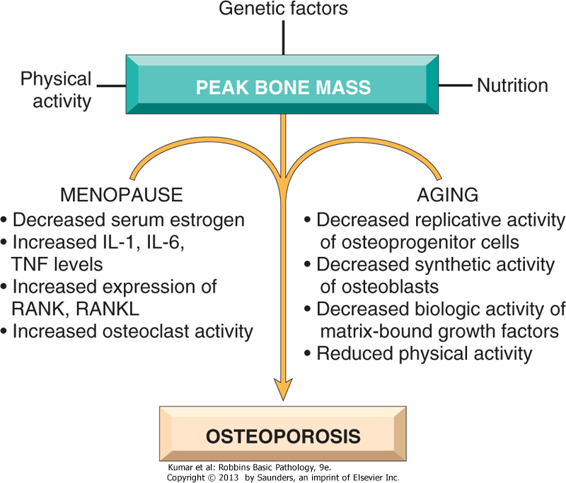
Pathophysiology of postmenopausal and senile osteoporosis

Slide 13
Causes of secondary osteoporosis
2- Secondary
1-ENDOCRINE DISORDERS
Hyperparathyroidism
Hypo or hyperthyroidism
Hypogonadism
Pituitary tumors
Diabetes, type 1
Addison disease
Multiple myeloma
Carcinomatosis
2-GASTROINTESTINAL DISORDERS
Malnutrition
Malabsorption
Hepatic insufficiency
Vitamin C, D deficiencies
Idiopathic
3-DRUGS
Anticoagulants
Chemotherapy
Corticosteroids
Anticonvulsants
Alcohol
4-MISCELLANEOUS
Osteogenesis imperfecta
Immobilization
Pulmonary disease
Homocystinuria
Anemia

Slide 14
Morphology
The cortices are thinned, with dilated haversian canals
The trabeculae are reduced in thickness and lose their interconnections.
Osteoclastic activity is present but is not dramatically increased
the mineral content of the bone tissue is normal

Slide 15
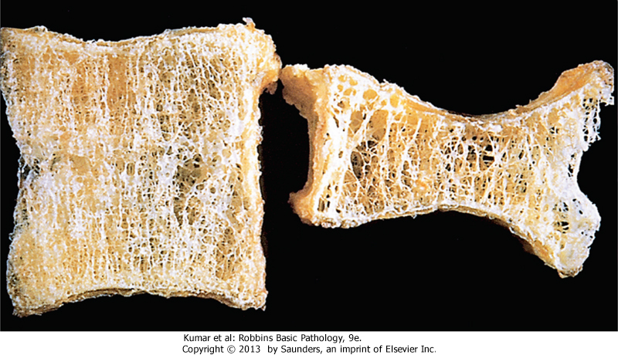
Osteoporotic vertebral body (right) shortened by compression fractures, compared with a normal vertebral body. The osteoporotic vertebra exhibits a characteristic loss of horizontal trabeculae and thickened vertical trabeculae

Slide 16
Clinical Course
The patient is asymptomatic until he comes with a fracture
The most common= Thoracic and lumbar vertebral fractures
produce loss of height
various deformities, including kyphoscoliosis
can compromise respiratory function.
Diagnosis :
The best is bone scan→ very sensitive
x-rays: cannot be reliably detected until 30%-40% of bone mass has already disappeared.
serum levels of calcium, phosphorus, and alkaline phosphatase are not sensitive.

Slide 17
Complications
1-Fractures of the femoral neck, pelvis, or spine.
2- bone deformities (kyphoscolyosis)
3-Pulmonary embolism
4-Pneumonia
Osteoporosis prevention and treatment:
adequate dietary calcium intake
vitamin D supplements
regular exercise
Calcium and vitamin D supplements later in life can also modestly reduce bone loss.
Pharmacologic treatments include use of antiresorptive and osteoanabolic agents

