Slide 1
The Ear
The ear consists of :
1-THE EXTERNAL EAR
2-THE MIDDLE EAR, OR TYMPANIC CAVITY
3-THE INTERNAL EAR, OR LABYRINTH
1-THE EXTERNAL EAR
Made of
A-AURICLE
B-EXTERNAL AUDITORY MEATUS

Slide 2
A-AURICLE
It consists of:
a-Skin
b-a thin plate of elastic cartilage (except the lobule, which is devoid of cartilage)
3-It possesses both extrinsic and intrinsic muscles, which are supplied by the facial nerve.
Important names

Slide 3
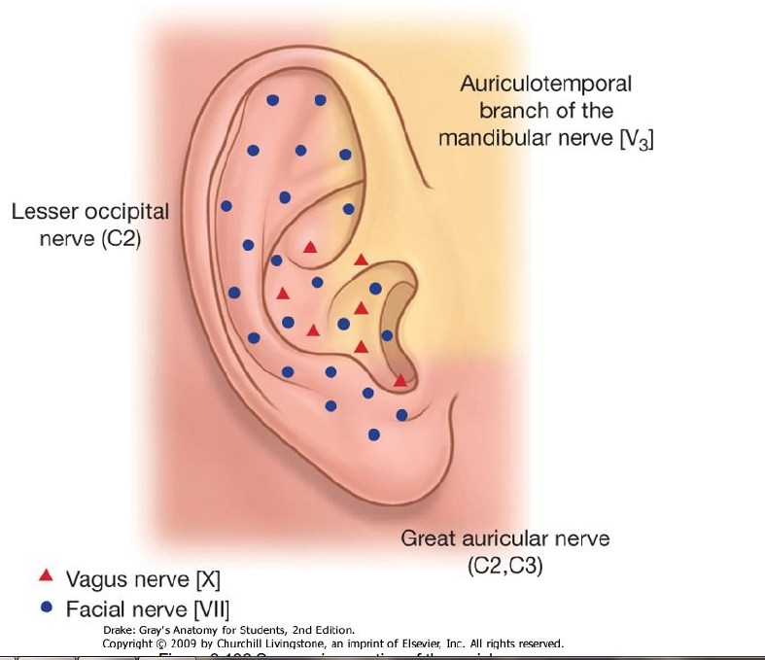
Auriculotemporal nerve: upper ½ of the outer surface
Lesser occipital nerve: the upper ½ of the inner surface
Great auricular nerve: the lower ½ of both inner and outer surfaces
Auricular branch of vagus supplies an area on the inner surface

Slide 4
The external auditory meatus
Outer 1/3
Inner 2/3
Upwards & backwards
Downwards & forwards
The outer third of the meatus is elastic cartilage (directed upwards and backwards)
The inner two thirds is bone formed by the tympanic plate (directed downwards and forwards).
The meatus is lined by skin,
and its outer third is provided with hairs and sebaceous and ceruminous glands. secrete a yellowish brown wax
The sensory nerve supply of the lining skin is derived from
1-The auriculotemporal nerve
2-The auricular branch of the vagus nerve.!!!!
Remember that in the adult the external meatus is about 1 in. (2.5 cm) long and is narrowest about 0.2 in. (5 mm) from the tympanic membrane.

Slide 5
Clinical Notes
Tympanic Membrane Examination
Otoscopic
examination of the tympanic membrane is facilitated by first straightening the external auditory meatus by gently pulling the auricle upward and backward in the adult,
And
straight backward or backward and downward in the infant

Slide 6
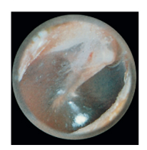
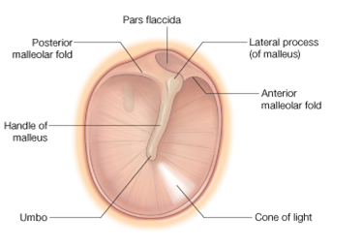
The tympanic membrane (ear drum)
Is a thin, fibrous membrane
The membrane is obliquely placed, facing downward, forward, and laterally
Is formed of:
1-An outer layer; skin
2-Middile layer; fibrous tissue
3-Inner layer ; mucous membrane
Remember that the middle fibrous layer is present in the major parts of the ear drum which called
pars tensa.
However, this layer is absent in the upper part of the ear drum which is called pars flaccida Shrapnell's membrane (also known as Rivinus’ ligament)
The pars tensa and flaccida are separated from each other by two folds called the anterior and posterior malleolar folds

Slide 7
The tympanic membrane is extremely sensitive to pain and is innervated on its outer surface
by the auriculotemporal nerve and the auricular branch of the vagus
The antero-inferior quadrant of the ear drum is called The cone of light (because of it reflects the light coming from the otoscope)

Slide 8
Middle Ear (Tympanic Cavity)
It contains the auditory ossicles, whose function is to transmit the vibrations of the tympanic membrane (eardrum) to the perilymph of the internal ear.
It is a narrow, oblique, slitlike cavity whose long axis lies approximately parallel to the plane of the tympanic membrane.
It communicates in front through the
auditory tube with the nasopharynx
and behind with
the mastoid antrum.
The middle ear has
ROOF
FLOOR
ANTERIOR WALL
POSTERIOR WALL
LATERAL WALL
MEDIAL WALL

Slide 9
THE ROOF
TEGMENTAL WALL
Is formed by a thin plate of bone, the tegmen tympani, which is part of the petrous temporal bone
It separates the tympanic cavity from the meninges and the temporal lobe of the brain in the middle cranial fossa.
THE FLOOR
JUGULAR WALL
is formed by a thin plate of bone, which may be partly replaced by fibrous tissue.
It separates the tympanic cavity from the superior bulb of the internal jugular vein

Slide 10
THE ANTERIOR WALL
is formed below by a thin plate of bone that separates the tympanic cavity from the internal carotid artery
At the upper part of the anterior wall are the openings into two canals.
The lower and larger of these leads into the auditory tube
the upper and smaller is the entrance into the canal for the tensor tympani muscle

Slide 11
THE POSTERIOR WALL
1-has in its upper part a large, irregular opening, the
aditus
to the mastoid
2-Below this is a small, hollow, conical projection, the pyramid, from whose apex emerges the tendon of the stapedius muscle.
3-The vertical part of the fascial nerve
THE LATERAL WALL
is largely formed by the tympanic membrane .

Slide 12
The medial wall
Is formed by the lateral wall of the inner ear.
The greater part of the wall shows a rounded projection, called the promontory, which results from the underlying first turn of the cochlea
Above and behind the promontory lies the fenestra vestibuli, which is oval shaped and closed by the base of the stapes
Below the posterior end of the promontory lies the fenestra cochleae, which is round and closed by the secondary tympanic membrane.
The horizontal part of the facial nerve arching above the promontory

Slide 13
Auditory Tube
The auditory tube connects :
The anterior wall of the tympanic cavity to the nasal pharynx
Its posterior third is bony,
its anterior two thirds is cartilaginous.
As the tube descends it passes over the upper border of the superior constrictor muscle
It serves to equalize air pressures in the tympanic cavity and the nasal pharynx.
Mastoid Antrum
The mastoid antrum lies behind the middle ear in the petrous part of the temporal bone
It communicates with the middle ear by the aditus

Slide 14
Infections and Otitis Media
The meninges and the temporal lobe of the brain lie superiorly meningitis and a cerebral abscess in the temporal lobe.
(acute mastoiditis)
into the mastoid antrum
through the auditory tube from the nasal part of the pharynx.
The posterior wall of the mastoid antrum is related to the
sigmoid venous sinus.
If the infection spreads in this direction, a thrombosis in the sigmoid sinus may well take place
A spread of the infection in this direction can cause a facial nerve palsy and labyrinthitis with vertigo

Slide 16
CONTENTS OF THE MIDDLE EAR
A-3 Auditory Ossicles
B-2 muscles
C-2 nerves
D-air
The auditory ossicles are:
MALLEUS
INCUS
STAPES
1-The malleus is the largest ossicle and possesses
head, a neck, a long process or handle,
an anterior process, and a lateral process.
its head is rounded and articulates posteriorly with the incus.
The stapes has a head, a neck, two limbs, and a base
The head articulates with the long process of the incus.
The neck is narrow and receives the insertion of the stapedius muscle. The two limbs diverge from the neck and are attached to the oval base which closes the oval window of the internal ear
The handle is firmly attached to the medial surface of the tympanic membrane
The incus possesses:
a large body and two processes:
The body articulates with the head of the malleus.
The long process articulates with the head of the stapes.

Slide 17
Muscles of the Ossicles
These are the tensor tympani and the stapedius muscles.

Slide 18
Tympanic Nerve
The tympanic nerve arises from the glossopharyngeal nerve, just below the jugular foramen
It passes through the floor of the middle ear and onto the promontory
Here it splits into branches, which form the tympanic plexus.
The tympanic plexus supplies the lining of the middle ear and gives off the lesser petrosal nerve, which sends secretomotor fibers to the parotid gland via the otic ganglion
It leaves the skull through the foramen ovale

Slide 19
The chorda tympani
arises from the facial nerve just above the stylomastoid foramen
It enters the middle ear close to the posterior border of the tympanic membrane.
It then runs forward over the tympanic membrane and crosses
the root of the handle of the malleus
It lies in the interval between the mucous membrane and the fibrous layers of the tympanic membrane.
The nerve leaves the middle ear through the petrotympanic fissure and enters the infratemporal fossa, where it joins the lingual nerve
The chorda tympani contains:
Taste fibers from the mucous membrane covering the anterior two thirds of the tongue (not the vallate papillae) and the floor of the mouth.

