Slide 1
Anatomy of the
Thorax

Slide 2
A) THE THORACIC WALL
Boundaries
Posteriorly
by the thoracic part of the vertebral column
Anteriorly
by the sternum and costal cartilages
Laterally
by the ribs and intercostal spaces
Superiorly
by the suprapleural membrane
Inferiorly
by the diaphragm, which separates
the thoracic cavity from the abdominal cavity

Slide 3
1-STERNUM
Lies in the midline of the anterior chest wall
It is a flat bone
Divides into three parts:
1-Manubrium sterni
2-Body of the sternum
3- Xiphoid process
The body of the sternum articulates above with the manubrium at the manubriosternal joint and below with the xiphoid process at the xiphisternal joint.
On each side it articulates with the second to the seventh costal cartilages
The xiphoid process is a thin plate of cartilage that becomes ossified at its proximal end during adult life
No ribs or costal cartilages are attached to it

Slide 4
The sternal angle
(angle of Louis)
formed by the articulation of the manubrium with the body of the sternum
Can be recognized by the presence of a transverse ridge on the anterior aspect of the sternum
The transverse ridge lies at the level of the second costal cartilage
The point from which all costal cartilages and ribs are counted
The sternal angle lies opposite the intervertebral disc between the fourth and fifth thoracic vertebrae

Slide 5
2-Ribs
There are 12 pairs of ribs, all of which are attached posteriorly to the thoracic vertebrae.
The ribs are divided into three categories according to their attachment to the sternum:
1-True ribs: The upper seven pairs
(1-7) are attached anteriorly to the sternum by their costal cartilages (vertebrosternal)
2-False ribs:
The 8th, 9th, and 10th pairs of ribs are attached anteriorly to each other and to the 7th rib by means of their costal cartilages and small synovial joints. (vertebrocostal)
3-Floating ribs:
The 11th and 12th pairs have no anterior attachment (vertebral)

Slide 6
According to the anatomical features presented on each rib they are classified into: typical and
a typical ribs
3-
5-
1-
Typical Rib
4-shaft
A typical rib has
1- A head :The head has two facets for articulation with the numerically corresponding vertebral body and that of the vertebra immediately above
2- Neck: is a constricted portion situated between the head and the tubercle
3-Tubercle:is a prominence on the outer surface of the rib at the junction of the neck with the shaft.
It has a facet for articulation with the transverse process of the numerically corresponding vertebra
4-Shaft: a long, twisted, flat bone having a rounded, smooth superior border and a sharp, thin inferior border .The inferior border overhangs and forms the costal groove, which accommodates the intercostal vessels and nerve.
5- Angle
2-

Slide 7
A typical ribs
Posterior
For example, Rib I
It is flat in the horizontal plane
Has broad superior and inferior surfaces
The head articulates only with the body of vertebra TI and therefore has only one articular surface.
The superior surface of the rib
is characterized by a distinct tubercle,
THE SCALENE TUBERCLE,
which separates two smooth grooves
The anterior groove is caused by
THE SUBCLAVIAN VEIN
and the posterior groove is caused by the SUBCLAVIAN ARTERY
Anterior

Slide 8
The diaphragm

Slide 9
The diaphragm is a thin muscular and tendinous septum that separates the chest cavity above from the abdominal cavity below
The diaphragm is the most important muscle of respiration.
It is dome shaped and consists of a peripheral muscular part and a centrally placed tendon
The origin of the diaphragm can be divided into three parts:
A sternal part: arising from the posterior surface of the xiphoid process
A costal part arising from the deep surfaces of the lower six ribs and their costal cartilages
A vertebral part arising by vertical columns or crura and from the arcuate ligaments

Slide 10
The right crus arises from the sides of the bodies of the first three lumbar vertebrae and the intervertebral discs
Some of the muscle fibers of the right crus pass up to the left and surround the esophageal orifice in a slinglike loop. These fibers appear to act as a sphincter and possibly assist in the prevention of regurgitation of the stomach contents into the thoracic part of the esophagus
The left crus arises from the sides of the bodies of the first two lumbar vertebrae and the intervertebral disc
Lateral to the crura the diaphragm arises from the medial and lateral arcuate ligaments
The medial arcuate ligament extends from the side of the body of the second lumbar vertebra to the tip of the transverse process of the first lumbar vertebra.
The lateral arcuate ligament extends from the tip of the transverse process of the first lumbar vertebra to the lower border of the 12th rib.
The medial borders of the two crura are connected by a median arcuate ligament, which crosses over the anterior surface of the aorta

Slide 11
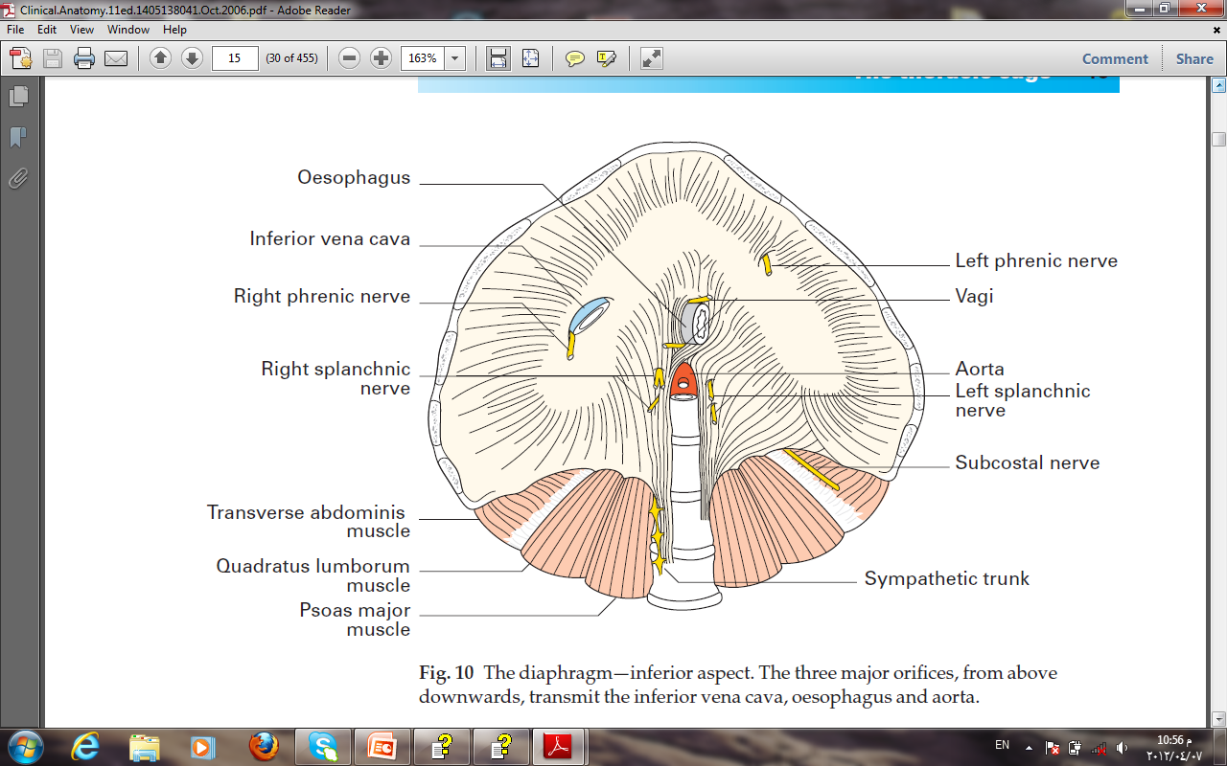
The diaphragm is inserted into a central tendon
Openings in the diaphragm
The inferior vena cava passes through the central tendon at approximately vertebral level T8
The esophagus passes through the muscular part of the diaphragm, just to the left of midline, approximately at vertebral level T10
The vagus nerves pass through the diaphragm with the esophagus
The aorta passes behind the posterior attachment of the diaphragm at vertebral level T12

Slide 12
Nerve supply of the diaphragm
The phrenic nerves pass vertically through the neck, the superior thoracic aperture, and the mediastinum to supply motor innervation to the entire diaphragm

Slide 13
Intercostal Spaces
1-SKIN
2-SUPERFISCIAL FASCIA
3- THREE MUSCLES OF RESPIRATION:
THE EXTERNAL INTERCOSTAL
THE INTERNAL INTERCOSTAL
THE INNERMOST INTERCOSTAL MUSCLE
4-THE ENDOTHORACIC FASCIA
5-THE PARIETAL PLEURA.
The intercostal nerves and blood vessels run between
the intermediate (internal intercostal) and deepest layers (innermost intercostal) of muscles
They are arranged in the following order from above downward:
INTERCOSTAL VEIN
INTERCOSTAL ARTERY
INTERCOSTAL NERVE
(VAN)

Slide 14
Intercostal Muscles
The external intercostal muscle
the most superficial layer.
Its fibers are directed
downward and forward
ORIGIN:
FROM THE INFERIOR BORDER OF THE RIB ABOVE
TO
INSERTION:
THE SUPERIOR BORDER OF THE RIB BELOW
The muscle extends forward to the costal cartilage where it is replaced by an aponeurosis,
THE ANTERIOR (EXTERNAL) INTERCOSTAL MEMBRANE

Slide 15
THE INTERNAL INTERCOSTAL MUSCLE
forms the intermediate layer.
Its fibers are directed
downward and backward
from the subcostal groove of
the rib above to
the upper border of the rib below
The muscle extends backward from the sternum in front to the angles of the ribs behind, where the muscle is replaced by an aponeurosis,
the posterior (internal) intercostal membrane

Slide 16
The innermost intercostal muscle
Forms the deepest layer and corresponds to the transversus abdominis muscle in the anterior abdominal wall
It is an incomplete muscle layer and crosses more than one intercostal space within the ribs.
It is related internally to fascia (endothoracic fascia) and parietal pleura and externally to the intercostal nerves and vessels

Slide 17
Intercostal Arteries and Veins
Each intercostal space contains a large single posterior intercostal artery and two small anterior intercostal arteries.
The posterior intercostal arteries of the first two spaces are branches from
the superior intercostal artery, a branch of the costocervical trunk of the subclavian artery
The posterior intercostal arteries of the lower nine spaces are branches of
THE DESCENDING THORACIC AORTA
The anterior intercostal arteries of the first six spaces are branches of
THE INTERNAL THORACIC ARTERY which arises from the first part of the subclavian artery.
The anterior intercostal arteries of the lower spaces are branches of THE MUSCULOPHRENIC ARTERY, one of the terminal branches of the internal thoracic artery.

Slide 18
The corresponding posterior intercostal veins drain backward into the azygos or hemiazygos veins , and the anterior intercostal veins drain forward into the internal thoracic and musculophrenic veins

Slide 19
Intercostal Nerves
The intercostal nerves are the anterior rami of the first 11 thoracic spinal nerves
The anterior ramus of the 12th thoracic nerve lies in the abdomen and runs forward in the abdominal wall as the subcostal nerve

Slide 20
Each intercostal nerve enters an intercostal space between
the parietal pleura and the posterior intercostal membrane
It then runs forward inferiorly to the intercostal vessels in the subcostal groove of the corresponding rib, between the innermost intercostal and internal intercostal muscle.

Slide 21
The first six nerves are distributed within their intercostal spaces.
The seventh to ninth intercostal nerves leave the anterior ends of their intercostal spaces by passing deep to the costal cartilages, to enter the anterior abdominal wall.
The 10th and 11th nerves, since the corresponding ribs are floating, pass directly into the abdominal wall

Slide 22
6- Joints of the Chest Wall
A-Joints of the Sternum
1-The manubriosternal joint: is a cartilaginous joint between the manubrium and the body of the sternum.
A small amount of movement is possible during respiration.
2-The xiphisternal joint: is a cartilaginous joint between the xiphoid process (cartilage) and the body of the sternum.
The xiphoid process usually fuses with the body of the sternum during middle age.
Read only

Slide 23
B-Joints of the Ribs
1-Joints of the Heads of the Ribs
The first rib and the three lowest ribs have a single synovial joint with their corresponding vertebral body.
For the second to the ninth ribs, the head articulates by means of a synovial joint with the corresponding vertebral body and that of the vertebra above it
2-Joints of the Tubercles of the Ribs
The tubercle of a rib articulates by means of a synovial joint with the transverse process of the corresponding vertebra
This joint is absent on the 11th and 12th ribs
3-Joints of the Ribs and Costal Cartilages
These joints are cartilaginous joints. No movement is possible.
Read only
4-Joints of the Costal Cartilages with the Sternum
The first costal cartilages articulate with the manubrium, by cartilaginous joints that permit no movement
The 2nd to the 7th costal cartilages articulate with the lateral border of the sternum by synovial joints.
In addition, the 6th, 7th, 8th, 9th, and 10th costal cartilages articulate with one another along their borders by small synovial joints.
The cartilages of the 11th and 12th ribs are embedded in the abdominal musculature.

