Slide 1
III. Parkinson Disease

Slide 2
- Parkinsonism is a clinical syndrome characterized motor disturbances and may be seen in a range of diseases that damage dopaminergic neurons, which project from the substantia nigra to the striatum.

Slide 3
Parkinsonism characterized by:
Diminished facial expression (often termed masked facies),
Stooped posture,
Slowing of voluntary movement,
Festinating gait (progressively shortened, accelerated steps),
Rigidity, and a “pill-rolling” tremor.

Slide 4
- Causes:
Several neurodegenerative diseases , main example is Parkinson disease (PD)
2. Toxins that selectively damage the dopaminergic system

Slide 5
a. MPTP (1-methyl-4-phenyl-1,2,3,6-tetrahydropyridine), causes an an acute parkinsonian syndrome and destruction of neurons in the substantia nigra

Slide 6
b. Pesticide exposure
3. Post encephalitic parkinsonism that followed pandemic influenza in 1918

Slide 7
- Thee diagnosis of PD can be based on:
The presence of triad of parkinsonism—tremor, rigidity, and bradykinesia
In the absence of a toxic or other known underlying etiology.
3. . And is confirmed by symptomatic response to L-DOPA replacement therapy

Slide 8
Note
- Although the diagnosis of PD is based in large part on the presence of the motor symptoms, there is clear evidence that the disease is not restricted to dopaminergic neurons or to the basal ganglia

Slide 9
There is evidence that PD is a progressive diseases with stages:
It begins lower in the brainstem
Involves substantia nigra
Then involves cerebral cortex leading to cognitive impairment

Slide 10
Pathogenesis.
PD is associated with :
Protein accumulation and aggregation
2. Mitochondrial abnormalities,
3. and neuronal loss in the substantia nigra and elsewhere in the brain.

Slide 11
Pathogenesis in sporadic cases
Postulated theories
Oxidative injury may play a role
Neuromelanin , a product of dopamine aut oxidation is capable of forming a complex with iron and potentiates generation of free radicals and oxidative injury

Slide 12
2. Missence mutations in the gene encoding α-synuclein causing extra copies of α-synuclein (which is presynaptic neurotransmitter) favors intracellular aggregation and protofibril formation of this protein

Slide 13
and dopamine reacts with it
- And this slows the process of protofibrils to fibril conversion and the protofibrils are toxic to the neurons and this may explain dopaminergic selectivity of α-synuclein associated PD

Slide 14
3. Age related reduced proteasome degradation of α-synuclein may result in an increased intracellular accumulation of synuclein protofibrils

Slide 15
Note
- While most PD is sporadic, a series of genetic causes have been identified that shed light on its pathogenesis.

Slide 16
1. Autosomal dominant parkinson disease
a. Caused by point mutations and amplifications of the region of chromosome 4q21 that contains the gene which encodes α-synuclein, an abundant lipid-binding protein normally associated with synapses.

Slide 17
This protein was then demonstrated to be a major component of the Lewy body, which is the diagnostic hallmark of PD

Slide 18
α-synuclein form small which appear to be toxic to neurons.

Slide 19
b. Mutations in the gene encoding LRRK2 (leucine-rich repeat kinase 2)
- Are a more common cause of autosomal dominant PD and are found in some sporadic cases of the disease.

Slide 20
- LRRK2 is a cytoplasmic kinase.
- The mutations increase the kinase activity of LRRK2, which leads to hyperphosphorylation of normal targets

Slide 21
2. Autosomal recessive PD
- Caused by Mutations in the genes that encode the proteins DJ-1, PINK1, and parkin.
a. DJ-1 acts a as a transcriptional regulator, but in settings of oxidative stress it can relocate to the mitochondria and have cytoprotective effects.

Slide 22
- So loss of function mutqion in DJ1 leads to oxidative stress in the mitochondria and damage to neurons by free radicals

Slide 23
b. PINK1
Is a kinase that is degraded in the mitochondria under normal circumstances;
And with mitochondrial dysfunction, it recruits parkin, which is an E3 ubiquitin ligase.

Slide 24
Under normal circumstances, the combination of PINK1 and parkin results in clearance of dysfunctional mitochondria through mitophagy

Slide 25
Therefore loss of function mutations in these genes lead to loss of mitophagy of dysfunctional mitochondria
So dysfunctional mitochondria will lead to formation of large amounts of free radicals that will damage neurons

Slide 26
Morphology
Macroscopic appearance:
- A characteristic finding in PD is pallor of the substantia nigra and locus ceruleus, which is due to loss of the pigmented, catecholaminergic neurons in these regions.

Slide 27
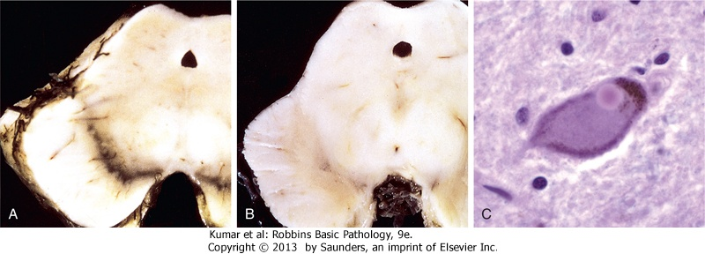
Parkinson disease

Slide 28
Microscopic findings
Loss of the pigmented, catecholaminergic neurons in these regions
associated with gliosis.

Slide 29
2. Lewy bodies
May be found in those neurons that remain viable
and these are single or multiple,
intracytoplasmic, eosinophilic, inclusions that often have a dense core surrounded by a pale halo

Slide 30
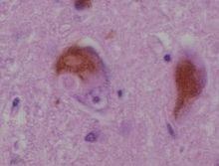
Lewy bodies

Slide 31
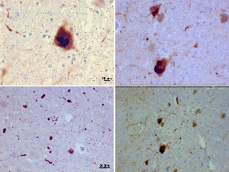
Immunostains for α-synuclein

Slide 32
Neurochemistry of parkinson disease
Loss of cells from substantia nigra pars compacta(SNc) leads to reduced inhibitory dopaminergic input into the striatum
This in turn results in increase release of GABA from striatum to lateral globus pallidus

Slide 33
3. Decrease GABA release from lateral globus to Subthalamic nucleus ,
therefore the subthalamic nucleus production of excitaroy gluatamte increases to the medial globus pallidus
and then medial globus pallidus will increase its release of inhibitory GABA to the thalamus

Slide 34
GABA is inhibitory so it will lead to decrease glutamate from thalamic nuclei to the cortex and this leads to akinetic rigid syndrome of parkinson

