Slide 1
Cerebrovascular diseases-2

Slide 2
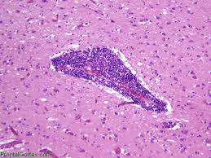
Primary angiitis of CNS

Slide 3
Other causes of infarction
Hypercoagulable states
Drug-abuse such as amphetamine, heroin and cocain

Slide 4
Note
- The venous side of the circulation may also undergo thrombosis and cause significant cerebral ischemia
- The striking example is the thrombosis of the superior sagittal sinus which can occur with infections or hypercoagulability state

Slide 5
Morphology of focal cerebral ischemia
- The macroscopic appearance changes in time.
1. During the first 6 hours of irreversible injury, little is observed
2. By 48 hours
- The tissue becomes pale, and swollen, as a result of edema

Slide 6
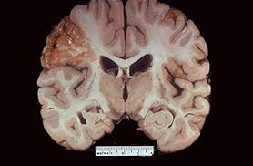
3. From 2 to 10 days
- The brain becomes gelatinous and friable,
4. From 10 days to 3 weeks
- The tissue liquefies, leaving a fluid-filled cavity which represents liquifactive necrosis

Slide 7
Microscopically,
1. After the first 12 hours:
a. Red neurons with edema
b. Disintegration and myelinated fibers .
2. Up to 48 hours, there is some neutrophilic emigration

Slide 8
3. 2-3 weeks
a. Mononuclear phagocytic cells predominate and macrophages containing myelin breakdown products or blood may persist in the lesion for months to years.
b. Gemistocytic gliosis followed by fibrillary astrocytosis after several months

Slide 9
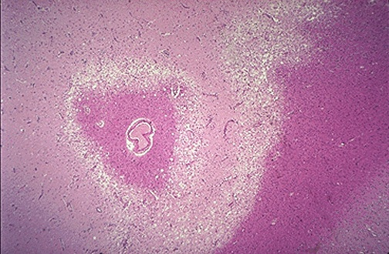
Edema in infarction

Slide 10
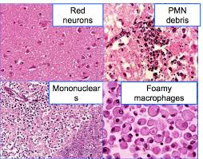
Microscopic changes in infarction

Slide 11
Notes:
a. In the cerebral cortex the cavity is delimited from the meninges and subarachnoid space by a gliotic layer of tissue, derived from the molecular layer of cortex.
b- The pia and arachnoid are not affected and do not contribute to the healing process.

Slide 12
B. Hypertensive cerebrovascular diseases

Slide 13
Effect of hypertension on the brain include:
Lacunar infarcts
Slit hemorrhages
Hypertensive encephalopathy
Massive hypertensive intraparenchymal hemorrhage

Slide 14
1. Lacunes or lacunar infarcts :
Mechanism
- Hypertension causes arteriolosclerosis of the deep penetrating arteries and arterioles that supply the basal ganglia, hemispheric white matter and brain stem

Slide 15
- This arteriolosclerosis sclerosis leads to occlusion of these vessels
The result is development of lake-like spaces defined as less than 15 mm wide
Occur mainly in the
i. Lenticular nucleus

Slide 16
ii. Thalamus
iii. Internal capsule
iv. Caudate nucleus
v. Pons
- In descending order of frequency

Slide 17
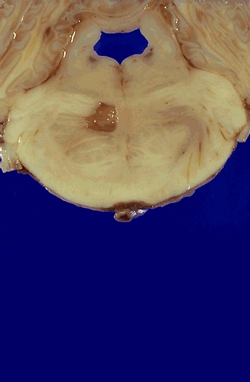
Lacunar infarct in the Pons

Slide 18
2. Slit hemorrhages;
Hypertension can lead to rupture of the small caliber blood vessels and lead to development of small hemorrhages
With time these hemorrhages resorb leaving behind a slit-like spaces called slit hemorrhages

Slide 19
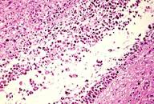
Microscopically characterized by
Focal tissue destruction
Pigment-laden macrophages
Gliosis

Slide 20
3. Hypertensive encephalopathy
Is a clinico pathologic syndrome arising in the setting of malignant hypertension
Most often is associated with sudden sustained rises in diastolic blood pressure to greater than 130 mm Hg and characterized

Slide 21
a. By increased intracranial pressure due to loss of autoregulation and forcefull overdistention of blood vessels, leading to fluid extravasation (hydrostatic edema)

Slide 22
b Global cerebral dysfunction, manifesting as headaches, confusion, vomiting, convulsions, and sometimes coma.
- Rapid therapeutic intervention to reduce the intracranial pressure is essential.because this syndrome does not remit spontaneously

Slide 23
Postmorteum examination shows edematous brain with or without trantentorial or tonsillar herniations
Microscopic examination shows
Fibrinoid necrosis and thrombosis of arterioles and capillaries
and microinfarcts and microhemorrhages Microscopic examination shows

Slide 24
C. Intracranial Hemorrhage
.

Slide 25
May occur at any site within the CNS either
Intraparenchymal hemorrhage
Causes
Hypertension
Amyloid angiopathy

Slide 26
2. Subarachnoid hemorrhages:
- Are most commonly seen with aneurysms but occur also with other vascular malformations.
3. Hemorrhages associated with the dura (in either subdural or epidural spaces) usually due to trauma.

Slide 27
1. Intraparenchymal hemorrhages
- Rupture of a small intraparenchymal vessel can lead to intraparenchymal hemorrhage and this condition is called hemorrhagic stroke

Slide 28
Spontaneous non traumatic brain hemorrhage occur most commonly in the middle to late adult life
The peak incidence is at about 60 years

Slide 29
- Is divided into
Ganglionic hemorrhages
Occur in the basal ganglia and thalamus
Mainly caused by hypertension
ii. Lobar hemorrhages
In the cerebral hemispheres
Main cause by cerebral amyloid angiopathy

Slide 30
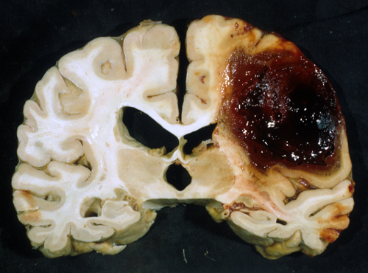
Lobar intraparenchymal hemorrhages

Slide 31
Other causes of intraparenchymal hemorrhages
Systemic coagulation disorder
Neoplasms
Primary brain tumors mainly glioblastoma and oligodendroglioma
b. Metastatic tumors to brain mainly melanoma and renal cell carcinomaiv.
iii. Vascular malformations

Slide 32
Hypertensive hemorrhages
Hypertension is the risk factor for deep brain parenchymal hemorrhages
Accounts for more than 50% of clinically significant brain hemorrhages
It accounts for about 15% of deaths among individuals with hypertension

Slide 33
Sites
Putamen in 50-60% of the case
Thalamus
Pons
cerebellum

Slide 34
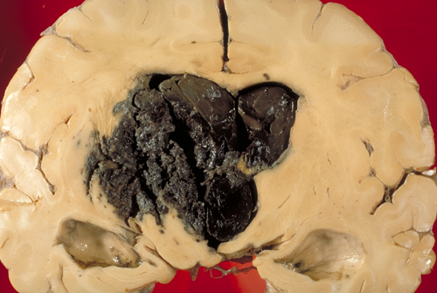
Basal ganglia hemorrhage

Slide 35
Mechanisms of massive hemorrhage in Hypertension:
1. Hyaline arteriolar sclerosis
- Affects the deep penetrating arteries and arterioles that supply the basal ganglia and the brain stem
- Affected arteriolar walls are weakened and are more vulnerable to rupture.

Slide 36
2. Chronic hypertension results in formation of minute aneurysms (Charcot-Bouchard microaneurysms )
- Mainly occurs in the basal ganglia
- Form in vessels less than 300 μm in diameter

Slide 37
Cerebral Amyloid Angiopathy (CAA) :
Is the risk factor most commonly associated with lobar hemorrhages
In CAA, amyloidogenic peptides usally the same ones in Alzheimer diseases ((Aβ amyloid) are deposited in the walls of medium-small caliber menigeal and cortical vessel

Slide 38
This deposition can weaken the vessel wall and lead to hemorrhage
Morphology
- The underlying vascular abnormality in CAA is typically restricted to the leptomeningeal and cerebral cortical arteioles and capillaries

Slide 40
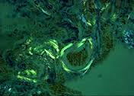

Slide 41
Subarachnoid Hemorrhage

Slide 42
Causes:
A. Saccular (berry) aneurysm rupture
Is the most frequent cause of clinically significant subarachnoid hemorrhage
B. Vascular malformation
C. Trauma
D. Rupture of intraparenchymal hemorrhages into the ventricles

Slide 43
Berry (saccular ) aneurysms
- Rupture of berry aneurysms is the most frequent cause of clinically significant subarachnoid hemorrhage

Slide 44
Saccular aneurysm is the most common type of intracranial aneurysms
Other types of aneurysms include:
Atherosclerotic aneurysm , mostly of the basilar artery

Slide 45
2. Mycotic aneurysms
3. Traumatic aneurysms
4. Dissecting aneurysms

Slide 46
Note: Mycotic, traumatic and dissecting aneurysms
Arise in the anterior circulation
Cause infarction rather than hemorrhage

