Slide 1
Control of eye movement

Slide 2
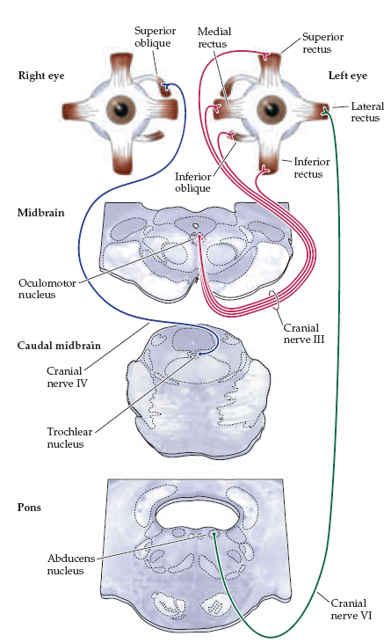
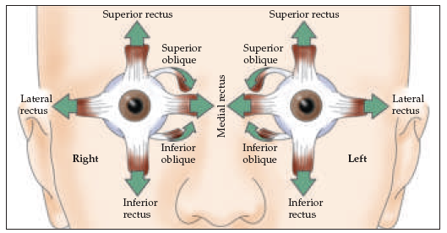

Slide 4
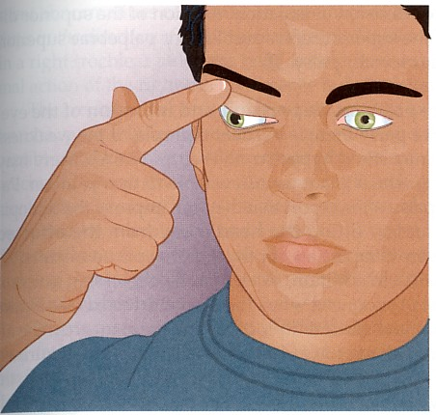
Third Nerve Palsy
Eye “down and out”

Slide 5
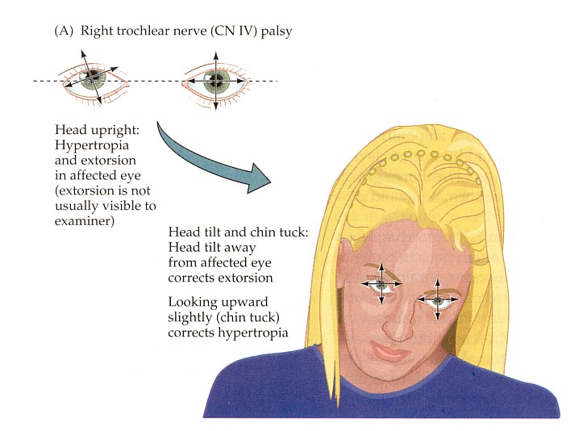
Trochlear Nerve Palsy
Note: Right eye
Instead of intorsion and depression
action of superior oblique
See extorsion and elevation
Observe how the axes over
the right eye shift when patient
generates a compensatory head
movement
Attempted Correction:
Patient tilts head to her left
Tucks chin to foveate on object
Left eye will align accordingly

Slide 6
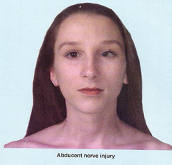
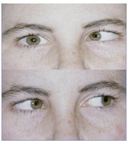

Slide 7
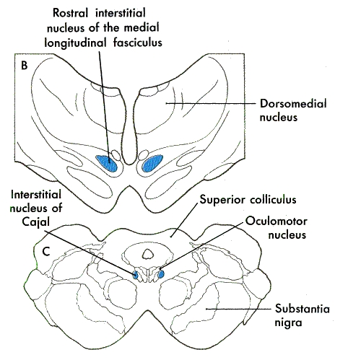
(Also known as
Field of Forel)
Figure 28-11
Vertical eye movements

Slide 8
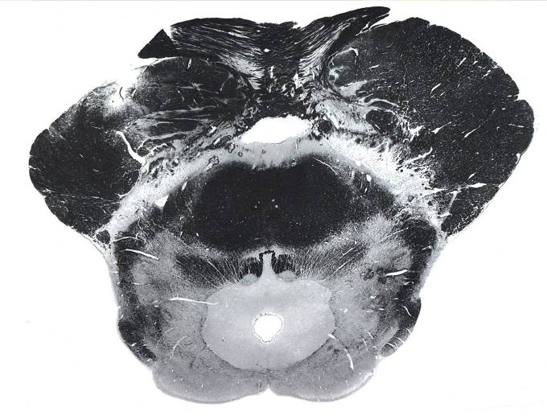
Atlas 6-23

Slide 9
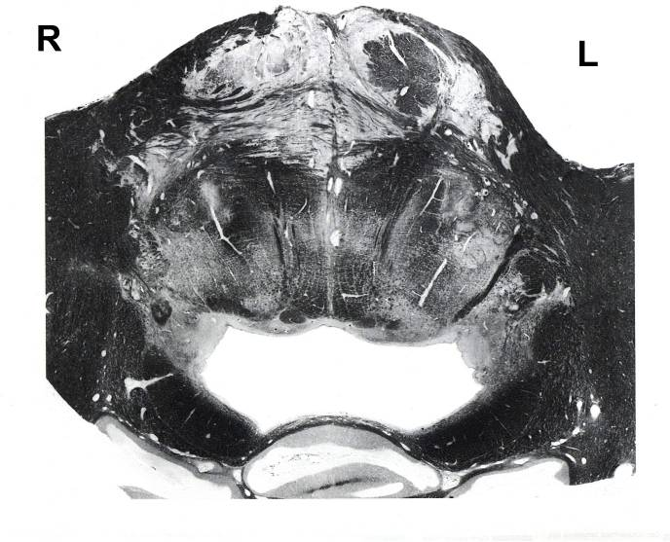
VI
VII
nuc. VI

Slide 10
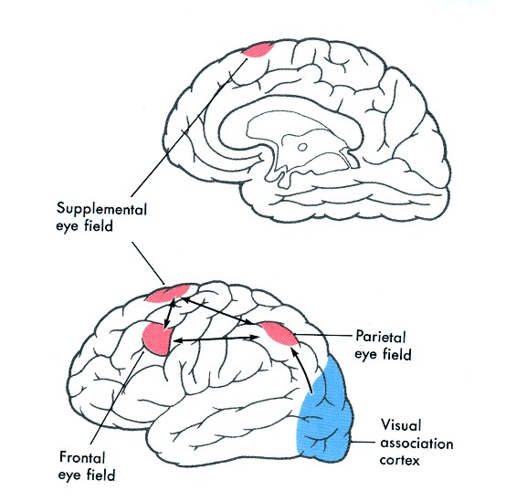
Fig. 28-13

Slide 11
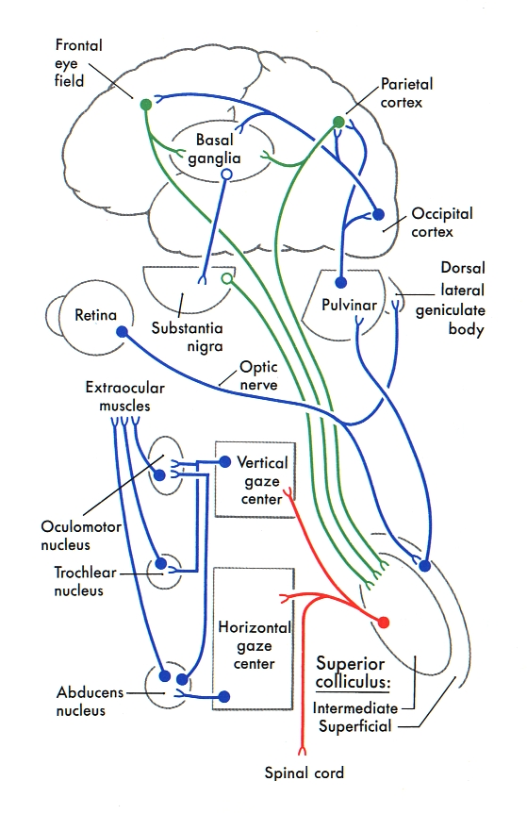
Basic pathway
for controlling
saccadic eye
movements

Slide 12
MLF

Slide 13
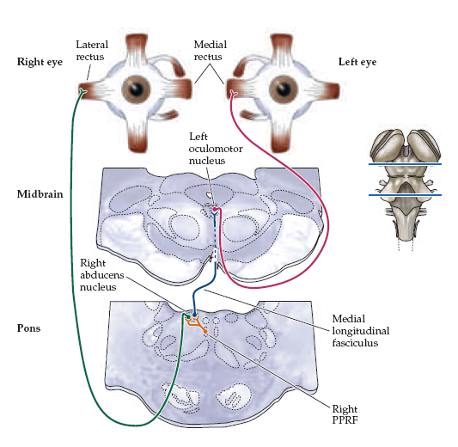

Slide 14
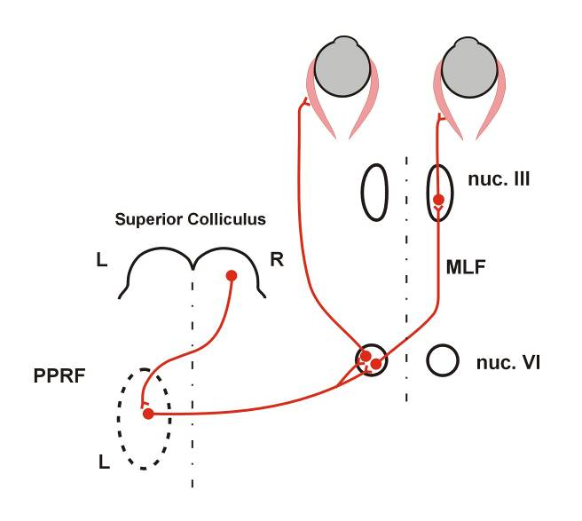
L
R
L
R

Slide 15
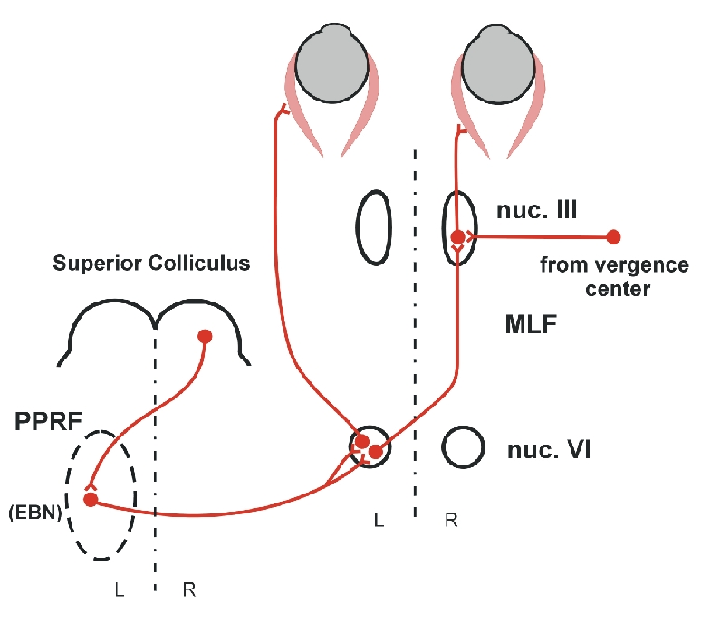
L
R
Disconjugate
eye
movements
Conjugate
eye
movements

Slide 16
L
R
X
Disconjugate
eye
movements
Conjugate
eye
movements
Internuclear Ophthalmoplegia

Slide 17
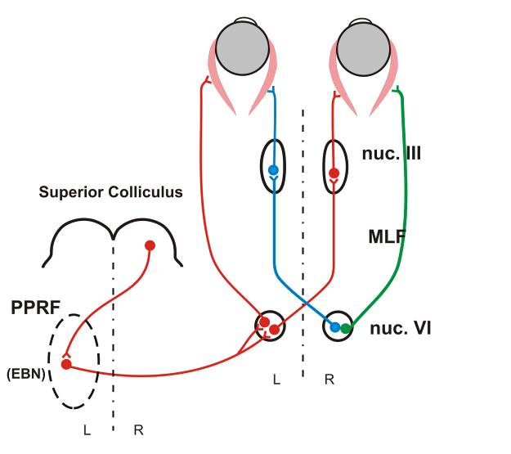
L
R
ONE-AND-A-HALF SYNDROME

Slide 18
The Vestibular System

Slide 19
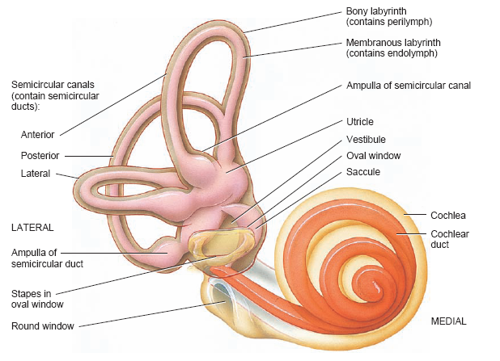
Anatomy of the ear

Slide 20
Anatomy of the ear

Slide 21
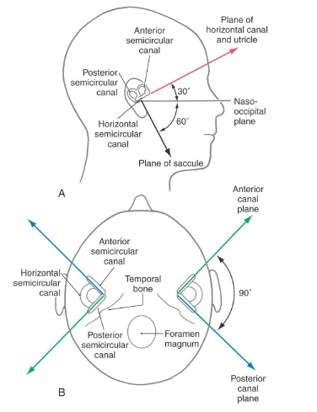

Slide 22
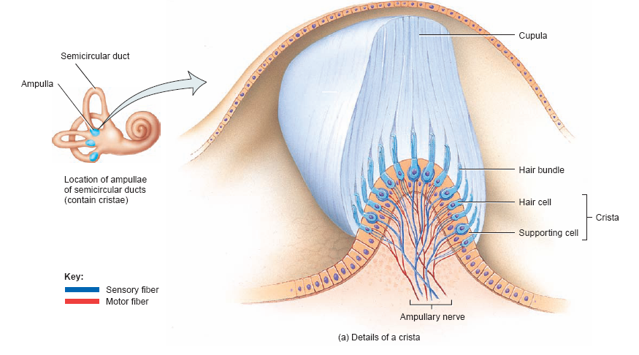

Slide 23
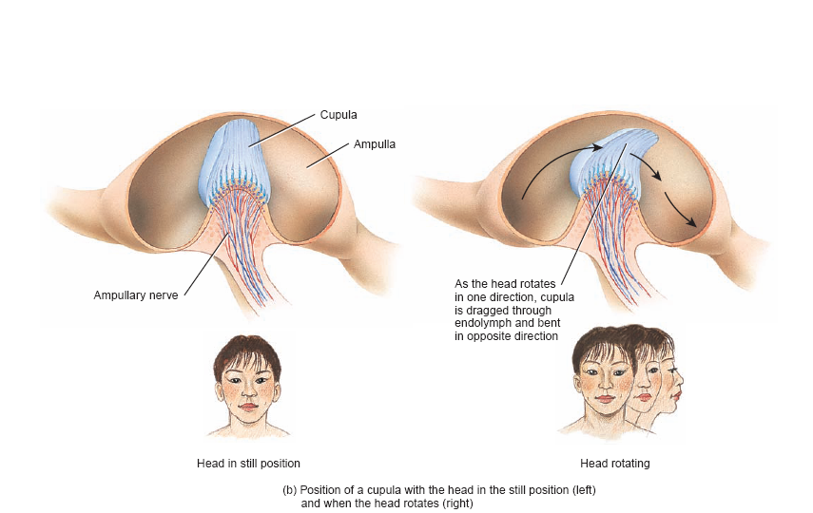
Ampulla of Semicircular canal

Slide 24
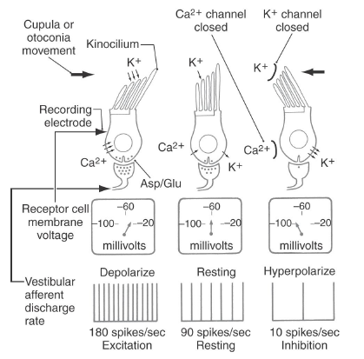

Slide 25
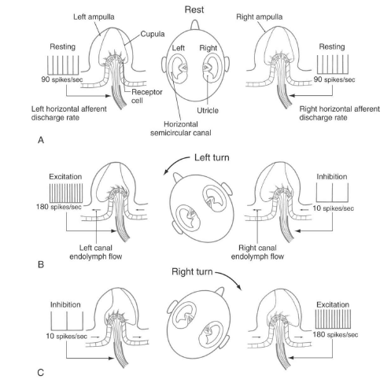

Slide 26
Anatomy of the ear

Slide 27
Anatomy of the ear

Slide 28
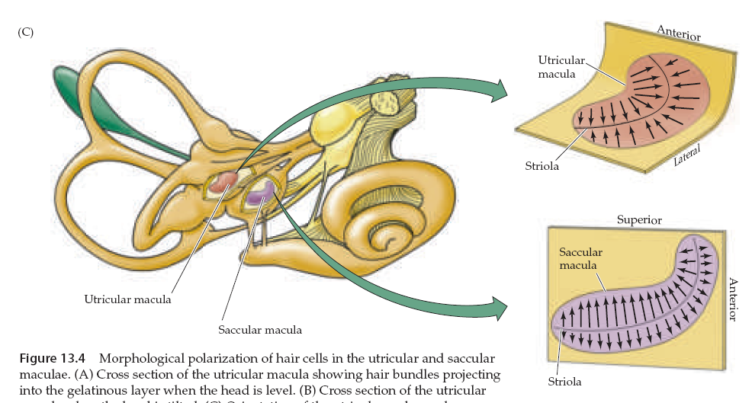
Macula and otolith organ

Slide 29
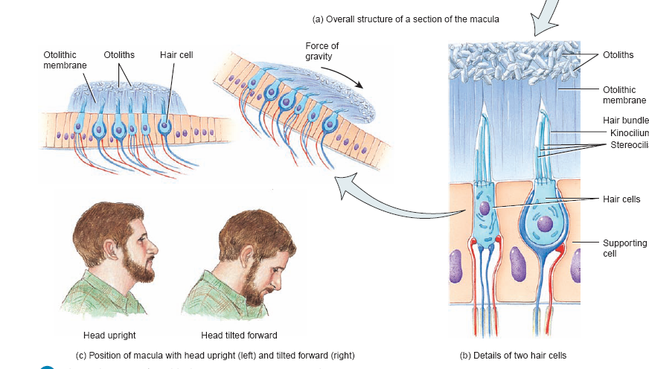
Macula and otolith organ

Slide 30
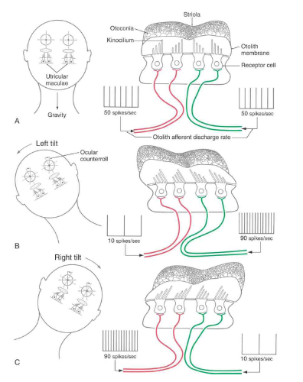

Slide 31
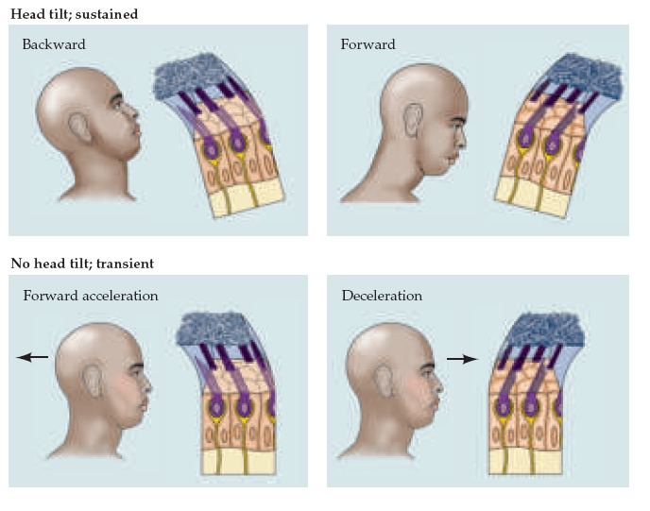

Slide 32
VESTIBULAR PATHWAY

Slide 33
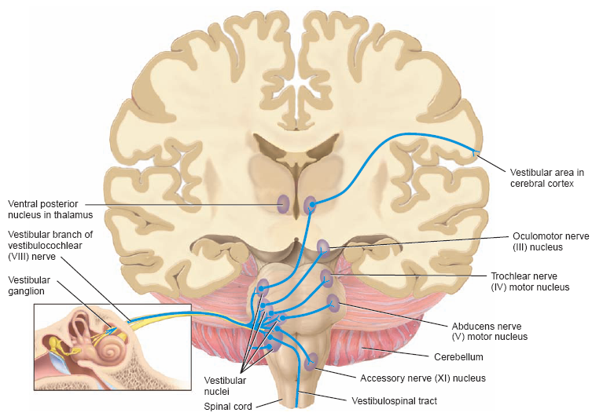

Slide 35
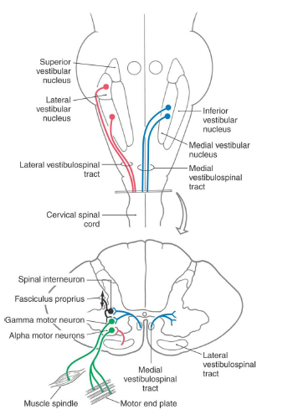

Slide 37
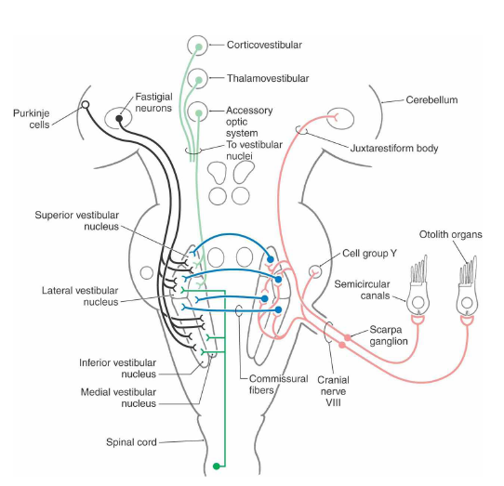

Slide 40
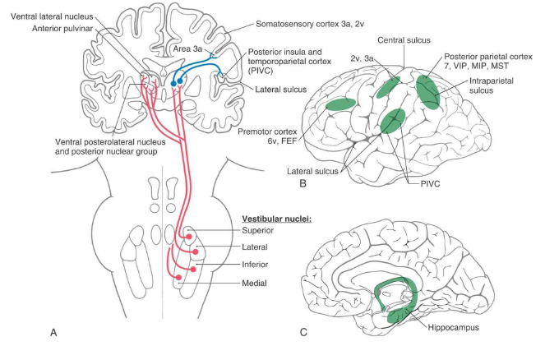

Slide 41
VESTIBULOOCULAR REFLEX
Compensatory for head movements
Rotational Reflex
Linear Reflex

Slide 42
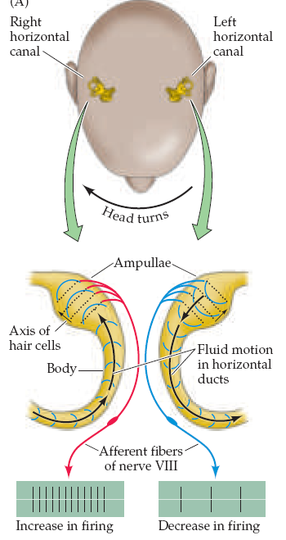

Slide 43
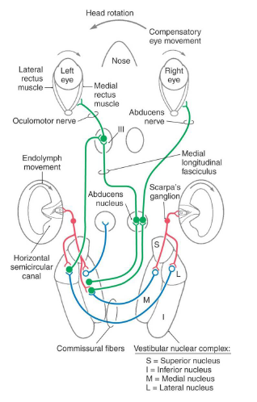

Slide 44
VESTIBULOOCULAR REFLEX
Compensatory for head movements
Rotational Reflex
Linear Reflex
Nystagmus

Slide 45
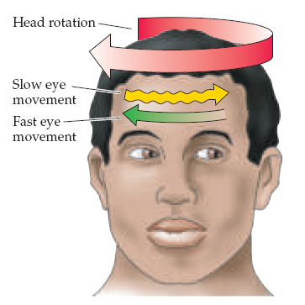

Slide 46
Caloric test

Slide 47
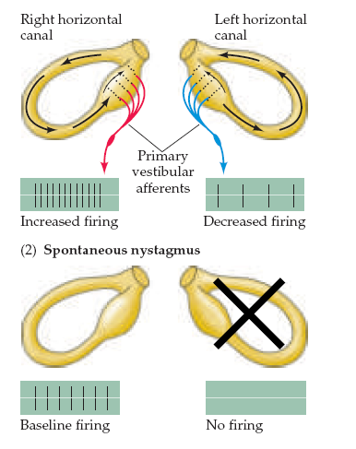

Slide 48
Ménière Disease
Disease results from a disruption of normal endolymph volume
Symptoms include: Severe vertigo
Positional nystagmus (when head in a particular position)
Nausea
Affected individuals can also experience-unpredictable attacks of auditory & vestibular
symptoms: Vomiting
Tinnitus (ringing in ears)
Inability to make head movements
Inability to stand passively
Low frequency hearing loss
Treatment: administration of a diuretic (hydrochlorothiazide) & a salt restricted diet
Persistent condition:shunt implantation into swollen endolymphatic sac, or
delivery of a vestibulotoxic agents (gentamicin) into erilymph.

Slide 49
Benign Paroxysmal Positional Vertigo
common clinical disorder.
condition characterized by brief episodes of vertigo that coincide with particular changes in body position.
pathophysiology poorly understood.
posterior canal abnormalities are implicated.
otoconia crystals in the utricle may separate from the otolith membrane and become lodged in the cupula, causing abnormal cupula deflections. AND/OR partial inflammation of cranial nerve VIII

Slide 50
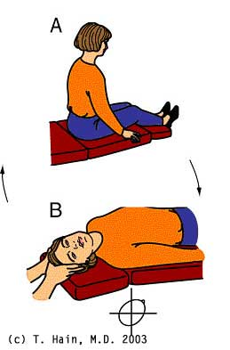
Dix-Hallpike test
The definitive diagnostic test for benign paroxysmal positional vertigo
Patient from sitting to supine
position.
Head turned 45⁰ to one side
and extended 20⁰ backward.
Observe eyes for nystagmus
(30 sec.).
Bring back to a sitting position.
Small delay, test other side.
A positive test consists of
a burst of nystagmus.
Posterior canal BPPV (more
common) – eyes jump upward.

Slide 51
Dizziness: non-specific term.
generally means spatial disorientation.
may or may not involve feelings of movement.
may be accompanied by nausea or postural instability.
may be caused by factors other than vestibular dysfunction.
Vertigo: specific term.
perception of body motion.
spinning or turning sensation when no real motion is taking place.
Tinnitus Some of these causes include
high blood pressure,
diabetes,
listening to loud music,
a tumor,
thyroid conditions,
and medications / antidepressants, sedatives, antibiotics, anti-inflammatories, and aspirin.

Slide 52
Semicircular Canal Dehiscence (opening)
Temporal bone overlying the anterior or the posterior semicircular canal thins,
creating an opening/dehiscence next to the dura.
Dehiscence over
left superior canal
Text Fig. 22-5
CT scan of the temporal
bone projected into the
plane of the left superior/anterior
canal, in a patient with
superior canal dehiscence
syndrome.
The dehiscense exposes the bony labyrinth to the extradural space.
Symptoms: vertigo and oscillopsia in response to loud sounds (Tullio Phenomenon),
or in response to maneuvers that change middle ear or intracranial pressure.
Nystagmus evoked by these stimuli aligns with the plane of the dehiscent
superior canal.
Treatment: Surgical closure of the defect by bone replacement.
© 2005 Elsevier

Slide 53
Vestibular Neuritis
severe vertigo, nausea, vomiting
no hearing loss or other CNS abnormalities
possible edema of the vestibular nerve/ganglion.
thought to be produced by acute viral infection.
treated with anitemetics, vestibular suppressants, corticosteroids, & antiviral agents.

